Slide 1


Cherenkov Light Imaging in Particle and Nuclear Physics Experiments
RICH 2018,
Moscow
Antonis Papanestis
STFC - RAL

Slide 2


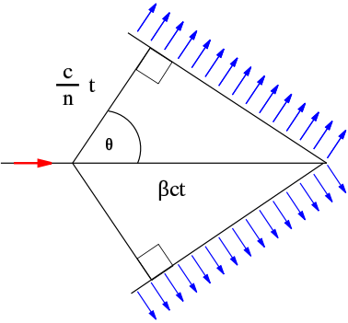
Cherenkov radiation
Lake Placid – LHCb Collaboration Week

Slide 3
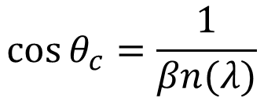
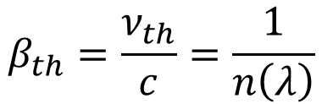
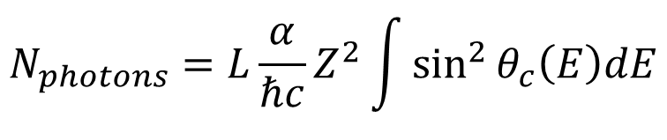
Cherenkov principles
$$β_{th}=\frac{ν_{th}}{c}=\frac{1}{n\left(λ\right)}$$
Threshold:
$$\cos{θ_{c}=\frac{1}{βn(λ)}}$$
Cherenkov angle:
$$N_{photons}=L\frac{α}{ℏc}Z^{2}\int{\sin^{2}{θ_{c}\left(E\right)dE}}$$
Number of produced photons:

Slide 4
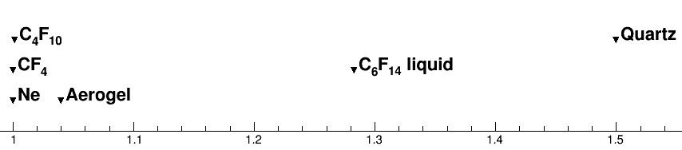
Refractive index range
1
1.5
~100 GeV/c
~1 GeV/c
Momentum

Slide 5
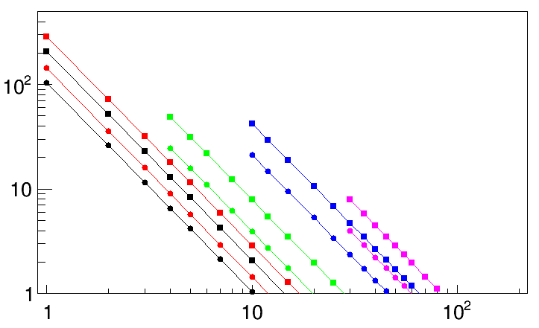
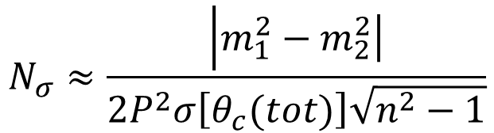
RICH performance
$$N_{σ}≈\frac{\left|m_{1}^{2}\right.−\left.m_{2}^{2}\right|}{2P^{2}σ\left[θ_{c}(tot)\right]\sqrt{n^{2}−1}}$$
For particles well above threshold
B. N. Ratcliff, NIMA 502 (2003) 211-221
0.5 mrad
Fused Silica
1 mrad
C₆F₁₄ (liquid)
Aerogel (1.04)
Nσ π/K separation
C₄F₁₀
CF₄
3 σ
Particle momentum (GeV/c)

Slide 6
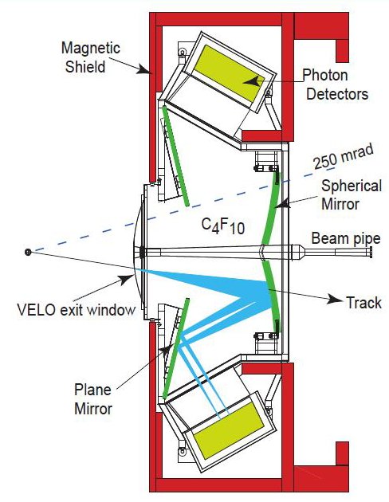
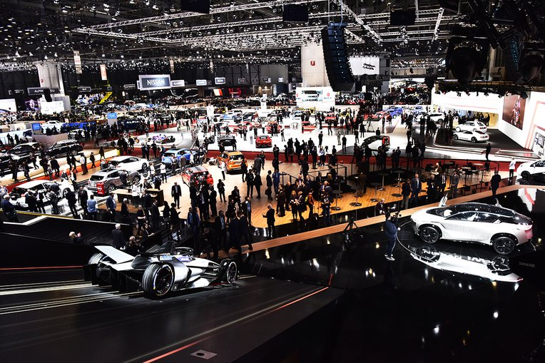
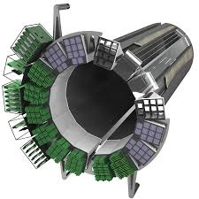
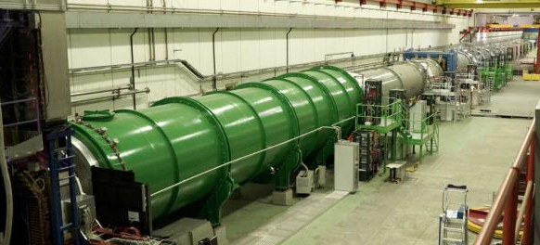
2018 Salon des RICH Detectors
We will not visit all the stands
We will follow the biases, preferences and knowledge of our guide

Slide 7
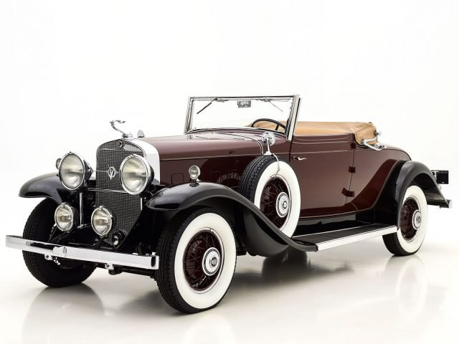
The Classic Selection

Slide 8
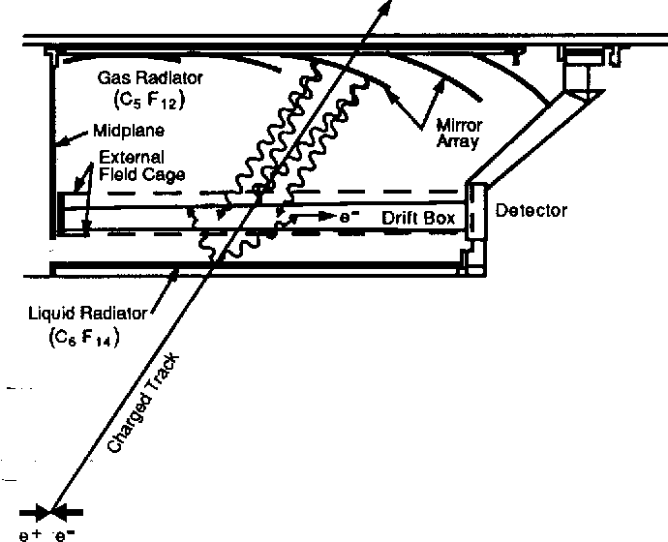
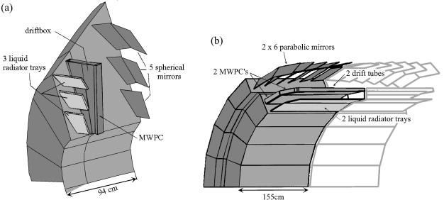
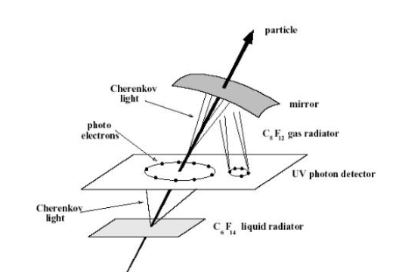
Delphi & SLD
Use of liquid and gas radiators
TMAE for photon conversion
Gas detectors for photo-electron detection
SLD barrel RICH
Delphi forward and barrel RICH

Slide 9
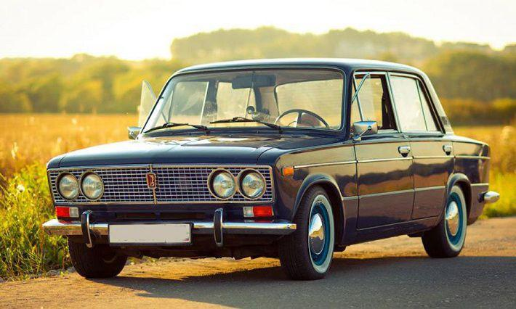
The Workhorses

Slide 10
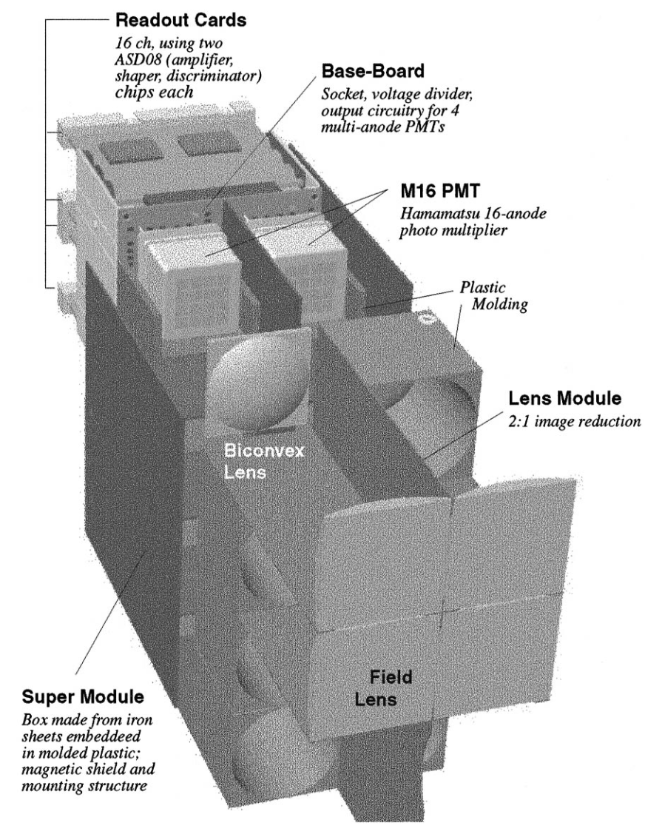
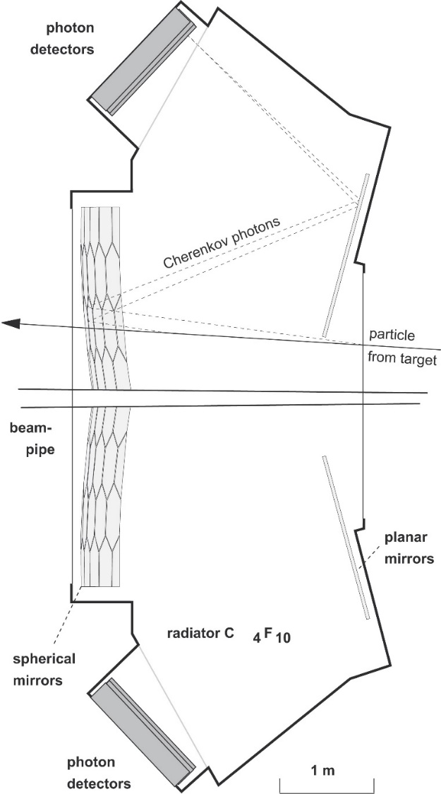
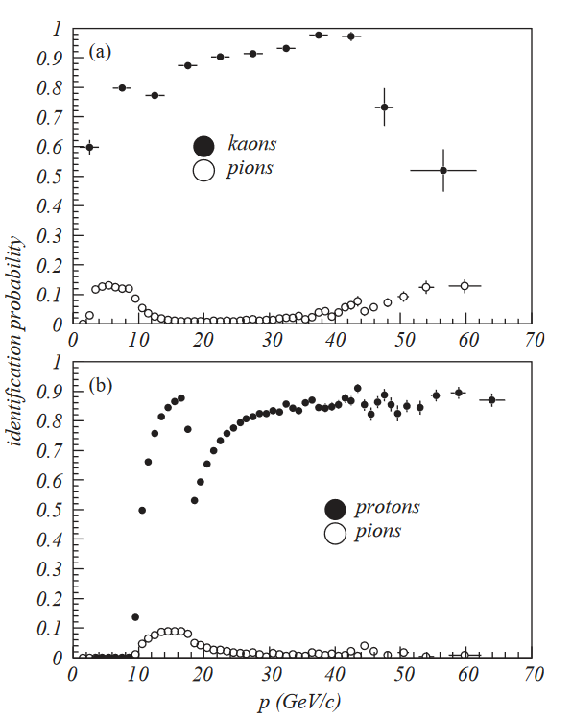
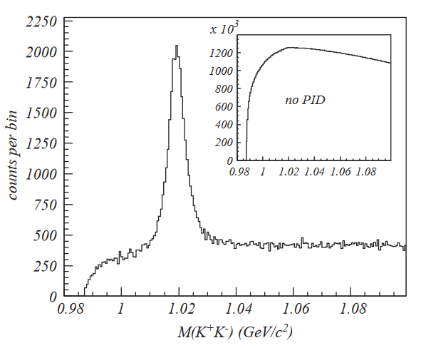
HERA-B RICH
Started operation in 1999
Gas radiator (100m³ C₄F₁₀)
Two sets of mirrors
  Primary/secondary
Photon detectors: MaPMTs
  Use of lenses
  Hamamatsu R5900-M16/M4

Slide 11
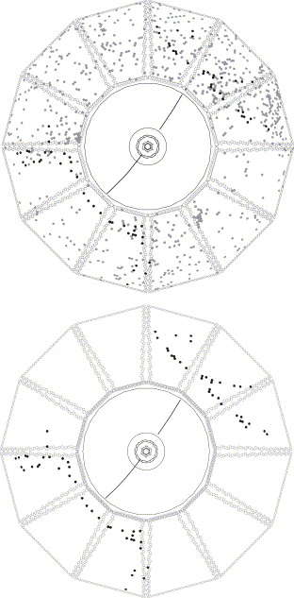
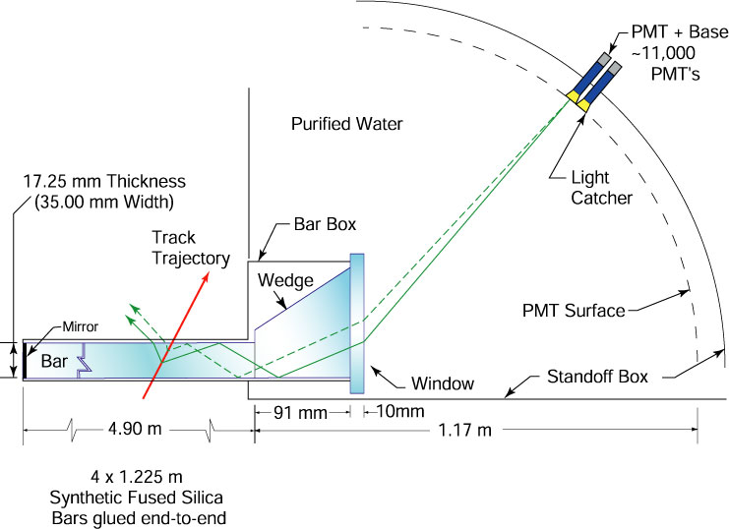
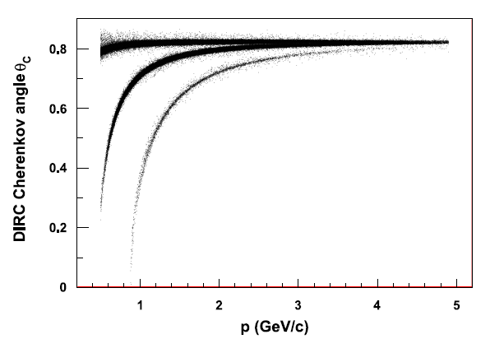
Babar DIRC
Started operation in 1999
Detection of Internally Reflected Cherenkov light
Purified water expansion volume
11000 PMTs for light detection
π/K separation: 3σ at 4 GeV/c
Single photon timing resolution: 1.7 ns

Slide 12
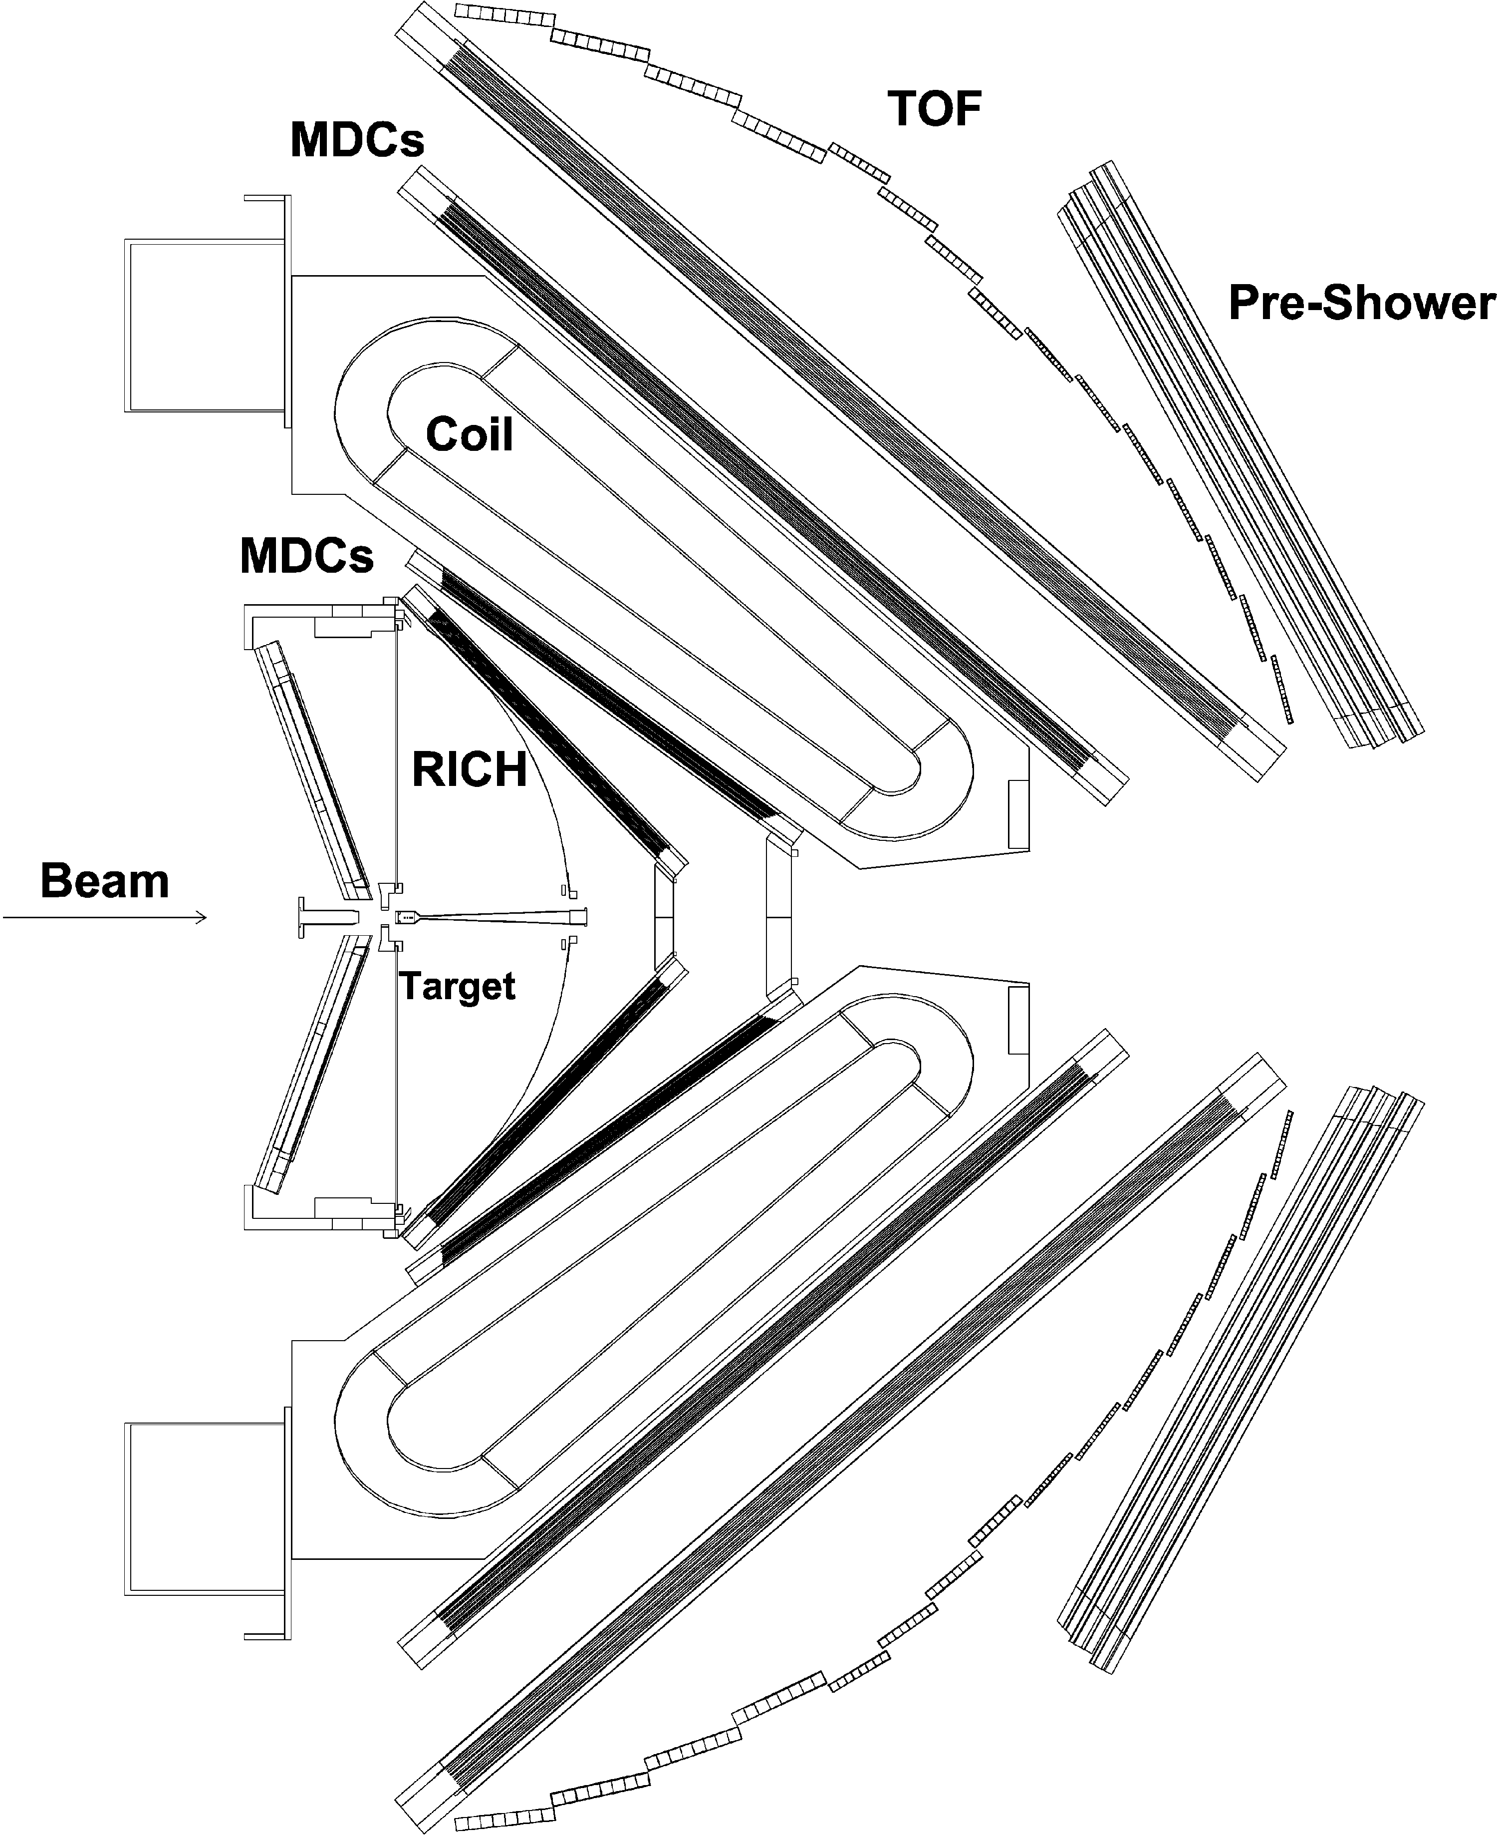
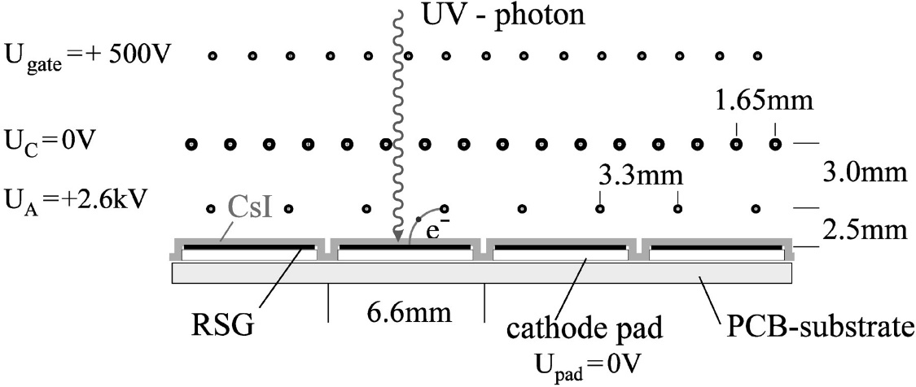
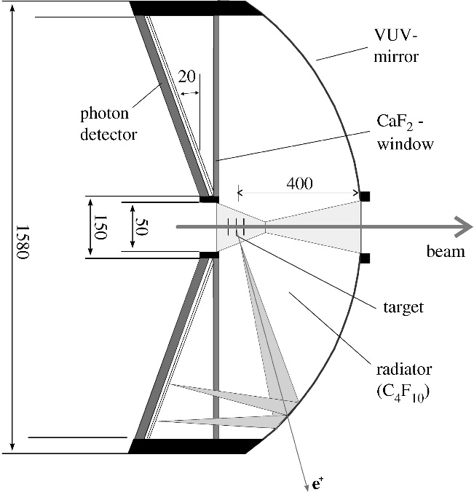
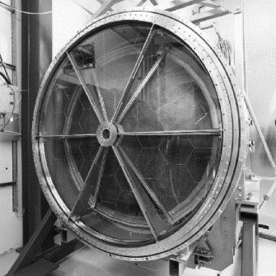
HADES
Operational since 2000
MWPC detectors with CsI photocathode
  Pad readout
Gaseous C₄F₁₀ radiator
Special UV coating for mirrors made of glassy carbon
CaF₂ entrance window
Hadron “blind”
  Hadrons below threshold
Part of the 2nd level trigger

Slide 13
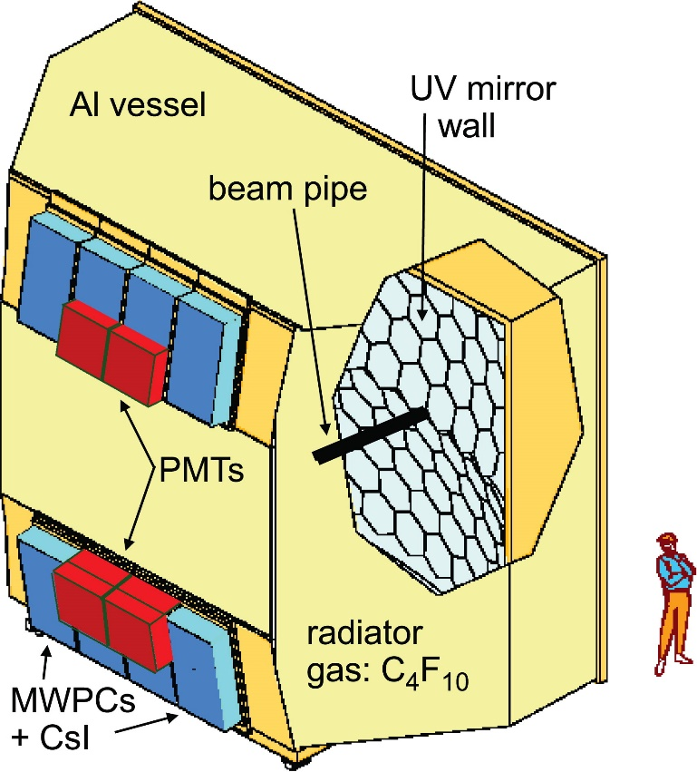
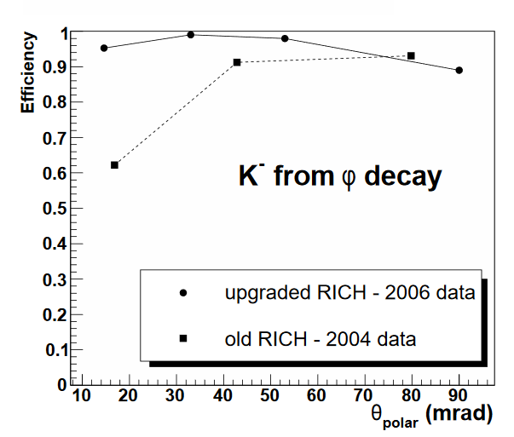
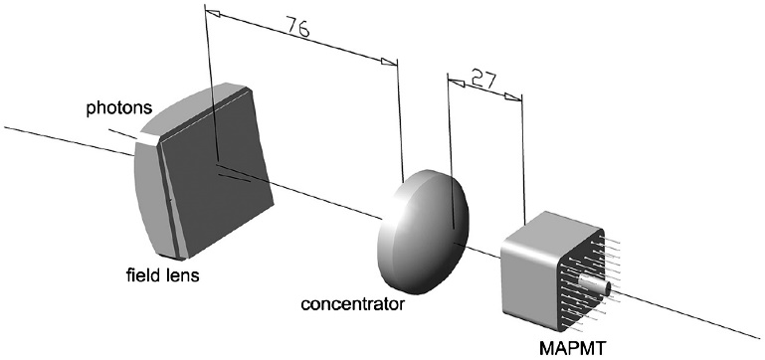
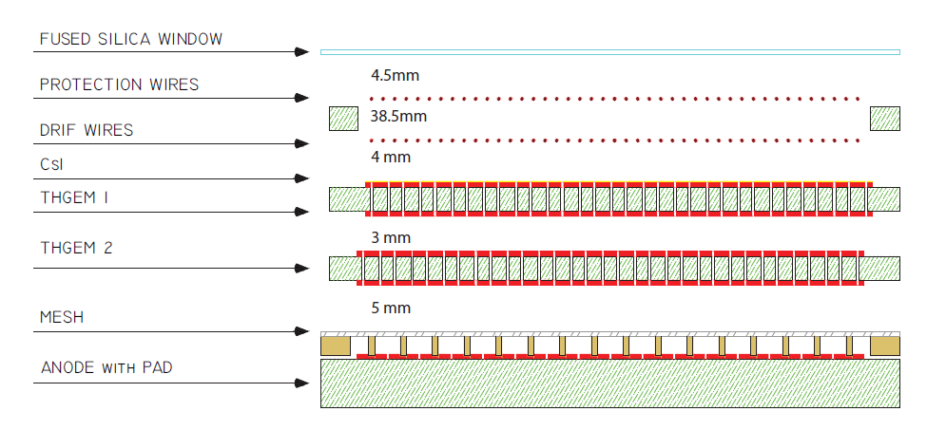
COMPASS RICH-1
Large detector volume with C₄F₁₀ radiator
Operational since 2002
Photon detectors: MWPCs with CsI photocathode
Upgrade of central part with MaPMTs and lenses (2006)
Plan to upgrade MWPCs with MPGD-Based Photon Detectors (THGEM)

Slide 14
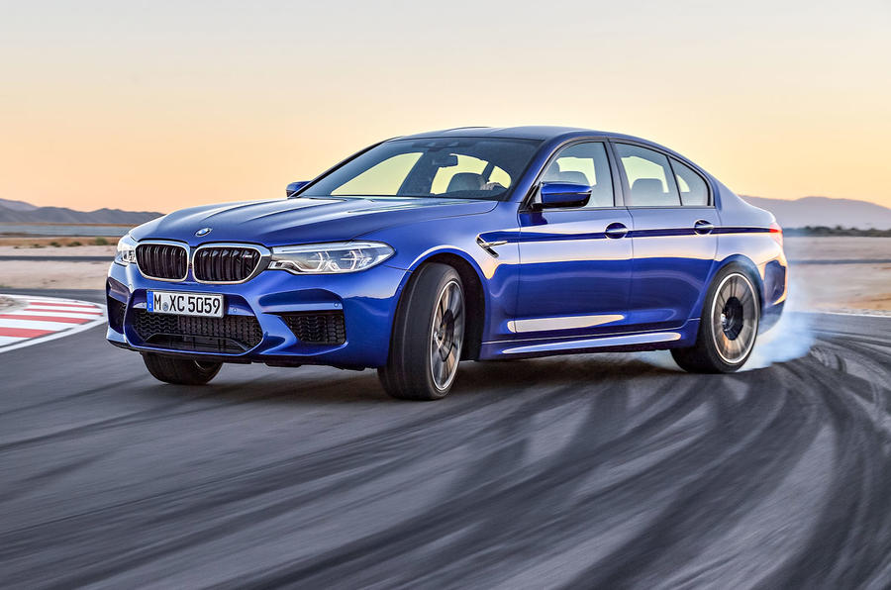
The Established Detectors

Slide 15
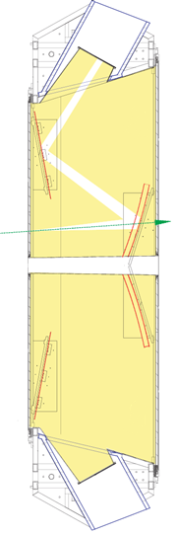
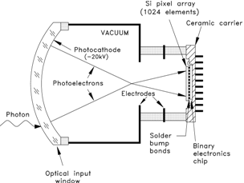
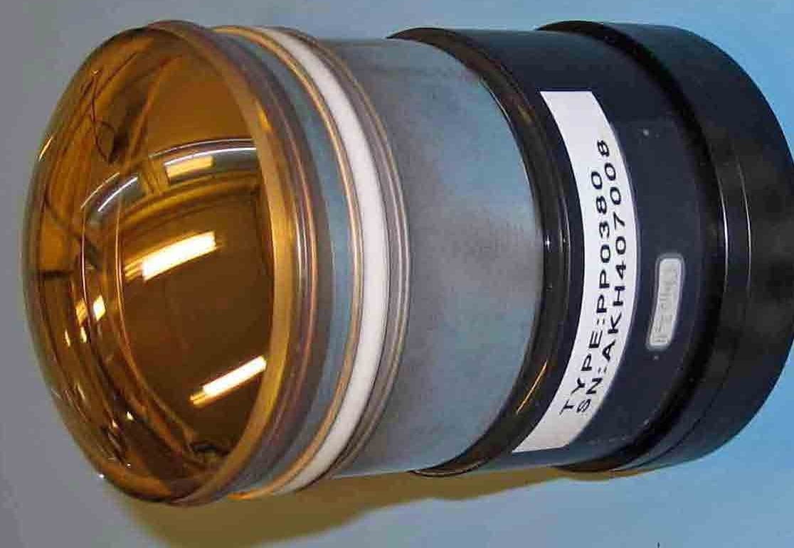
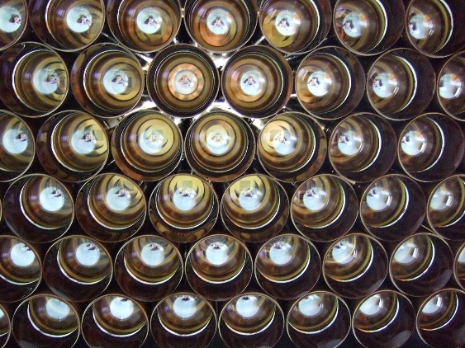
LHCb
~7 m
Two detectors with gas radiators (C₄F₁₀ and CF₄)
  Originally with a 3rd radiator (aerogel)
“Novel” photon detectors, pixel HPDs
  Aging, issues with vacuum
Two mirror systems
Complex pattern recognition
  100s of tracks
  Global likelihood method
300 mrad
120 mrad
Spherical mirrors
Flat mirrors
CF₄ gas

Slide 16
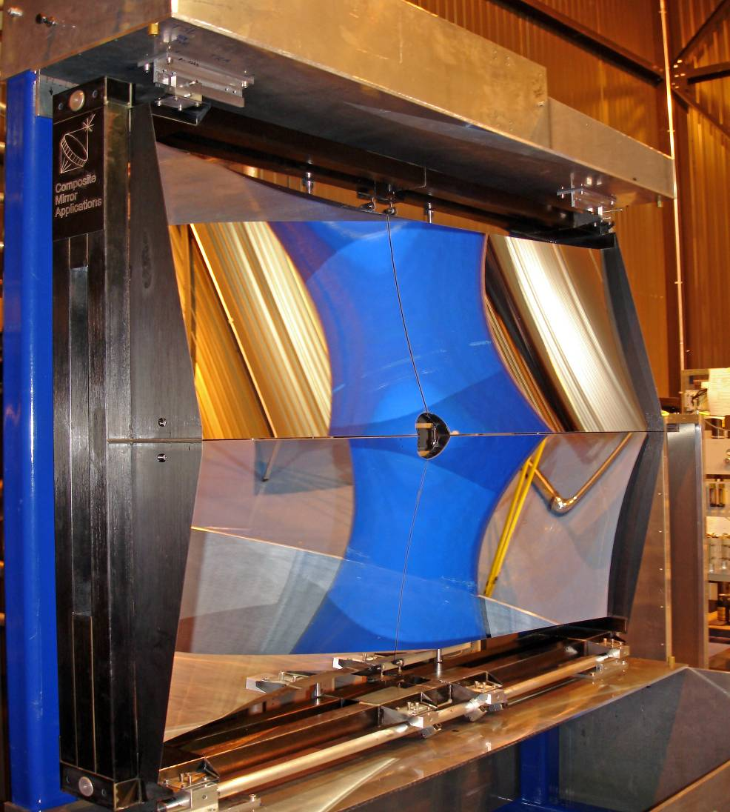
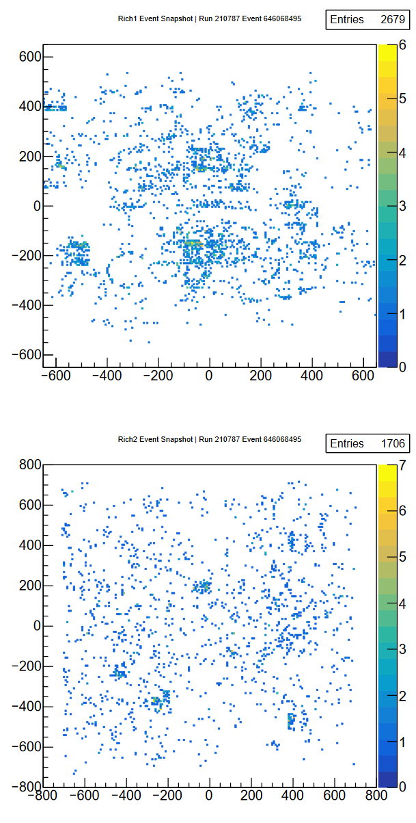
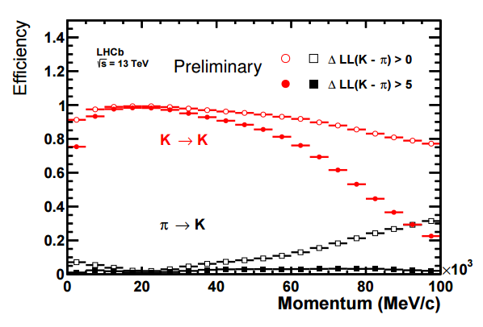
More on LHCb
RICH 1
RICH-1 carbon fibre mirrors
Single event
RICH 2
Pion – kaon PID performance

Slide 17
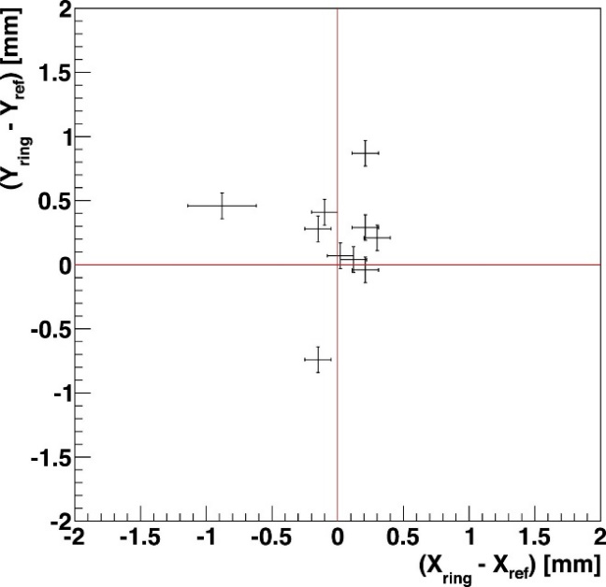
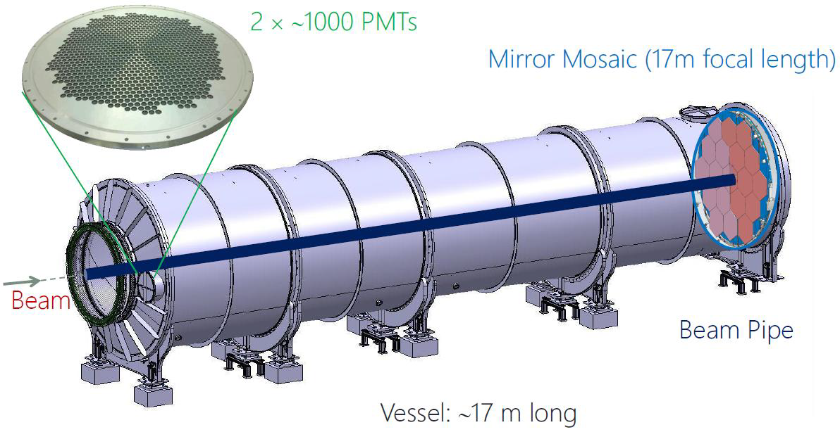
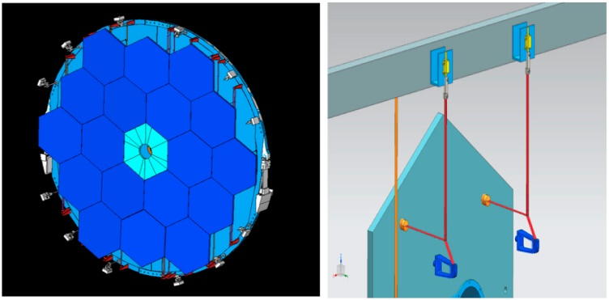
NA62
Mirror alignment
200m³, 17m long, cylindrical vacuum proof tank with Neon radiator
Operational since 2014
Photon detectors: 2000 PMTs (16mm, 8 active)
  With Winstone cone light guides
Mirror alignment ~30 μrad
Single photon resolution: ~140 μrad*
  Calculated by the author
Operation 15-35 GeV/c

Slide 18
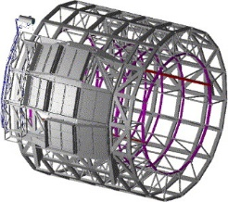
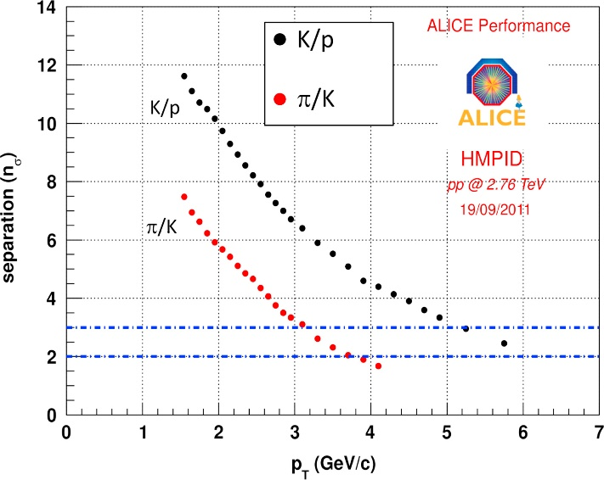
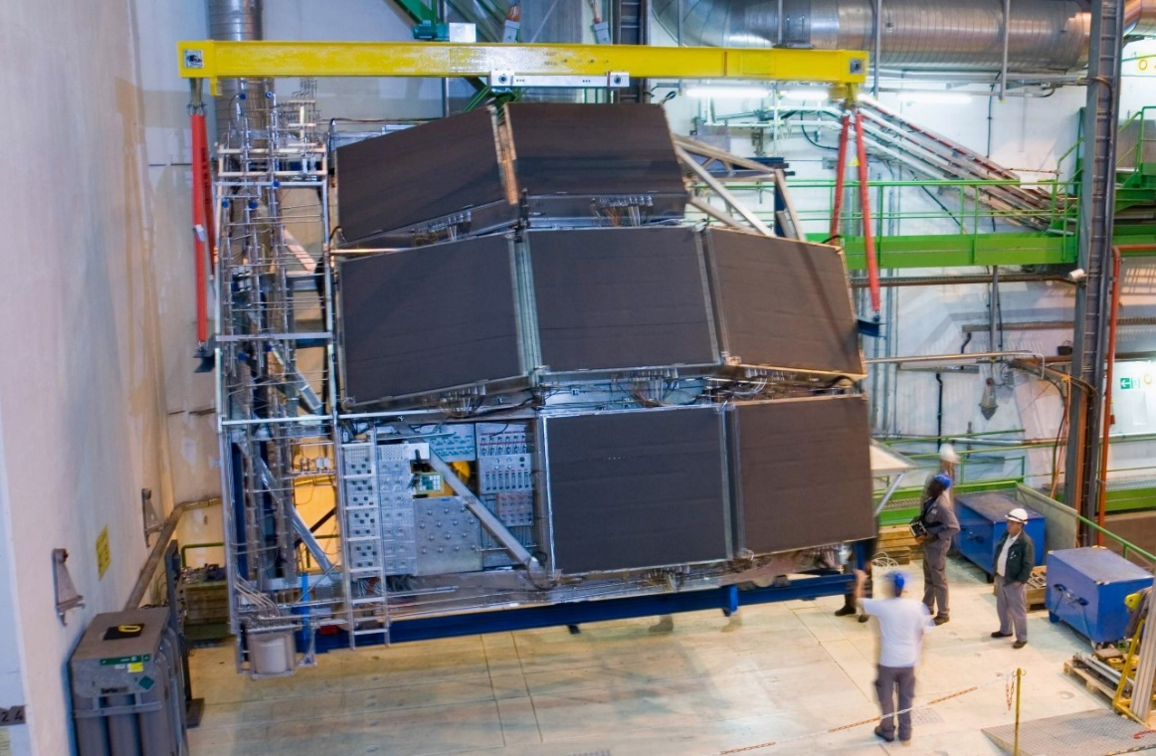
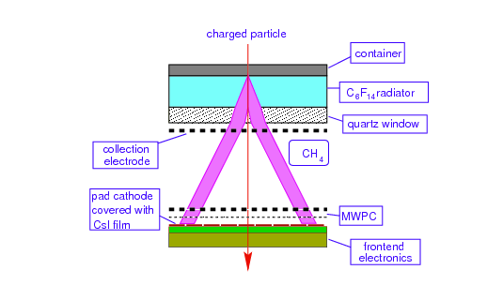
ALICE HMPID
MWPC detectors with CsI photocathode
Liquid C₆F₁₄ radiator
Proximity focusing
Seven modules
Momentum range 1-6 GeV/c

Slide 19
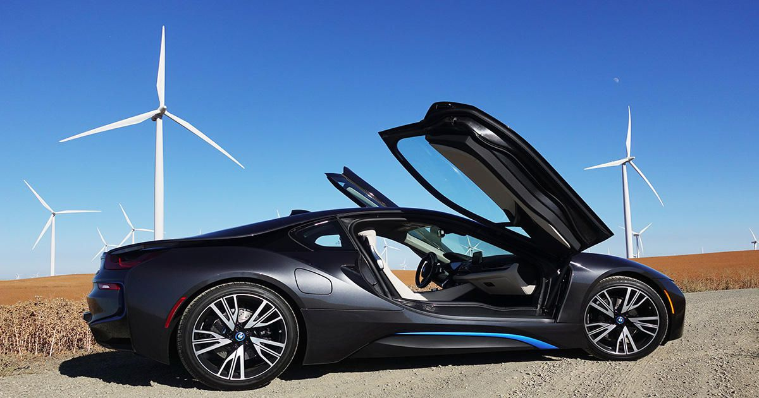
The New Models

Slide 20
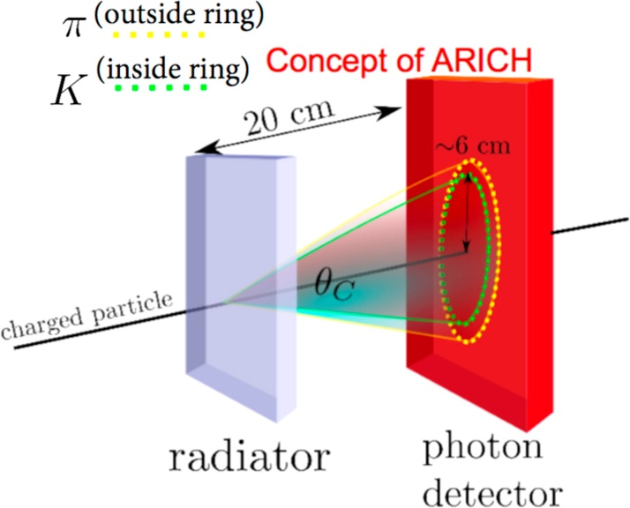
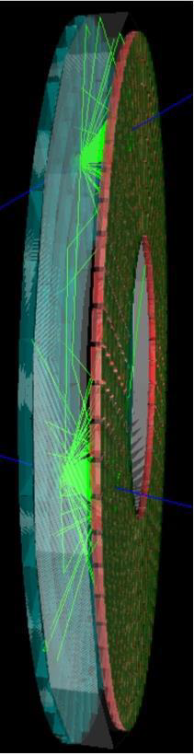
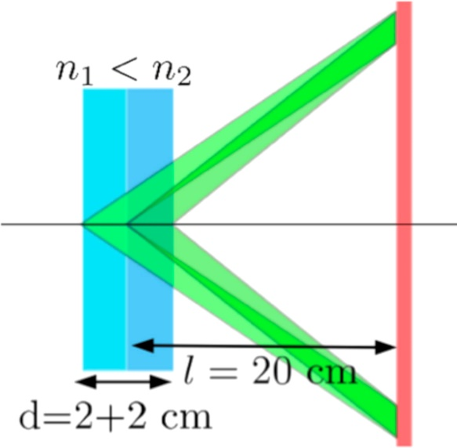


Belle II ARICH (Endcap)
Two tile focusing aerogel radiator
Proximity focusing optics
HAPD detectors
  Bi-alkali photocathode
  Work in magnetic field

Slide 21



Belle II TOP
Particle ID is based on Time Of Propagation
Photons emitted in a synthetic fused silica bar from pions and kaons follow different paths because they are emitted at different angles
Required time resolution per track ~50 ps
Detectors: Hamamatsu MCP-PMTs
Installation completed in May 2016

Slide 22




CBM
RICH with CO₂ radiator
MaPMTs: Hamamatsu H12700
  Share electronics with Panda
Cylindrical photon detection surface
Extensive testing of MaPMTs for radiation damage
Up to 1000 tracks per event
Momentum up to 8 GeV/c
Pion suppression factor ~5000 (with TRD)

Slide 23




Panda Barrel DIRC
DIRC detector following the design principles of the BABAR DIRC
Very compact Expansion Volume
Focusing optics; NLaK33 ref index 1.786
Photon detectors: MCP-PMTs; use of timing information

Slide 24


Panda Endcap DIRC
DIRC detector based on disc rather than bars; 2 cm thick fused silica
Cherenkov angle is calculated from MCP position and FEL position
MCP-PMT detectors, ~100 ps timing
  Timing is used to resolve ambiguities
  Can work in the magnetic field

Slide 25




CLAS12
Aerogel radiator with n=1.05; two different thicknesses
Some photons have to go through the aerogel twice before detected
Extensive studies of the feasibility
Photon detectors: MaPMTs H12700/H8500
Testbeam prototype

Slide 26



LHCb Upgrade
New optics layout for RICH 1
New photon detectors: Hamamatsu R13743 (H12700) and R13742 (R11265)
New electronics working at 40 MHz readout rate

Slide 27



VHMPID for ALICE
Extend PID beyond current limit of ~10 GeV to study jets
C₄F₁₀ gas radiator
Low material budget mirrors with UV reflectivity
CsI photcathode based gas detector
Expected resolution below 1 mrad

Slide 28



HADES Upgrade
Replace MWPCs with MaPMTs
  Hamamatsu H12700
  Same as for CBM-RICH
  Also share electronics

Slide 29




GlueX DIRC
DIRC detector based on the ideas of the Focusing DIRC for SuperB
Reuse of 4 Babar radiator boxes
MaPMT detectors; H12700
Compact EV for reduced background
Focusing unit and photon detectors

Slide 30

The Concepts

Slide 31




TORCH
Time of Flight detector using Cherenkov radiation
  Requires good timing
Quartz radiator
MCP-type photon detectors
Reconstruction of Cherenkov angle is used for the time of propagation
Many photons improves on time by $\sqrt{N}$

Slide 32


Future LHCb Upgrade
Provide PID at p-p luminosity of 10³⁴ in the forward region
Incremental improvements in:
  Cherenkov angle resolution
    More photons in the green
  Reduced event complexity with timing
  Enhanced number of photons

Slide 33

Trends

Slide 34
Common themes
RICH detectors are varied according to the needs of the experiment
  This is part of their strength
  Different kinds, highly customisable
Radiators:
  C₄F₁₀ is performing well
    Low dispersion
    Possibly not available in the future
  Aerogel is here to stay
    Clarity, homogeneity, tuning of ref index all are improving
    Can result is compact detectors

Slide 35
Photon detectors
Hamamatsu MaPMTS are performing well
  Big improvements in single photon detection with successors to the H8500 flat panel
    H12700 is used by many different experiments
    R11265 is smaller with half the pixel size
MCP-PMTs are performing well with really good time resolution (below 100 ps)
Time dimension is becoming a popular way to improve signal/noise

Slide 36
End of the tour
I hope you enjoyed the Salon des RICH Detectors (Moscow 2018 edition)
RICH technology has become the detector of choice for PID for most experiments
Many new developments in the field
  Radiators
  Photon detectors
  Mirrors
Incremental improvements can result in big changes

