Slide 1
LOW-ENERGY ELECTRON-POSITRON COLLIDER TO SEARCH AND STUDY (μ⁺μ⁻) BOUND STATE
A.V. Bogomyagkov, V.P. Druzhinin, V.A. Kiselev, V.V. Kobets, A.A. Krasnov, E.B. Levichev, A.I. Milstein, N.Y. Muchnoi, I.N. Okunev, Y.A. Pupkov, S.S. Serednyakov, S.V. Sinyatkin
BINP, Novosibirsk

Slide 2
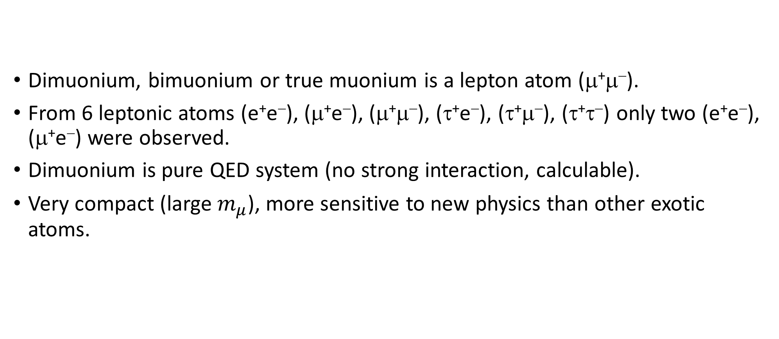
Dimuonium
Dimuonium, bimuonium or true muonium is a lepton atom (μ⁺μ⁻).
From 6 leptonic atoms (e⁺e⁻), (μ⁺e⁻), (μ⁺μ⁻), (τ⁺e⁻), (τ⁺μ⁻), (τ⁺τ⁻) only two (e⁺e⁻), (μ⁺e⁻) were observed.
Dimuonium is pure QED system (no strong interaction, calculable).
Very compact (large $m_{μ}$), more sensitive to new physics than other exotic atoms.

Slide 3
Why dimuonium?
Observation of the new classical QED object.
QED test in the new regime.
Experimental challenge leads to development of new techniques.
Tests of muon properties are motivated by
  3.5σ difference between (g-2)_{μ} measurement and SM prediction,
  discrepancies in the proton charge radius in muonic hydrogen,
  hints of lepton-universality violation in rare B decays (LHCb), B⁺→K⁺e⁺e⁻ and B⁺→K⁺μ⁺μ⁻.

Slide 4
Some references
V.N.Baier and V.S.Synakh, Bimuonium production in electron-positron collisions, SOVIET PHYSICS JETP, 14, № 5, 1962, pp.1122-1125
  Properties of the bound state, probability of observation
S.J. Brodsky and R.F. Lebed. Production of the Smallest QED Atom: True Muonium (μ⁺μ⁻). Phys. Rev. Lett., 102:213401, 2009
  Very large crossing angle in order to eliminate background
H. Lamm and R.F. Lebed, True Muonium (μ⁺μ⁻) on the Light Front, arXiv 1311.3245v3, 12 Nov 2014
  Spectrum
H. Lamm, True muonium: the atom that has it all, arXiv 1509.09306v1, 30 Sep 2016
  Novel properties

Slide 5
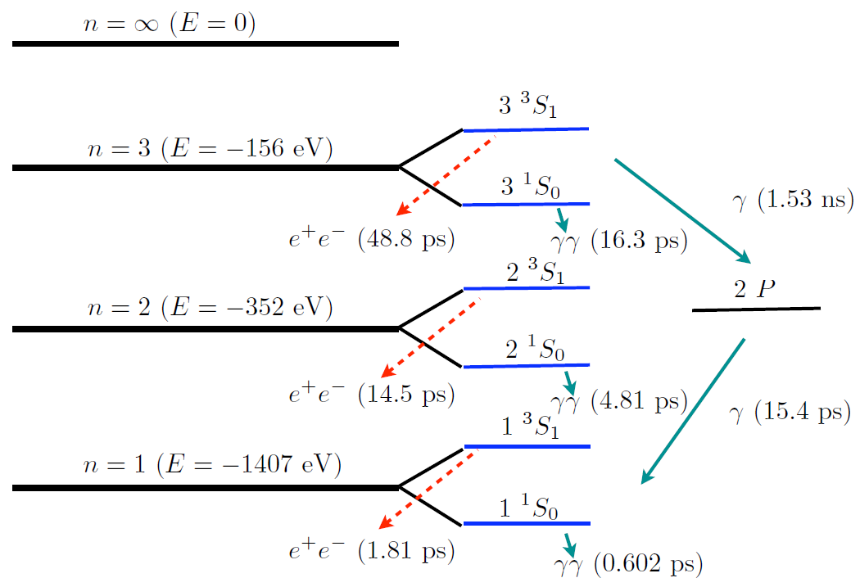
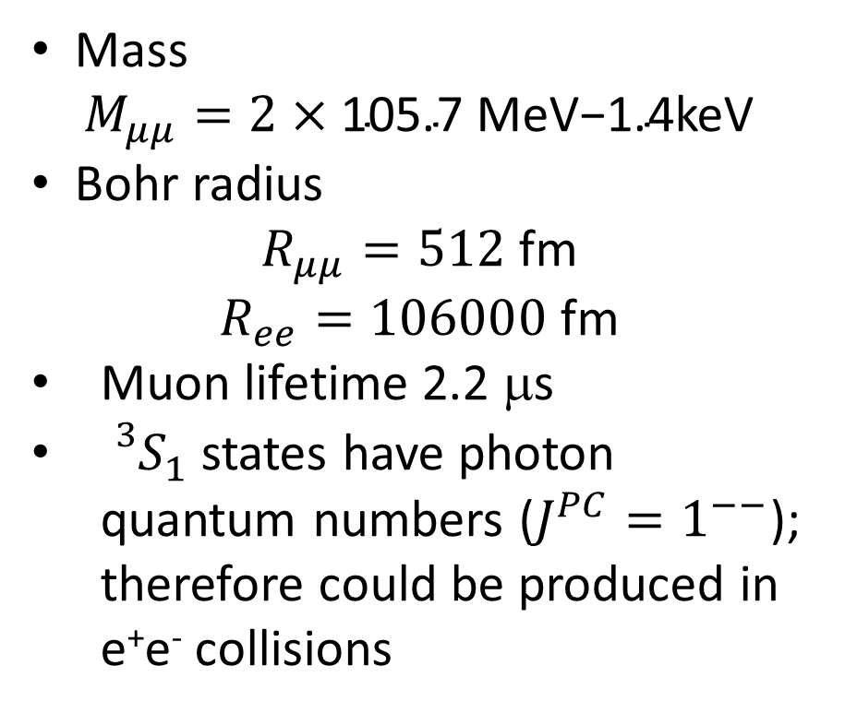
Dimuonium properties
Mass
$$M_{μμ}=\text{2}×\text{105.}\text{7 }\text{MeV}\text{−1}\text{.}\text{4}\text{keV}$$
Bohr radius
$R_{μμ}=512$ fm
$R_{ee}=106000$ fm
Muon lifetime 2.2 μs
${{}_{}^{3}S}_{1}$ states have photon quantum numbers ($J^{PC}=1^{−−}$); therefore could be produced in e⁺e⁻ collisions
Dimuonium energy levels diagram
S.J. Brodsky, R.F. Lebed, Phys. Rev. Lett., 102:213401, 2009
Notes:
Orthodimuonium, the constituents live longer than atom. 3S1 -- spin=1 -> 2S+1=3, S is orbital momentum zero, angular moment is J=1

Slide 6
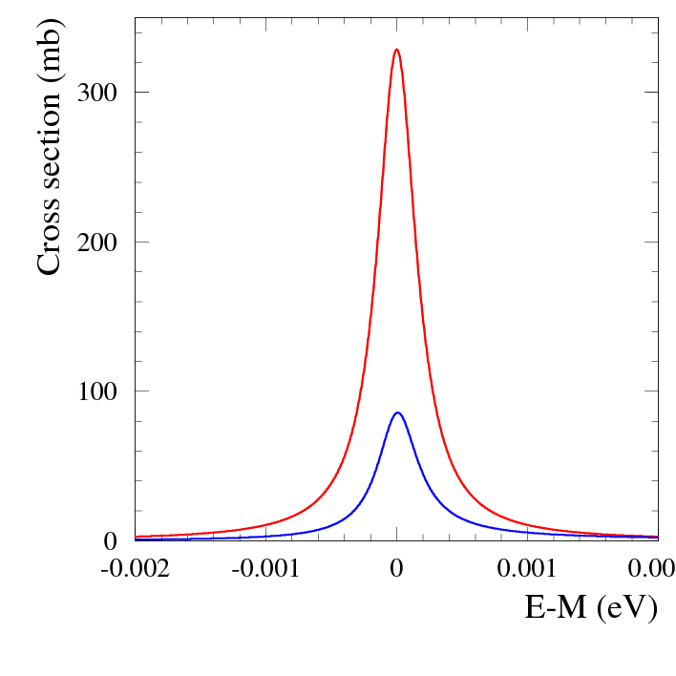
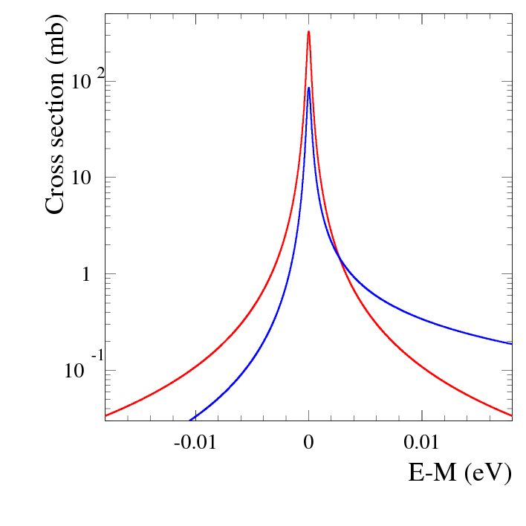
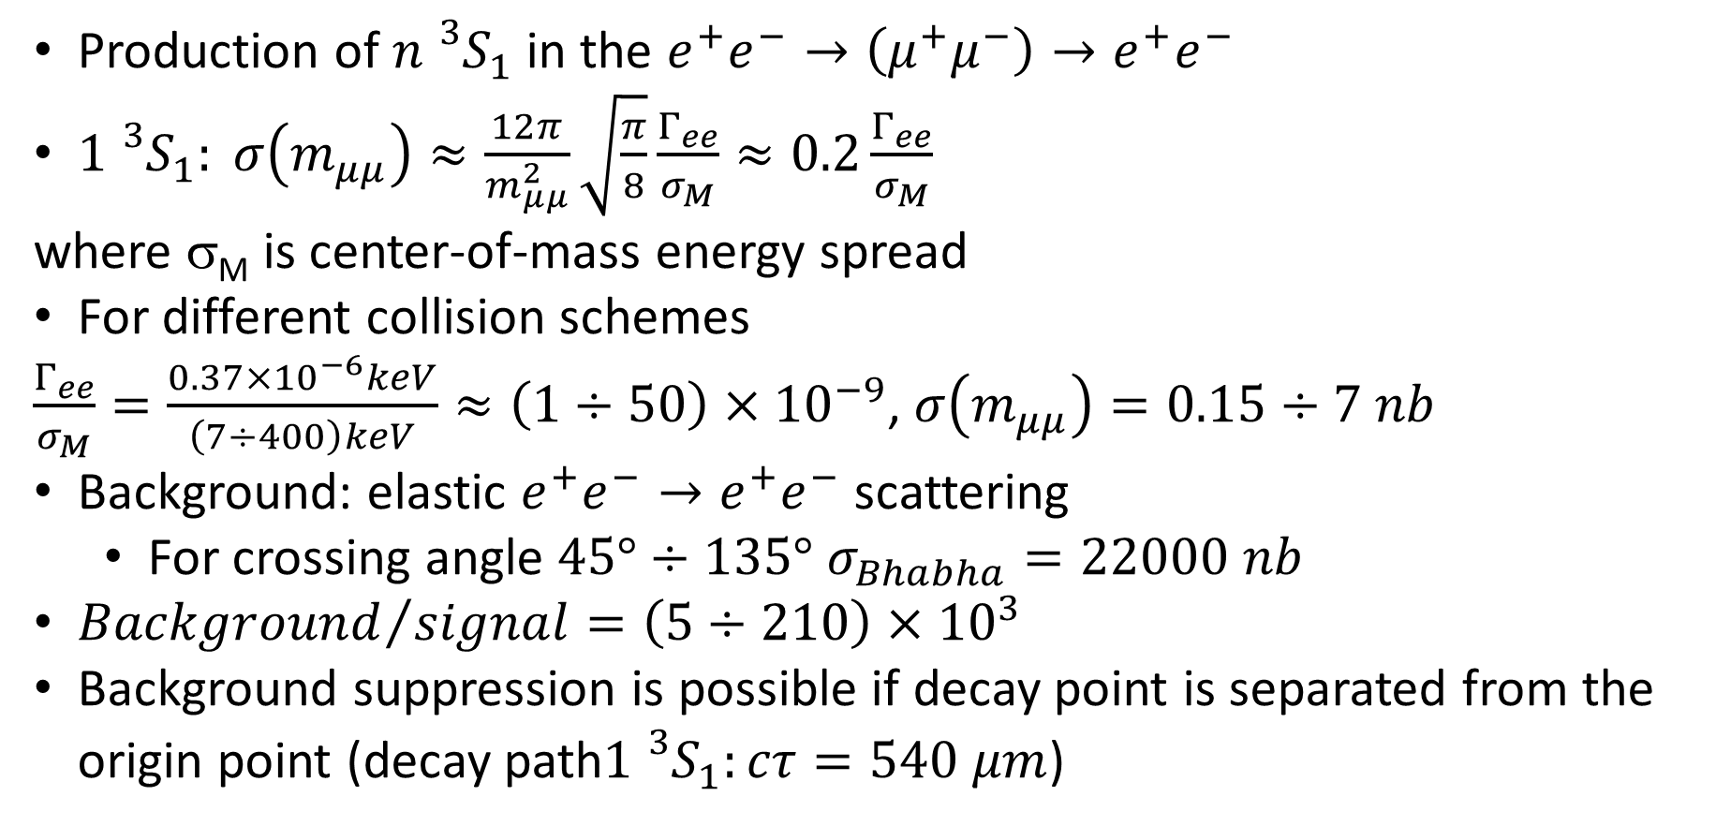
Dimuonium production cross section
Born
+r.c.
Production of ${n{}_{}^{3}S}_{1}$ in the $e^{+}e^{−}→\left(μ^{+}μ^{−}\right)→e^{+}e^{−}$
${1{}_{}^{3}S}_{1}: σ\left(m_{μμ}\right)≈\frac{12π}{m_{μμ}^{2}}\sqrt{\frac{π}{8}}\frac{Γ_{ee}}{σ_{M}}≈0.2\frac{Γ_{ee}}{σ_{M}}$
where σ_{M} is center-of-mass energy spread
For different collision schemes
$\frac{Γ_{ee}}{σ_{M}}=\frac{0.37×{10}^{−6}keV}{\left(7÷400\right)keV}≈\left(1÷50\right)×{10}^{−9}$, $σ\left(m_{μμ}\right)=0.15÷7 nb$
Background: elastic $e^{+}e^{−}→e^{+}e^{−}$ scattering
  For crossing angle $45°÷135°$ $σ_{Bhabha}=22000 nb$
${Background}/{signal}=\left(5÷210\right)×{10}^{3}$
Background suppression is possible if decay point is separated from the origin point (decay path${1{}_{}^{3}S}_{1}:cτ=540 μm$)
Born
+r.c.
Notes:
Background suppression only with large angle crossing

Slide 7
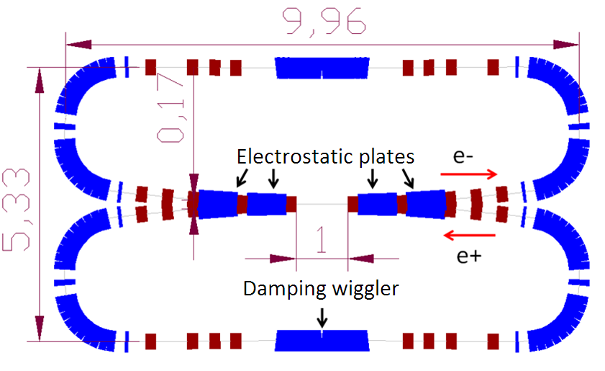
Head-on e+e- collision
E_{beam}=100÷150 MeV
Collision monochromatization a la Reniery:
10 keV invariant mass resolution
L ≈ 10³⁰ cm⁻²s⁻¹ (∼50 (μ⁺μ⁻)/hour).
Observation of the dimuonium
by searching for X-rays from (μ⁺μ⁻)
Bohr transitions such as 2P→1S (J.W.Moffat).
Failed due to large background.
Large crossing angle proposed by S.J.Brodsky and R.F.Lebed.
https://eventbooking.stfc.ac.uk/uploads/eefact/mumutron-eefact2016-2.pptx

Slide 8
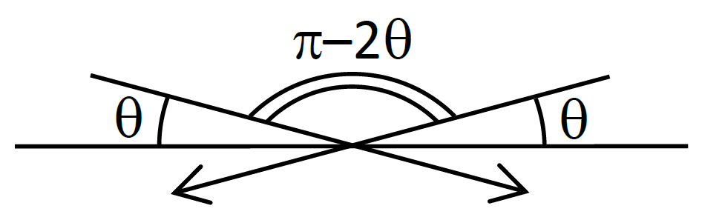
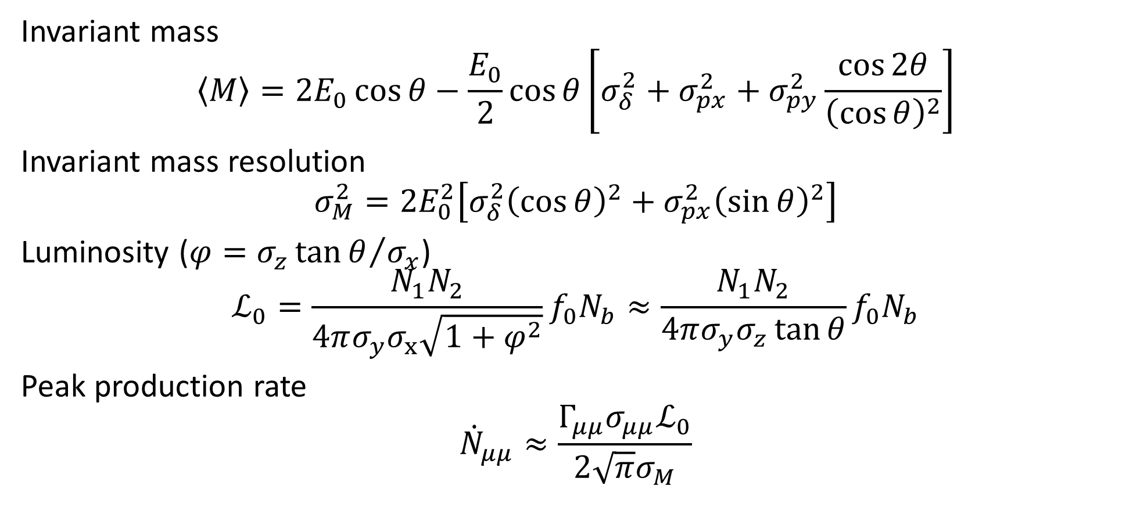
Large angle beam crossing
Invariant mass
$$\left\langle M\right\rangle =2E_{0}\cos{θ}−\frac{E_{0}}{2}\cos{θ}\left[σ_{δ}^{2}+σ_{px}^{2}+σ_{py}^{2}\frac{\cos{2θ}}{{\left(\cos{θ}\right)}^{2}}\right]$$
Invariant mass resolution
$$σ_{M}^{2}=2E_{0}^{2}\left[σ_{δ}^{2}{\left(\cos{θ}\right)}^{2}+{σ_{px}^{2}\left(\sin{θ}\right)}^{2}\right]$$
Luminosity (${{φ=σ}_{z}\tan{θ}}/{σ_{x}}$)
$$ℒ_{0}=\frac{N_{1}N_{2}}{4πσ_{y}σ_{x}\sqrt{1+φ^{2}}}f_{0}N_{b}≈\frac{N_{1}N_{2}}{4πσ_{y}σ_{z}\tan{θ}}f_{0}N_{b}$$
Peak production rate
$${\dot{N}}_{μμ}≈\frac{Γ_{μμ}σ_{μμ}ℒ_{0}}{2\sqrt{π}σ_{M}}$$
Notes:
Brodsky and Lebed proposal with very lathe theta will not work, because sigma_M will increase

Slide 9
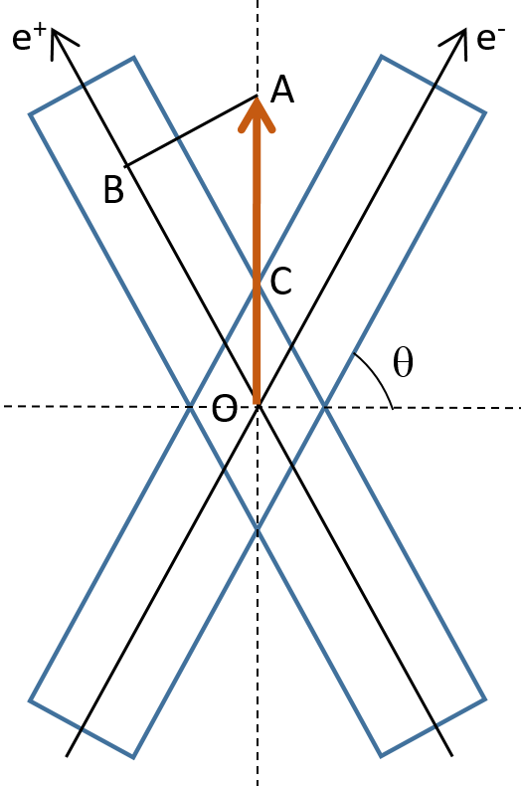
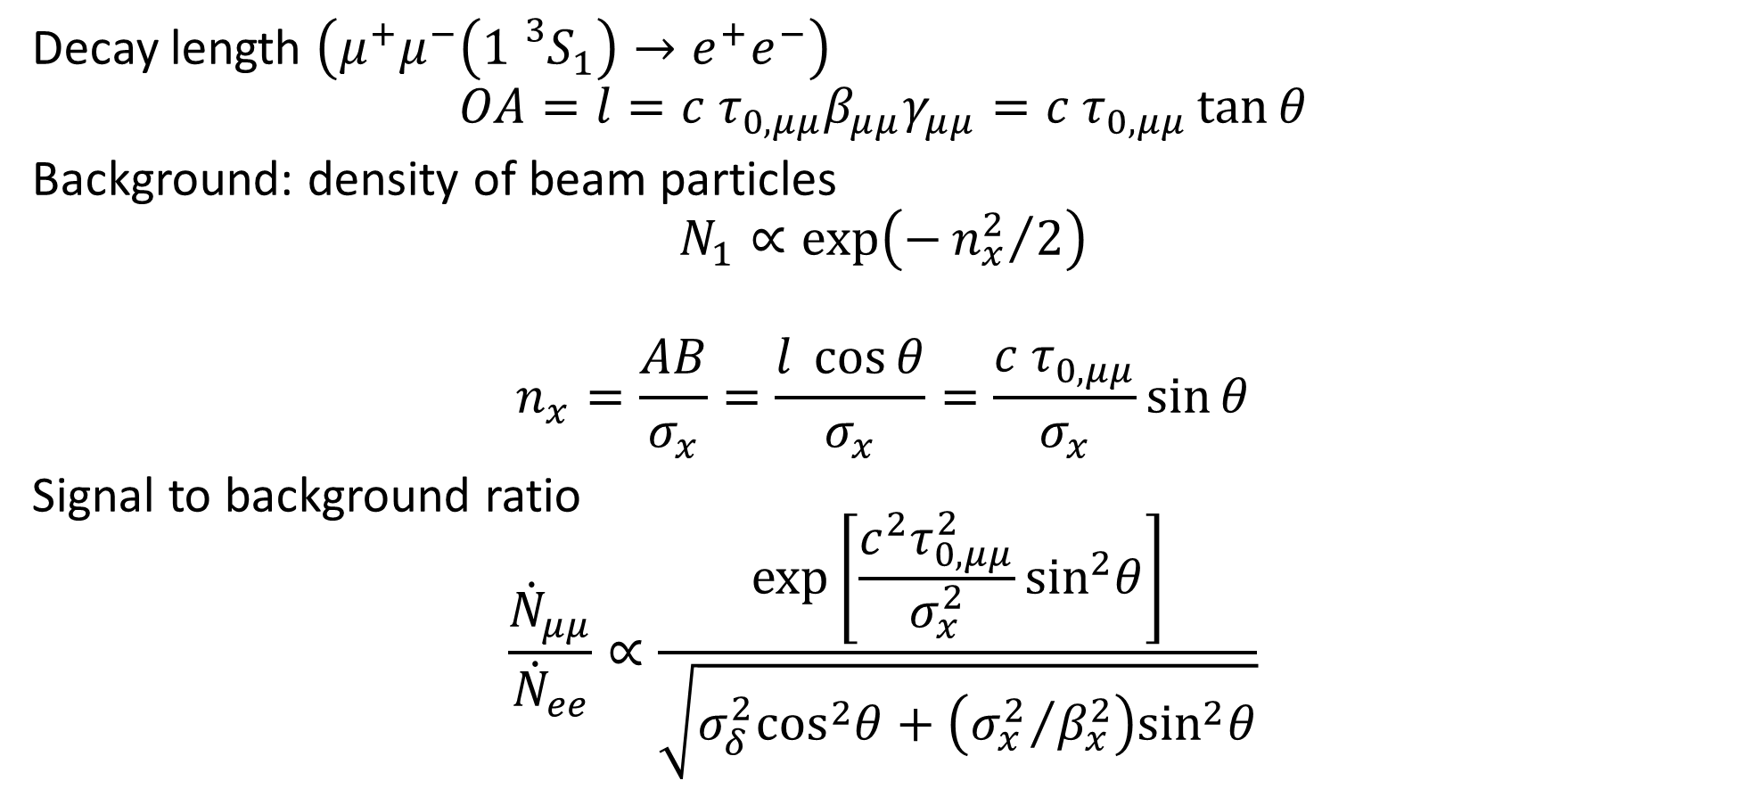
Background
Decay length $\left(μ^{+}μ^{−}\left({1{}_{}^{3}S}_{1}\right)→e^{+}e^{−}\right)$
$$OA=l=c τ_{0,μμ}β_{μμ}γ_{μμ}=c{ τ}_{0,μμ}\tan{θ}$$
Background: density of beam particles
$$N_{1}∝\exp\left(−{n_{x}^{2}}/2\right)$$
$$n_{x}=\frac{AB}{σ_{x}}=\frac{l \cos{θ}}{σ_{x}}=\frac{c{ τ}_{0,μμ}}{σ_{x}}\sin{θ}$$
Signal to background ratio
$$\frac{{\dot{N}}_{μμ}}{{\dot{N}}_{ee}}∝\frac{\exp\left[\frac{c^{2}τ_{0,μμ}^{2}}{σ_{x}^{2}}\sin^{2}θ\right]}{\sqrt{σ_{δ}^{2}\cos^{2}θ+\left({σ_{x}^{2}}/{β_{x}^{2}}\right)\sin^{2}θ}}$$
Notes:
Constituents are living longer. Preponderance of beam particles.

Slide 10
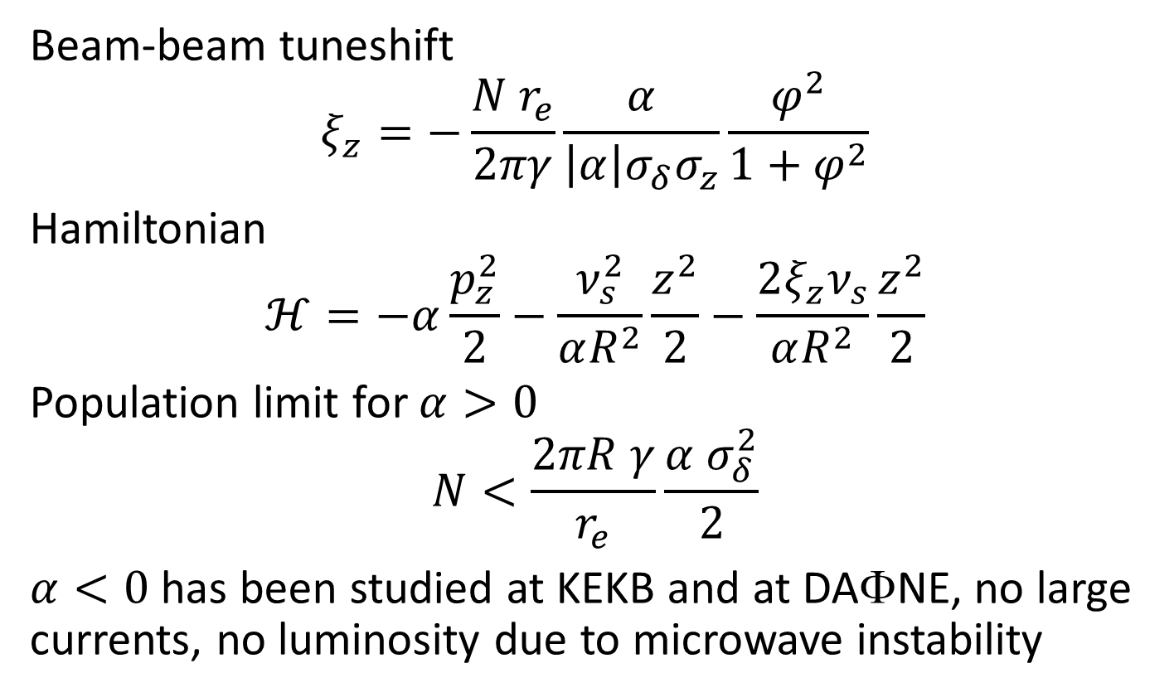
Beam-beam effects with large crossing angle
e⁻
Beam-beam tuneshift
$$ξ_{z}=−\frac{N r_{e}}{2πγ}\frac{α}{\left|α\right|σ_{δ}σ_{z}}\frac{φ^{2}}{1+φ^{2}}$$
Hamiltonian
$$ℋ=−α\frac{p_{z}^{2}}{2}−\frac{ν_{s}^{2}}{αR^{2}}\frac{z^{2}}{2}−\frac{2ξ_{z}ν_{s}}{αR^{2}}\frac{z^{2}}{2}$$
Population limit for $α>0$
$$N<\frac{2πR γ}{r_{e}}\frac{α σ_{δ}^{2}}{2}$$
$α<0$ has been studied at KEKB and at DAΦNE, no large currents, no luminosity due to microwave instability
e⁺
e⁺
e⁻

Slide 11
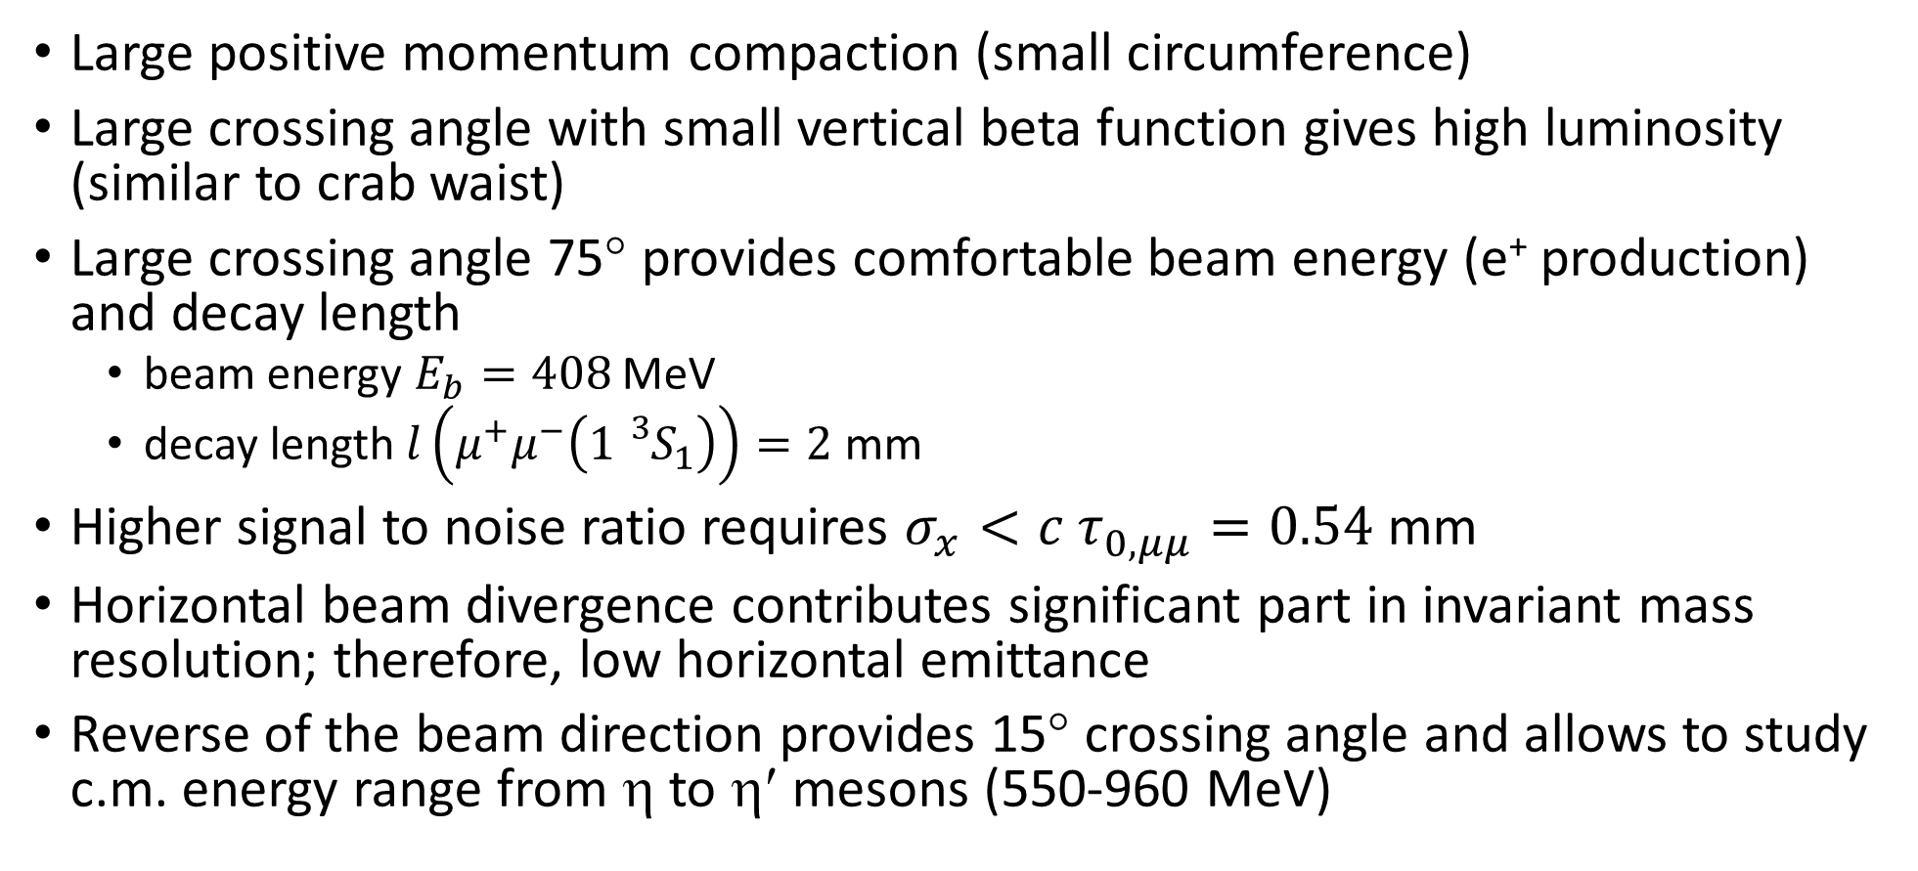
Accelerator requirements
Large positive momentum compaction (small circumference)
Large crossing angle with small vertical beta function gives high luminosity (similar to crab waist)
Large crossing angle 75° provides comfortable beam energy (e⁺ production) and decay length
  beam energy $E_{b}=408$ MeV
  decay length $l\left(μ^{+}μ^{−}\left({1{}_{}^{3}S}_{1}\right)\right)=2$ mm
Higher signal to noise ratio requires $σ_{x}<c{ τ}_{0,μμ}=0.54$ mm
Horizontal beam divergence contributes significant part in invariant mass resolution; therefore, low horizontal emittance
Reverse of the beam direction provides 15° crossing angle and allows to study c.m. energy range from η to η′ mesons (550-960 MeV)

Slide 12
Collider: overview

Slide 13
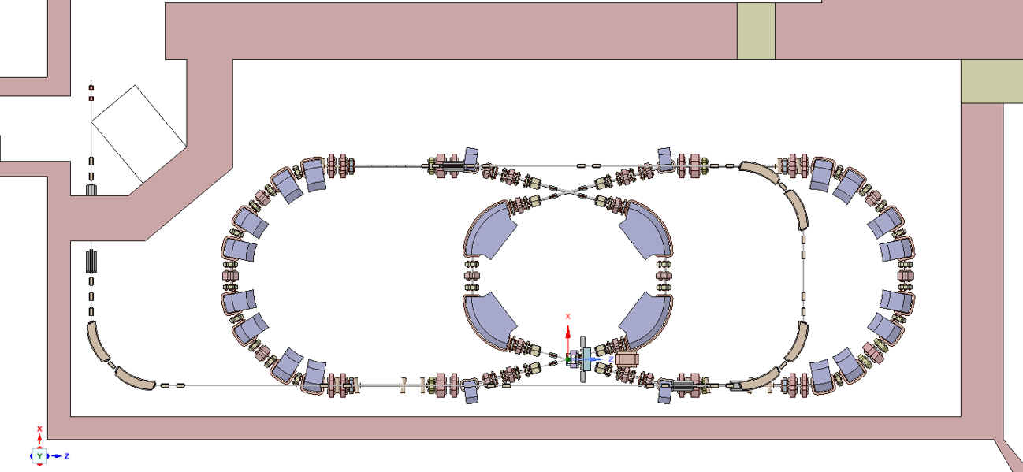
Collider: overview
Injection
RF cavities
IP1
IP2
Outer arc
Inner arc
Inner arc
Outer arc
RF cavities
IP1
Injection

Slide 14
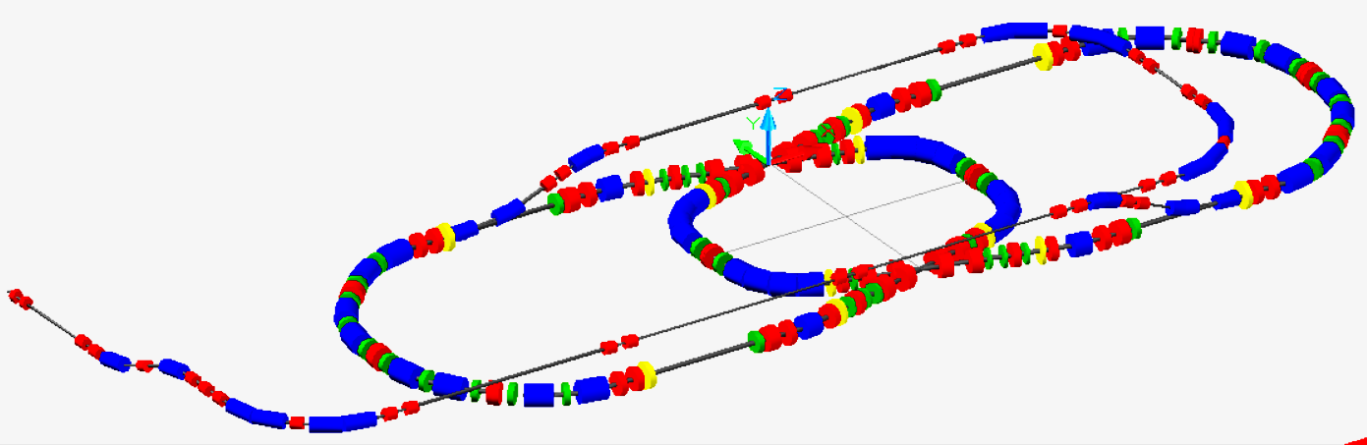
Injection channels
0.7 m

Slide 15
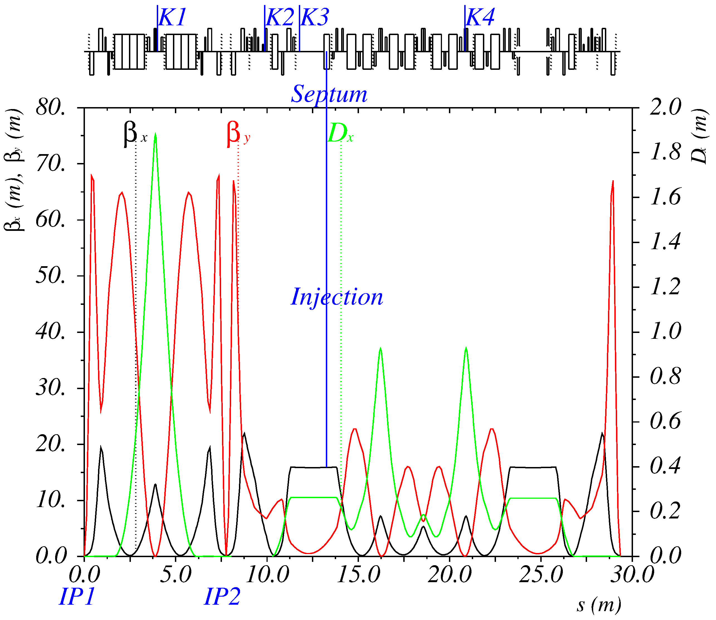
Injection optics
One turn injection in the horizontal plane
K1 – K4 – running wave kickers
Septum – Lambertson injection magnet

Slide 16

Injection trajectories
Remaining oscillations $±10 σ_{x}$

Slide 17
Dynamic aperture and energy acceptance
ν_{x} = 4.43
ν_{y} = 3.37

Slide 18
Dynamic aperture and energy acceptance
ν_{x} = 4.43
ν_{y} = 3.37

Slide 19
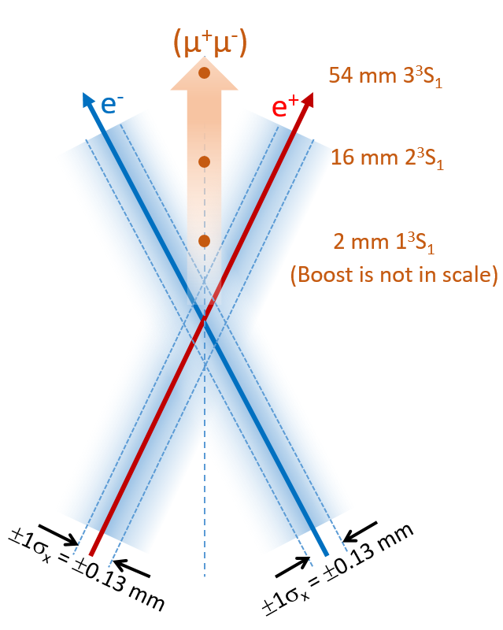
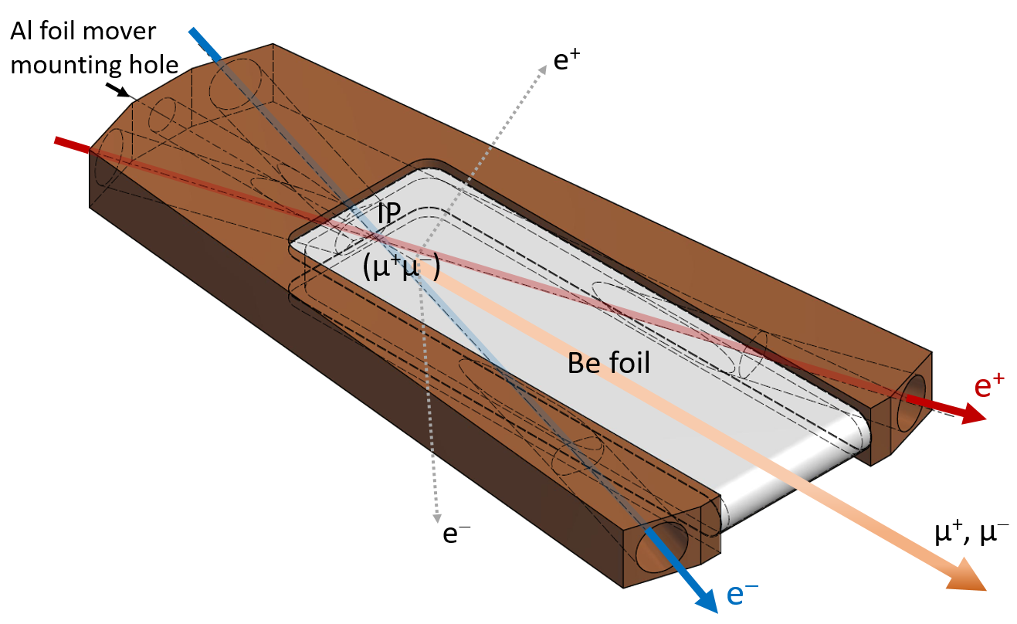
Interaction region
Experimental chamber: flat box with 0.5-mm-thick beryllium windows on the top and on the bottom allowing passage of е± produced by the dimuonium atoms decay.
Detector: tracking systems around the median plane, magnetic spectrometer

Slide 20
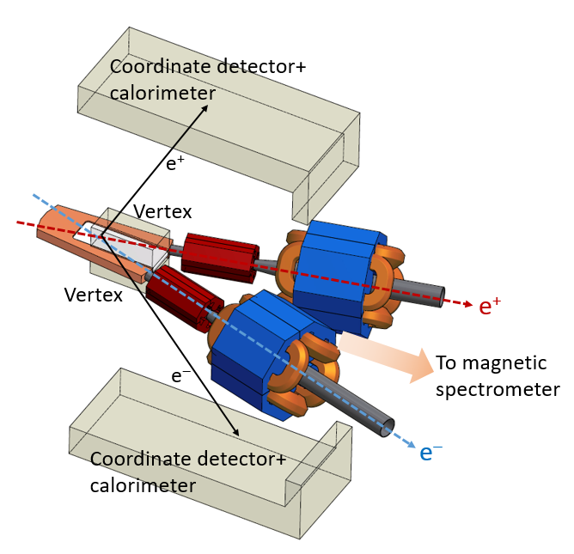
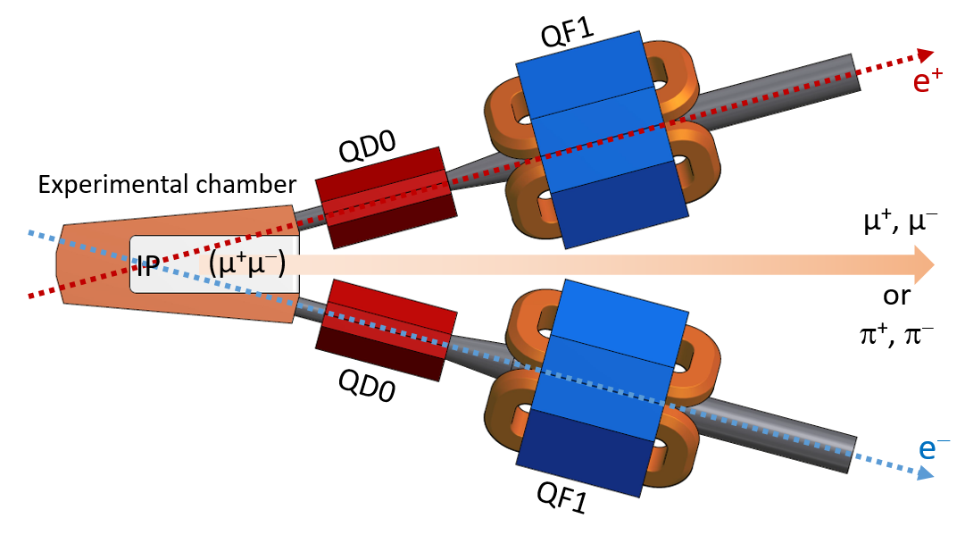
Interaction region
QD0: permanent magnet, G=-35 T/m, ∅ 30mm
QD/QF1: electromagnet

Slide 21
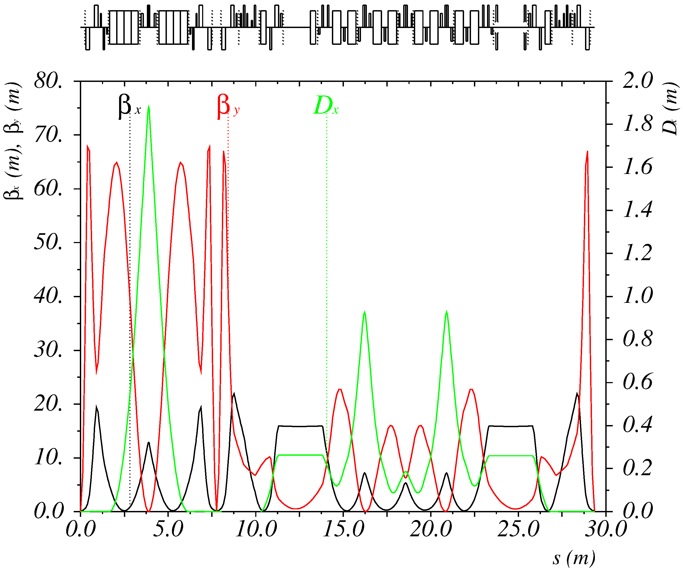
Collider: optics
Beam energy | 408 MeV
Circumference | 29.35 m
Momentum compaction | 5.8×10⁻²
Bunch intensity | 3.5×10¹⁰ / 57 mA
Horizontal emittance | 30 nm 65 nm (IBS)
Energy spread | 3.7×10⁻⁴ 8.7×10⁻⁴ (IBS)
β_{x} / β_{y} | 150 mm / 2 mm
Luminosity | 2.8×10³⁰ cm⁻²s⁻¹, Nb=1 8.3×10³¹ cm⁻²s⁻¹, Nb=30

Slide 22
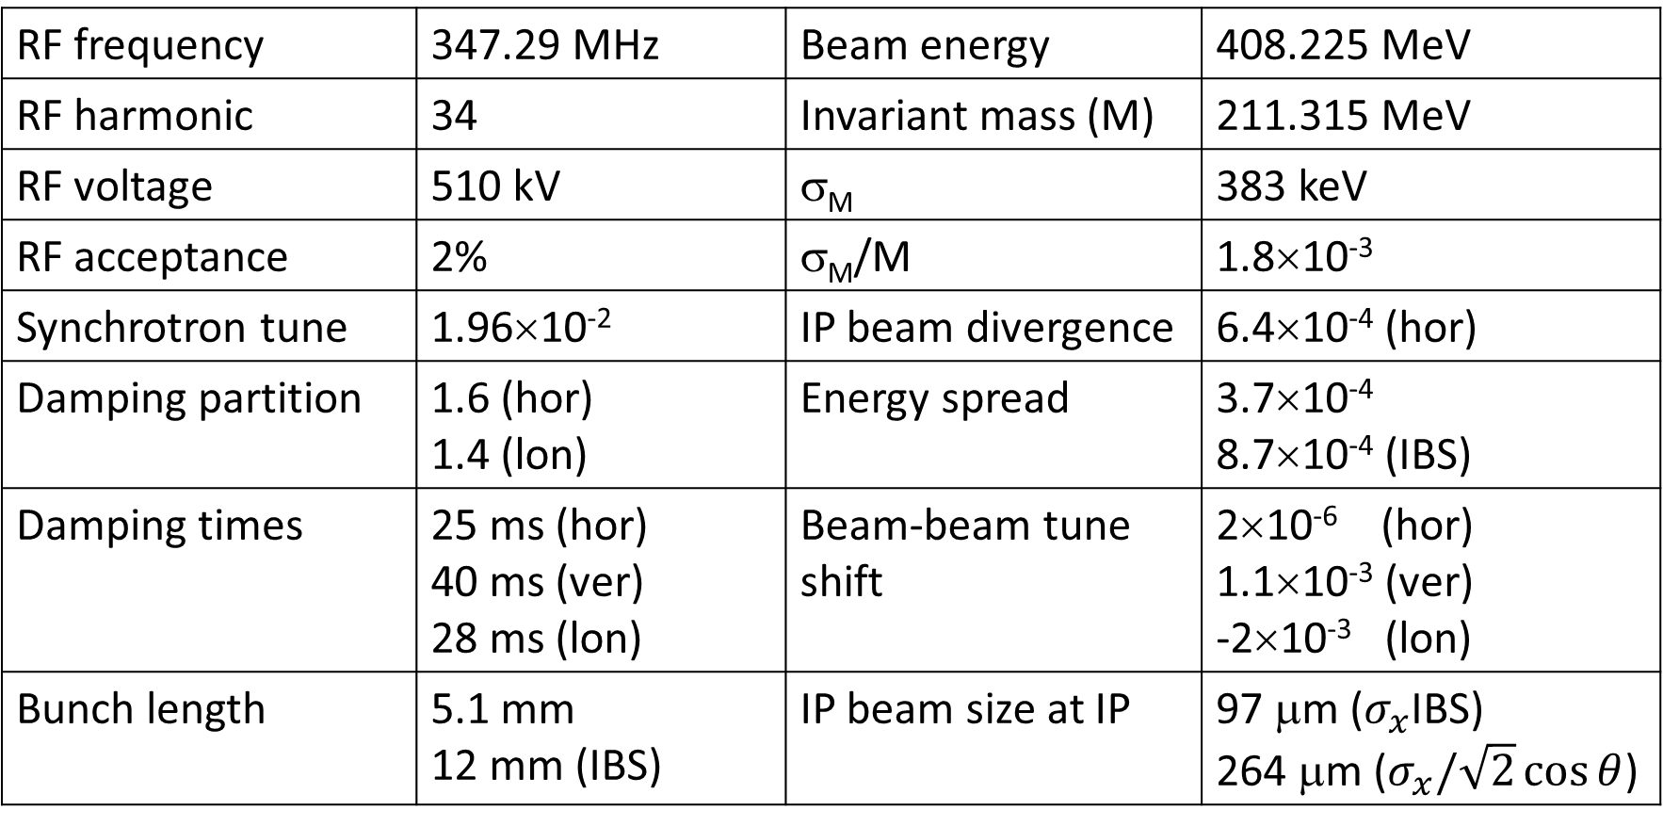
Collider: parameters
RF frequency | 347.29 MHz | Beam energy | 408.225 MeV
RF harmonic | 34 | Invariant mass (M) | 211.315 MeV
RF voltage | 510 kV | σ_{M} | 383 keV
RF acceptance | 2% | σ_{M}/M | 1.8×10⁻³
Synchrotron tune | 1.96×10⁻² | IP beam divergence | 6.4×10⁻⁴ (hor)
Damping partition | 1.6 (hor) 1.4 (lon) | Energy spread | 3.7×10⁻⁴ 8.7×10⁻⁴ (IBS)
Damping times | 25 ms (hor) 40 ms (ver) 28 ms (lon) | Beam-beam tune shift | 2×10⁻⁶ (hor) 1.1×10⁻³ (ver) -2×10⁻³ (lon)
Bunch length | 5.1 mm 12 mm (IBS) | IP beam size at IP | 97 μm ($σ_{x}$IBS) 264 μm ($σ_{x}/\sqrt{2}\cos{θ}$)

Slide 23
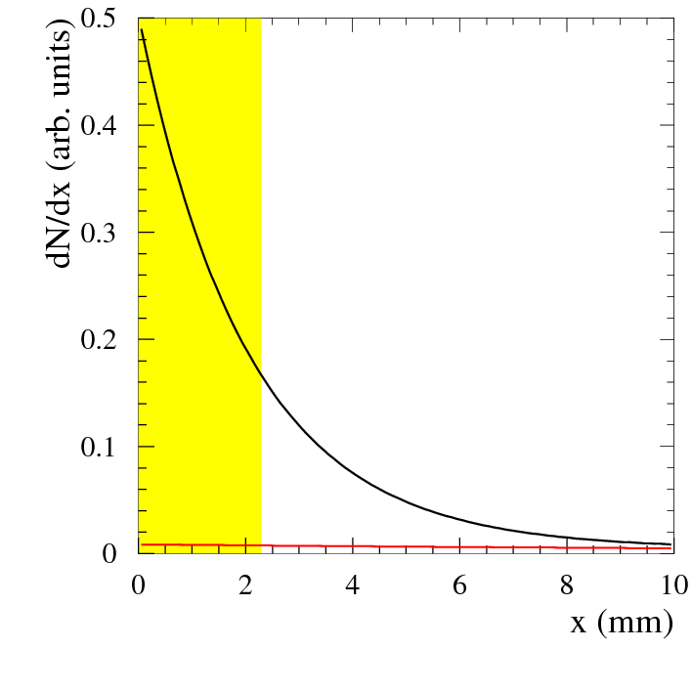
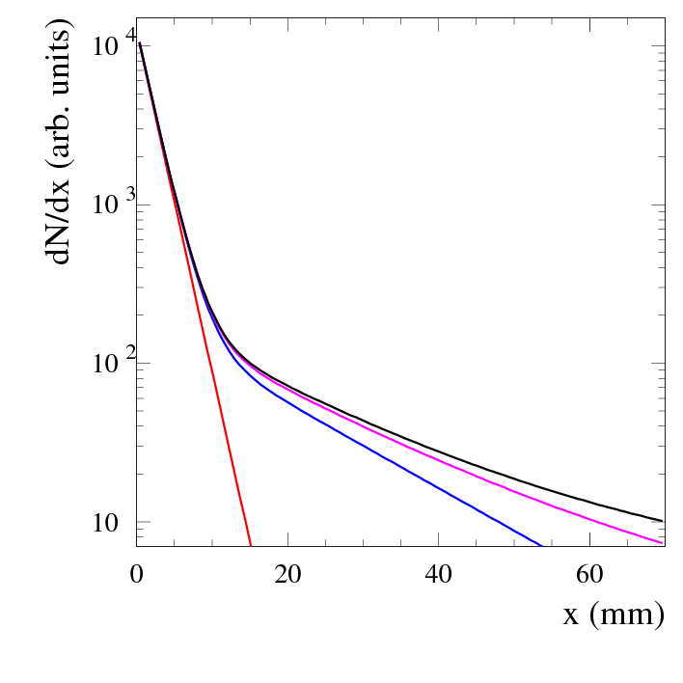
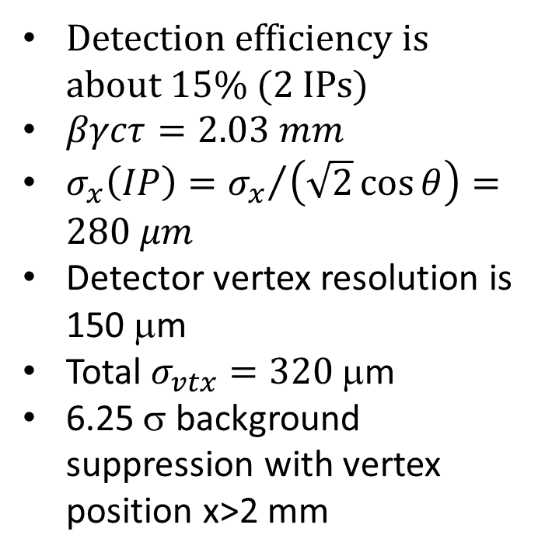
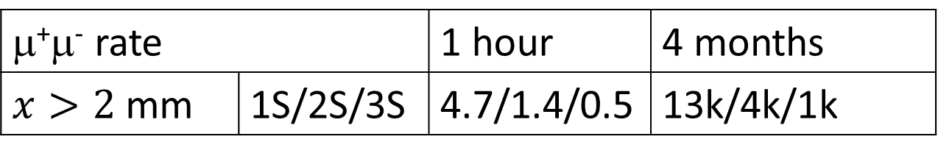
Dimuonium production and distribution
μ⁺μ⁻ rate |  | 1 hour | 4 months
$x>2$ mm | 1S/2S/3S | 4.7/1.4/0.5 | 13k/4k/1k
Detection efficiency is about 15% (2 IPs)
$βγcτ=2.03 mm$
$σ_{x}\left(IP\right)={σ_{x}}/{\left(\sqrt{2}\cos{θ}\right)}=280 μm$
Detector vertex resolution is 150 μm
Total $σ_{vtx}=320$ μm
6.25 σ background suppression with vertex position x>2 mm
Σn³S₁
1³S₁
Σn³S₁−1³S₁
2³S₁
3³S₁
Σn³S₁

Slide 24
Experiments: what can we measure?
From the fit of the decay vertex distribution
  dimuonium production rate (Γ_{ee}) of 1S (2% for 10⁷ s), 2S(15%), 3S(30%)
  dimuonium decay lengths with the same accuracy
Dimuonium interaction with a thin foil (30μm Al) allows
  measurement of the breakup probability
  measurement 1S-2P transition probabilities
  2P lifetime
Laser spectroscopy (?)
  ΔE(2S-2P) (laser λ≈100μm)
  2P lifetime

Slide 25
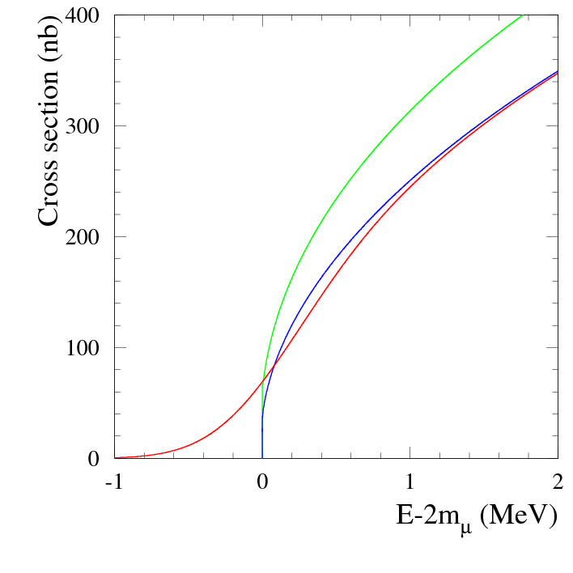
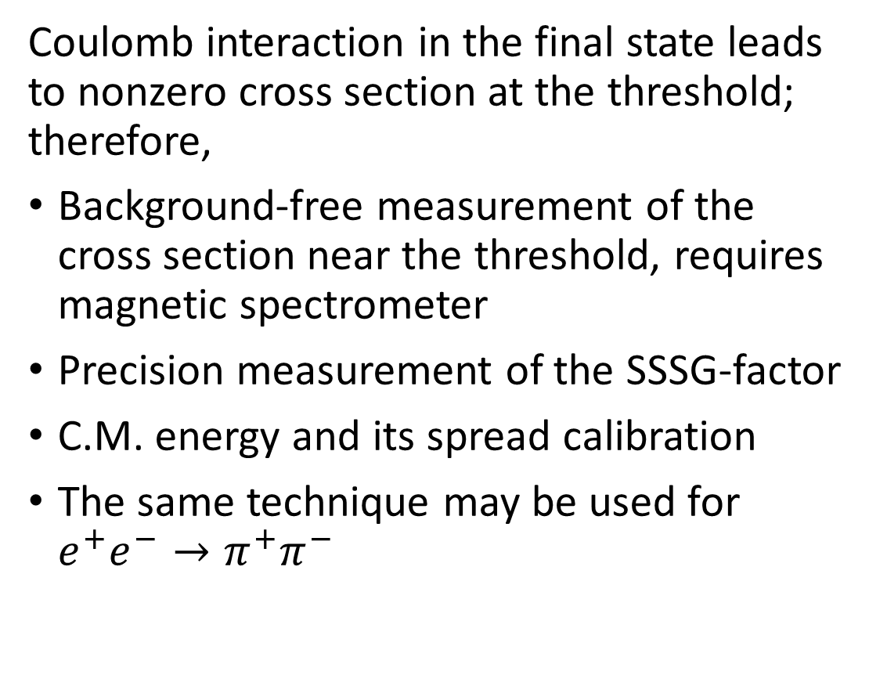
Experiments: $e^{+}e^{−}→μ^{+}μ^{−}$ near threshold
Coulomb interaction in the final state leads to nonzero cross section at the threshold; therefore,
Background-free measurement of the cross section near the threshold, requires magnetic spectrometer
Precision measurement of the SSSG-factor
C.M. energy and its spread calibration
The same technique may be used for $e^{+}e^{−}→π^{+}π^{−}$
Born cross section
+ rad. correction
+ energy spread
with δ=400 keV
Notes:
Saharov, Schwinger, Sommerfeld, Gamov, кулоновский фактор

Slide 26
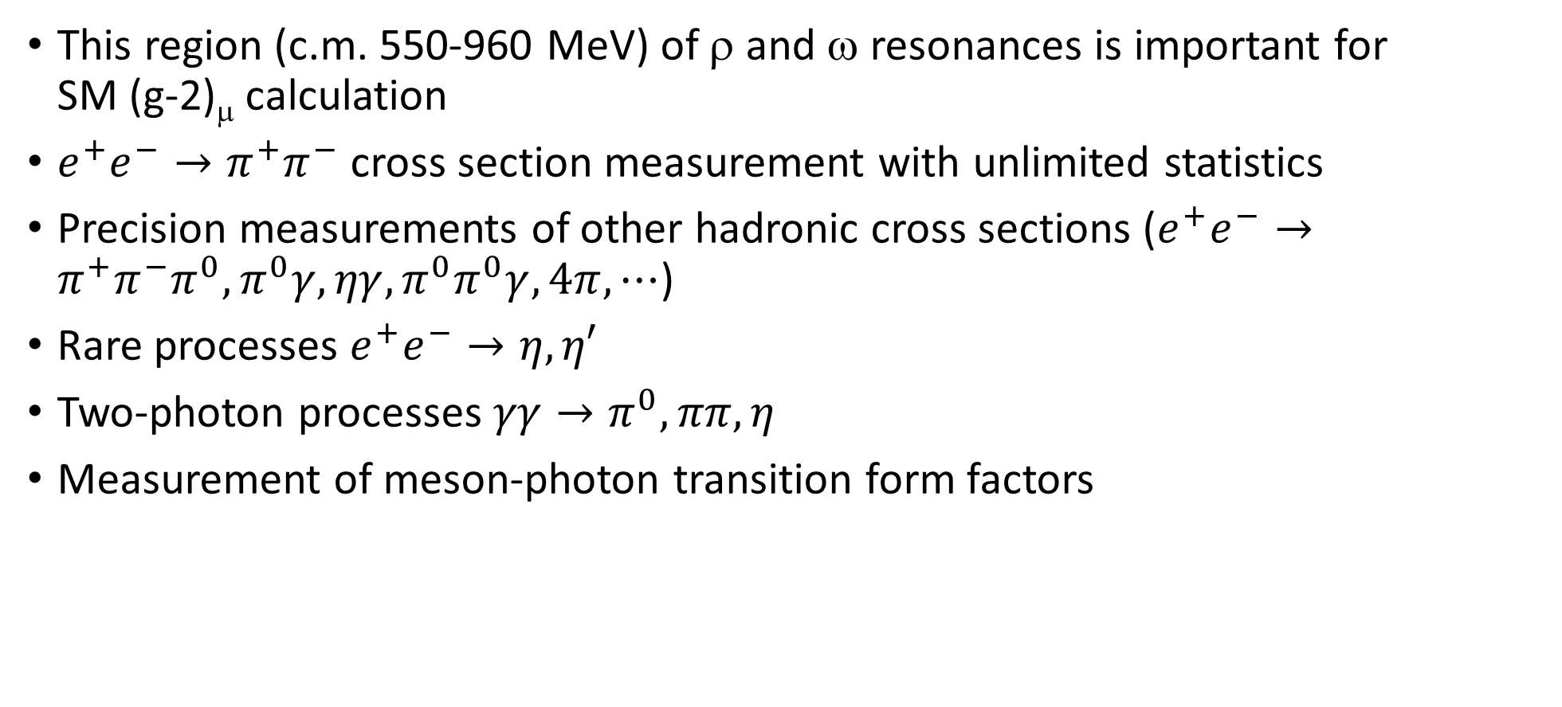
Experiments: 15° crossing angle
This region (c.m. 550-960 MeV) of ρ and ω resonances is important for SM (g-2)_{μ} calculation
$e^{+}e^{−}→π^{+}π^{−}$ cross section measurement with unlimited statistics
Precision measurements of other hadronic cross sections ($e^{+}e^{−}→π^{+}π^{−}π^{0},π^{0}γ,ηγ,π^{0}π^{0}γ,4π,⋯$)
Rare processes $e^{+}e^{−}→η,η′$
Two-photon processes $γγ→π^{0},ππ,η$
Measurement of meson-photon transition form factors

Slide 27
Reverse beam: 15° crossing angle
Beam energy | 283.59 MeV (η) | 495.78 MeV (η′)
Invariant mass (M) | 547.86 MeV | 957.76 MeV
σ_{M} (σ_{M}/M) | 420 keV ( 7.7×10⁻⁴ ) | 580 keV ( 6.1×10⁻⁴ )
Energy spread | 2.8×10⁻⁴ / 10.6×10⁻⁴ (IBS) | 4.8×10⁻⁴ / 8.4×10⁻⁴ (IBS)
IP beam divergence (hor) | 8.3×10⁻⁴ | 7.1×10⁻⁴
Horizontal emittance | 11.4 nm / 105 nm (IBS) | 34.8 nm / 75 nm (IBS)
Bunch length | 3.7 mm / 14.2 mm (IBS) | 6.3 mm / 11 mm (IBS)
Beam-beam ξ (h/v/l) | 3×10⁻⁴ /1.4×10⁻² /-2×10⁻³ | 3×10⁻⁴ /1.3×10⁻² /-2×10⁻³
Synchrotron tune | 1.67×10⁻² | 1.71×10⁻²
Luminosity (Nb=1 / 30) | 3.3×10³¹ / 9.9×10³² | 5.2×10³¹ / 1.5×10³³

Slide 28
Conclusion
Collider to observe and study bound state of (μ⁺μ⁻)
  two rings, large crossing angle
  circumference 29 m, not expensive to build and operate
  luminosity 8×10³¹ cm⁻²s⁻¹
Reverse of the beam allows experiments in 500-1000 MeV central mass energy range
Geometry is optimized to fit the present hall.
Dynamic aperture and energy acceptance are sufficient for injection and beam life time.
Details are in https://doi.org/10.1051/epjconf/201818101032
https://pos.sissa.it/314/810/pdf and https://arxiv.org/abs/1708.05819
We are open for collaboration and experiments proposals

