Slide 1


Introduction into Machine Learning challenges for Particle Physics
MISP, Voronovo, 3 March, 2020
Andrey Ustyuzhanin

Slide 2



Quick self-intro
  Head of LHCb Yandex School of Data Analysis (YSDA) team
  Head of Laboratory (link) of methods for Big Data Analysis at Higher School of Economics
    Applications of Machine Learning to natural science challenges
  Co-organizer of ML for HEP challenges: Flavours of Physics Kaggle competitions (2015), TrackML (2018)
  Education activities (MLHEP, ML at ICL, ClermonFerrand, URL Barcelona, Coursera)

Slide 3
CERN
The world largest international laboratory
More than 20 experiments – international collaborations
Birthplace of the WWW
Large Hadron Collider – arena for the Universe models contest

Slide 4
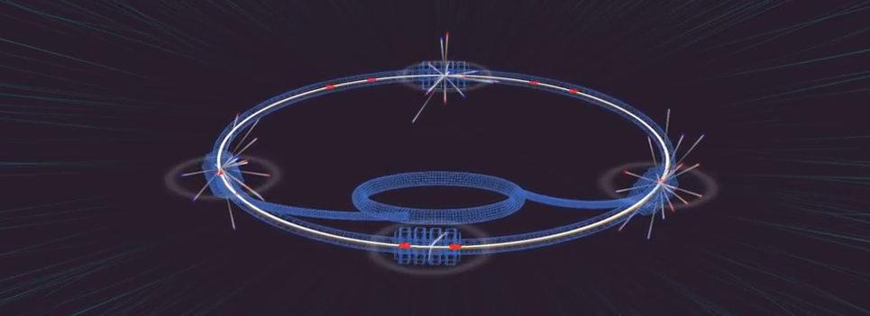
ABC of LHC
27 km-long tunnel, 50-175 meters deep
Proton speed: 0,99999999 c
Total collision Energy: up to 14 TeV
4 “big” detectors: ALICE, ATLAS, CMS, LHCb
40 mln bunch collisions per second
Tens of petabytes of data per year
PostScience/https://postnauka.ru/animate/83458

Slide 5
Main stages
Create protons out of Hydrogen, accelerate to 0,99999999 c
Smash bunches of protons (‘events’)
Convert raw detector information into ‘hits’ (pixels)
Reconstruct particle trajectories – ‘tracks’, ‘jets’, ‘showers’
Identify types of particles
Reconstruct decay structure
Filter meaningful events
Analyse statistical properties

Slide 6
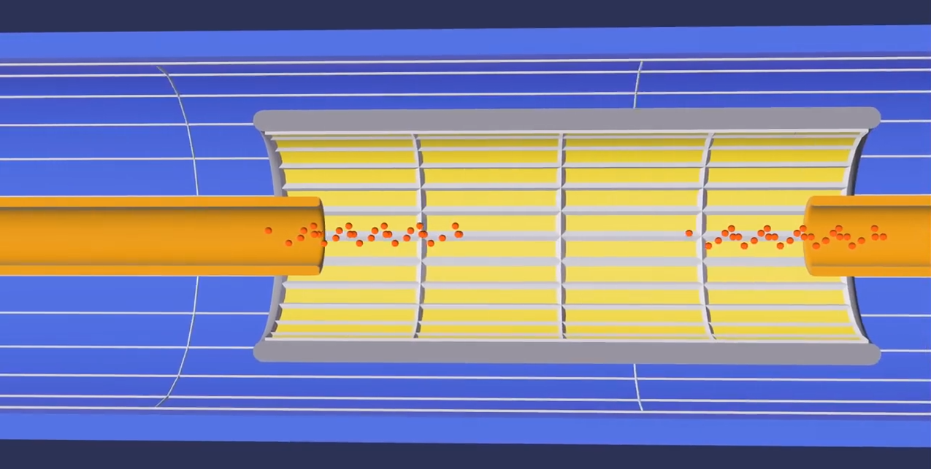
Smashing Protons
PostScience/https://postnauka.ru/animate/83458

Slide 7
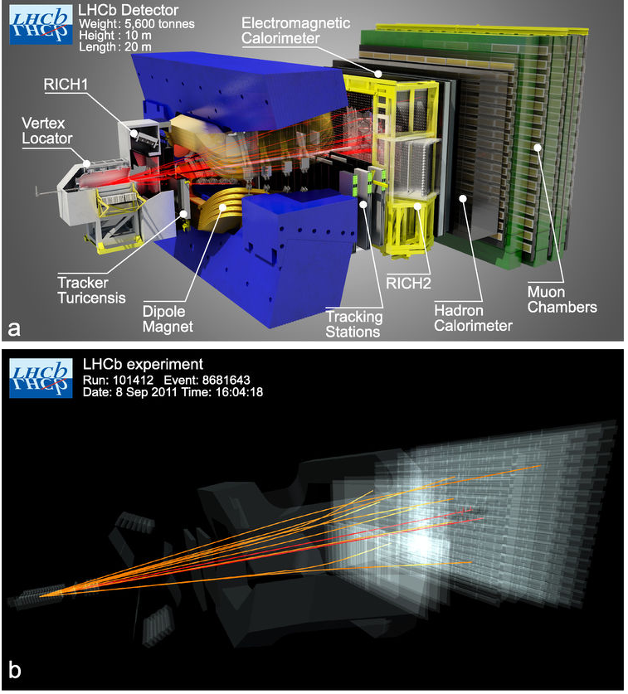
Detector: Sub-atomic Digital Camera
http://go.nature.com/2prxxGY

Slide 8
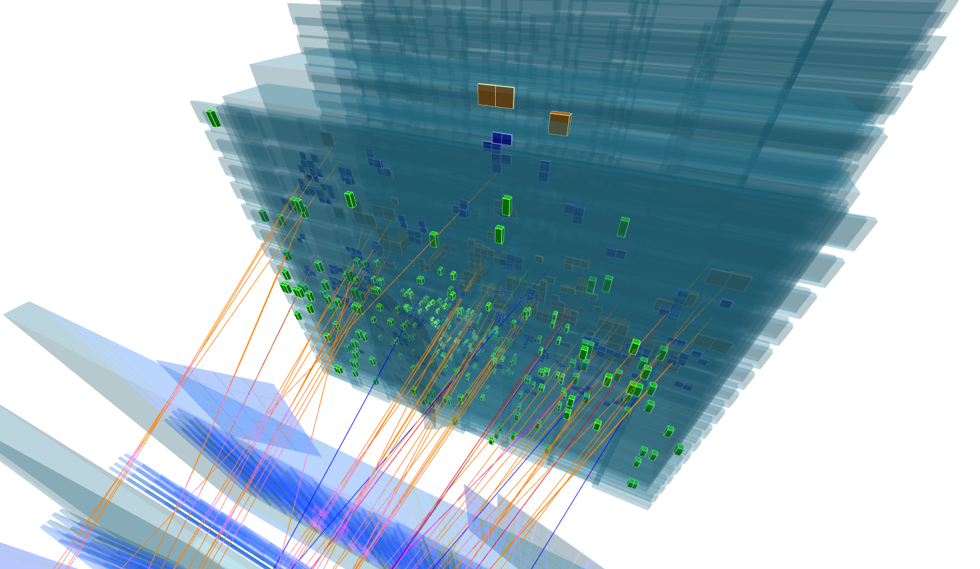
Pixels

Slide 9
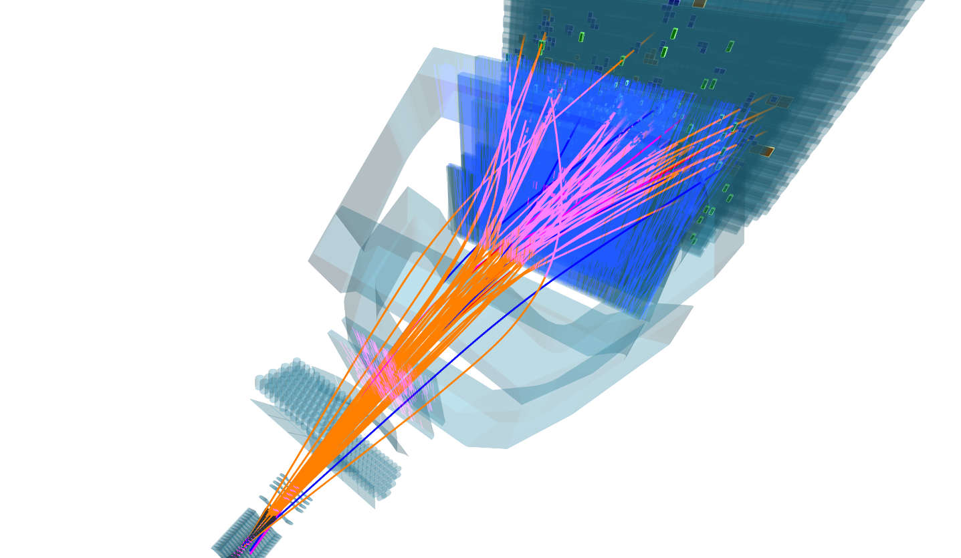
Tracks

Slide 10
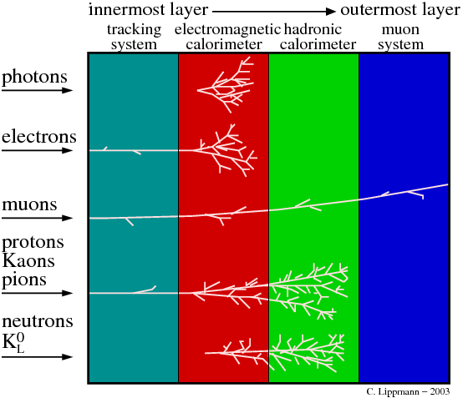
Particle Identification
Lippmann / https://inspirehep.net/record/884672/plots

Slide 11
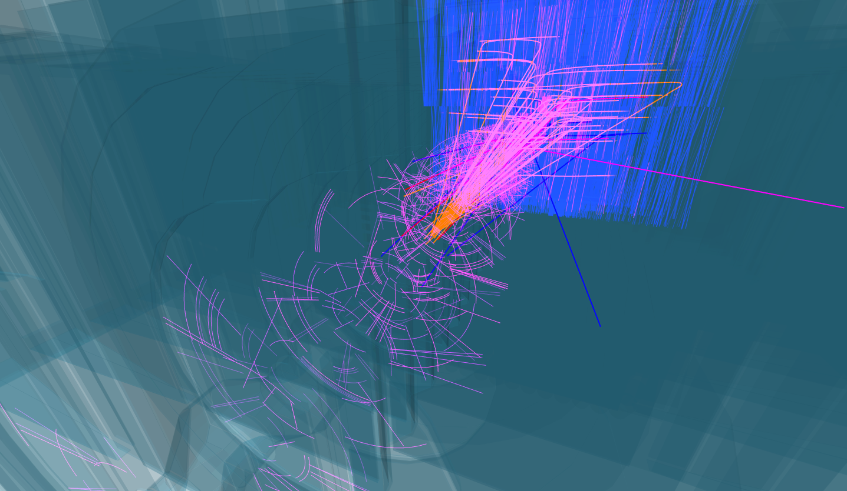
Decay Reconstruction

Slide 12
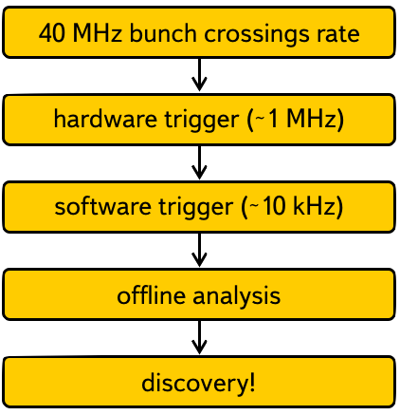
Triggers

Slide 13
Machine Learning Challenges
Precise and fast particle tracking:
  single tracks, shower, jets.
Particle identification;
Fast and accurate online data processing and filtering;
Anomaly detection:
  data quality monitoring;
  infrastructure monitoring.
Detector design optimization (bayesian optimization, surrogate modelling).

Slide 14
Machine Learning Intro
<different deck>

Slide 15
Particle Identification Example

Slide 16
Overview
Ring Imaging Cherenkov
Electromagnetic Calorimeter
Hadron Calorimeter
Muon Chambers
Momentum and charge estimation
Energy and particle type estimation

Slide 17
Overview
Lippmann / https://inspirehep.net/record/884672/plots

Slide 18
Problem statement
The goal of the particle identification (PID) is to identify a type of a particle associated with a track using responses from different subdetectors.
There are 5 particle types: Electron ( ), Proton ( ) ,Kaon ( ),
Pion ( ), Muon ( ).
Subdetectors:
Tracking system
Ring Imaging Cherenkov detector (RICH)
Electromagnetic calorimeter (ECAL)
Hadron calorimeter (HCAL)
Muon Chambers

Slide 19
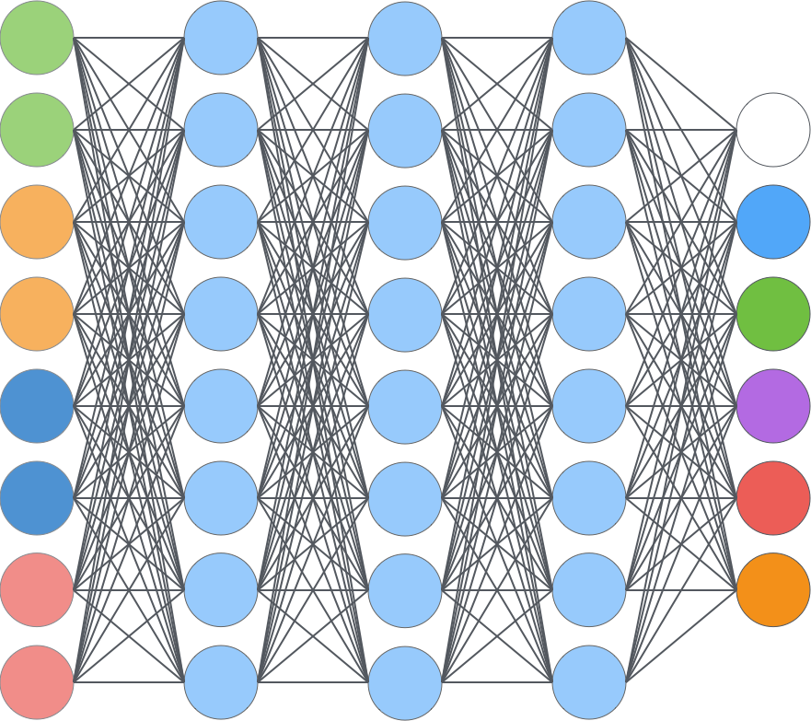
General idea
Particle identification is multiclass problem in machine learning:
Muon Chambers
Ghost
RICH
ECAL & HCAL
Tracking System

Slide 20
Tracking system features
Particle momentum
Particle charge
Track parameters
Quality of track fit
Number of track hits
…

Slide 21
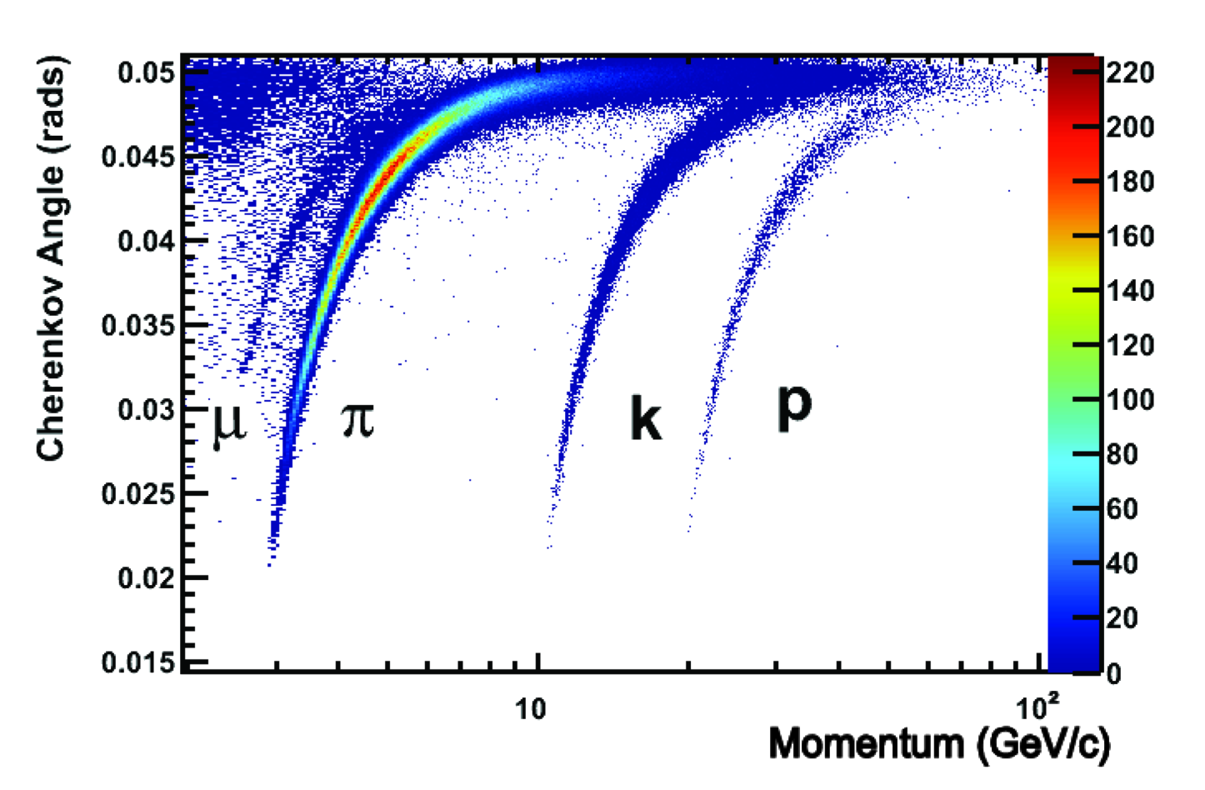
RICH features
Angle
Quality of angle reconstruction
Reconstructed particle type
Reconstructed particle energy
Light intensity
…
LHCb / https://cds.cern.ch/record/1495721

Slide 22
Calorimeter features
Measured particle enegry
Shower parameters: ,width, ...
Number of clusters in each layer
Intensity of the clusters
Distance form track of the original particle
…
Cluster

Slide 23
Muon chambers features
Muon track parameters
Quality of track fit
Number of active chambers
Distance between the track and the active chambers
…
Metal

Slide 24
Machine learning in PID
Particle identification is multiclass problem in machine learning:
Muon Chambers
Ghost
RICH
ECAL & HCAL
Tracking System

Slide 25
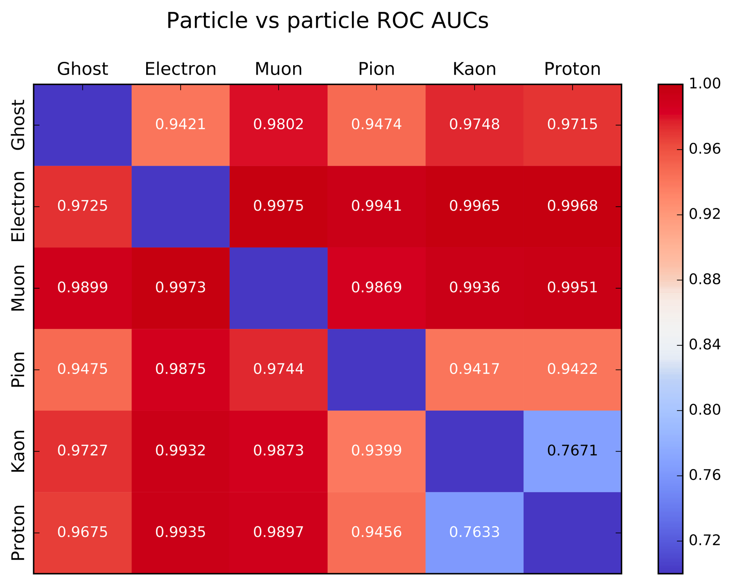
Machine learning in PID
In modern experiments the particles are recognized very well:

Slide 26
Testing Hypotheses Experimentally

Slide 27
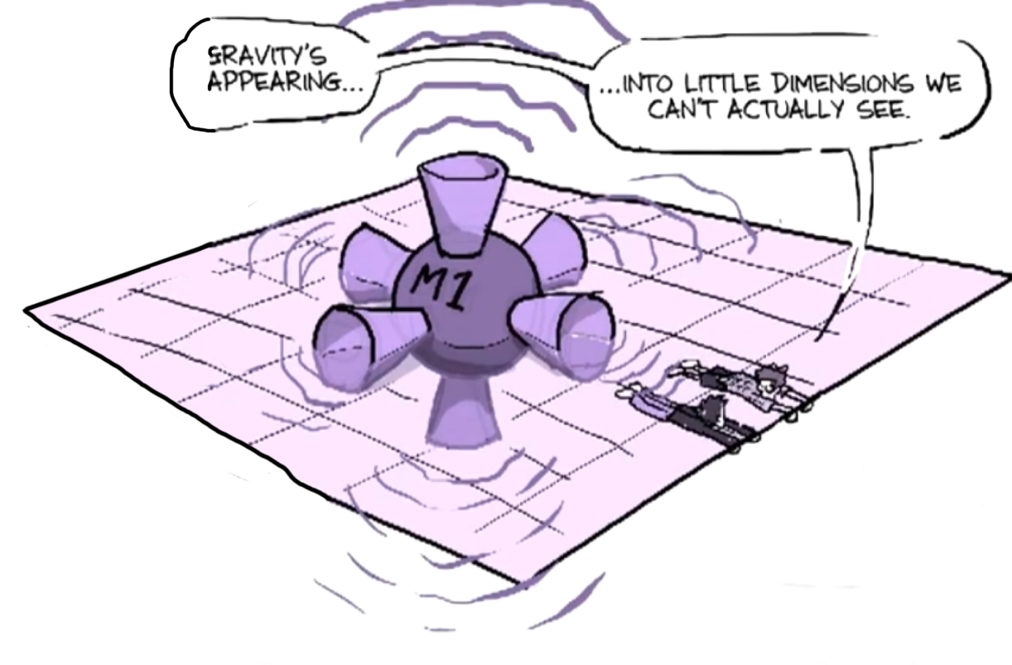
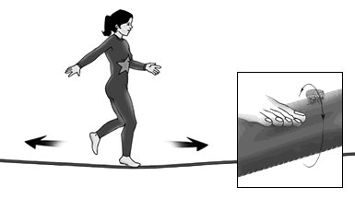
Extra Dimensions
Why is gravity so much weaker than the other forces?
Large Extra Dimension (LED models)
Graviton
Micro black-holes
https://www.youtube.com/watch?v=BMvT2sriq34

Slide 28
Theory Graveyard
QFTHEP2015/ http://bit.ly/2FkadnH

Slide 29
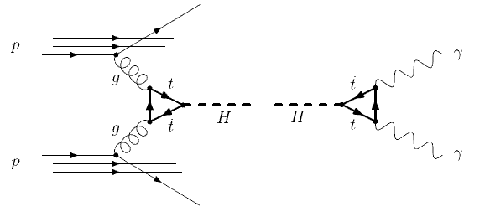

Looking for Higgs Boson
Looking for:
https://cds.cern.ch/record/2230893

Slide 30
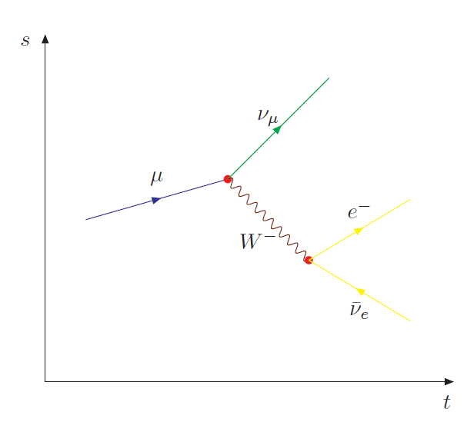
Feynman Diagrams Detour
Decay of a muon into a particle and a muon neutrino
Notes:
\mu \to \nu_{\mu} W^- \to e^- \bar{\nu}_e

Slide 31
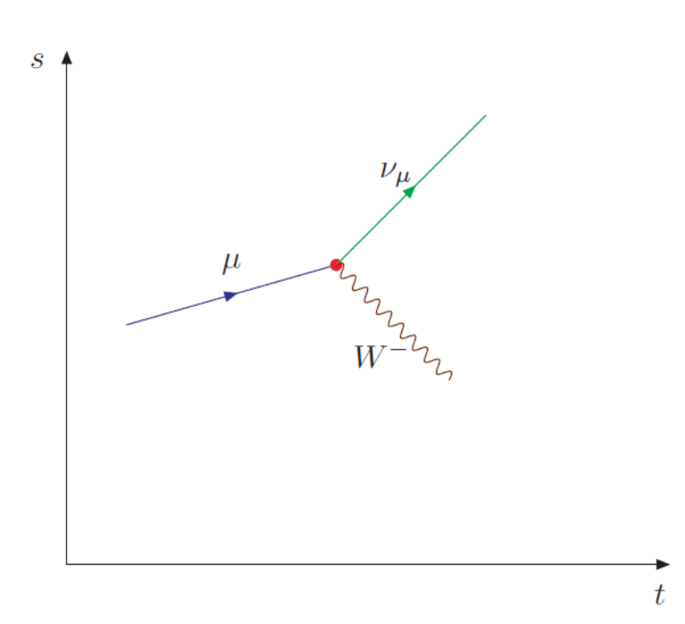
Feynman Diagrams Detour
Interaction points are represented by vertices (red). It also mark places where charge, momentum and energy conservation must be valid

Slide 32
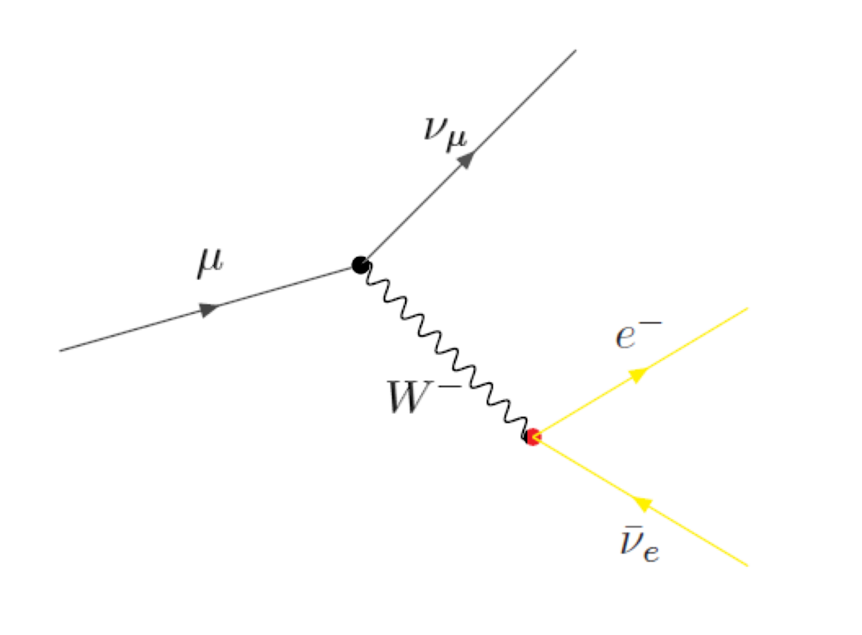
Feynman Diagrams Detour
The secondary vertex shows the creation of particles. Here, the
particle transforms into an electron and an electron anti-neutrino.

Slide 33
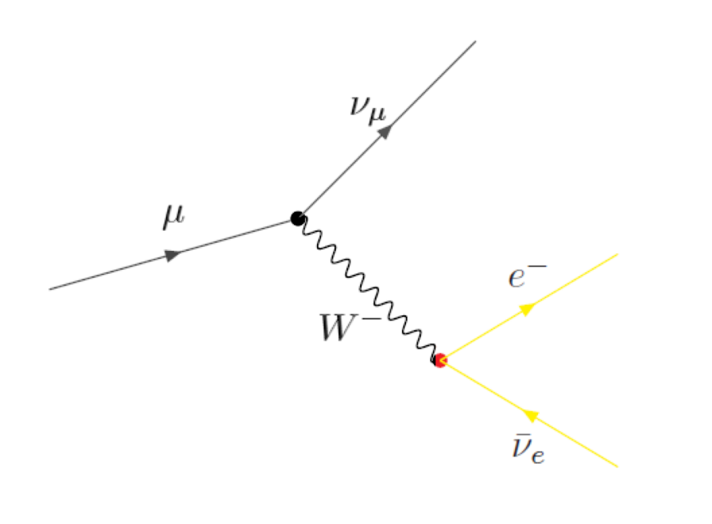
Feynman Diagrams Detour
Represent quantum process (space and time)
Based on Quantum Field Theory
Consist of
  elementary particles (straight lines)
  Force representatives (bosons, wavy lines)
Vertex represent interaction point
  Conservation of energy and momenta
Allows for calculation of probability of the process

Slide 34
Z Boson
Mediates weak interactions along with W-bosons
Can decay into:
  lepton, anti-lepton pair (10%)
  Neutrino, anti-neutrino pair (20%)
  Quark, anti-quark (70%)
  http://pdglive.lbl.gov/Particle.action?init=0&node=S044
Important part of SM jigsaw puzzle
Discovered in 1983 at CERN

Slide 35
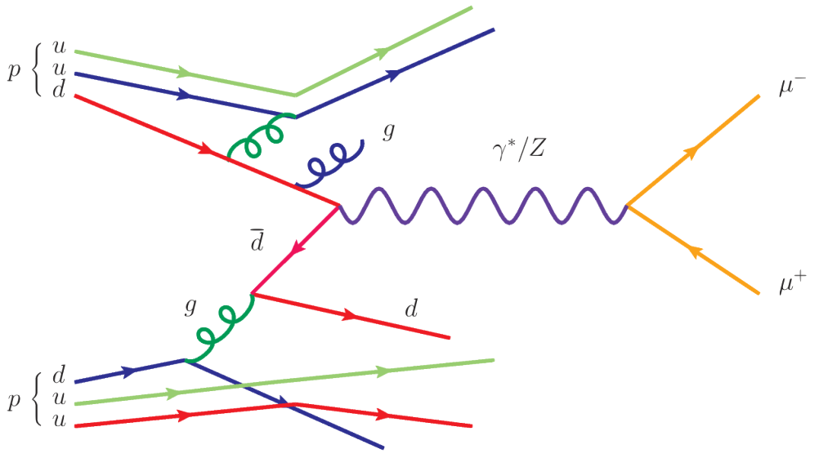
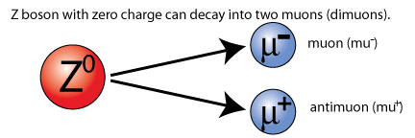
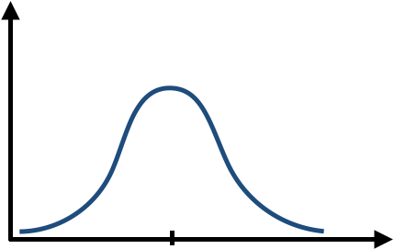

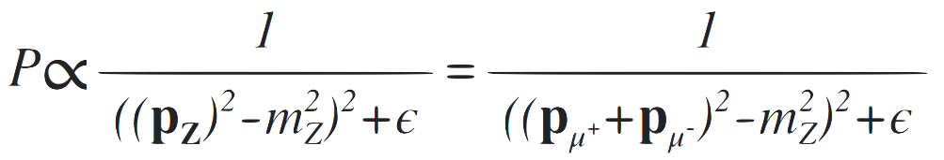
Process Probability Estimation
Process of particle (Z) decay is called resonance and its probability can be estimated from the diagram:
http://www.quantumdiaries.org/author/richard-ruiz/

Slide 36
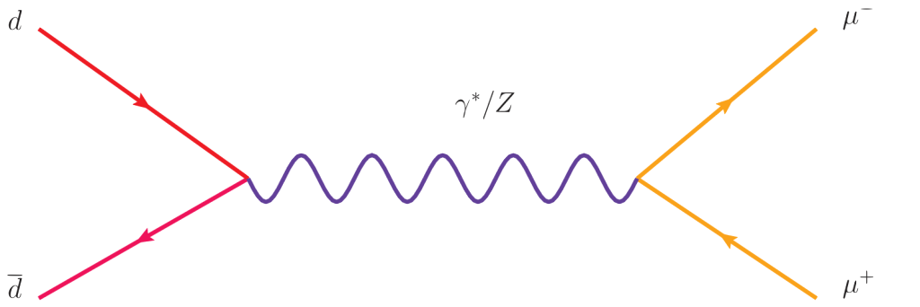
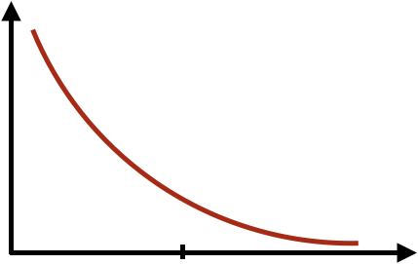
Background
(Drell-Yan process)

Slide 37
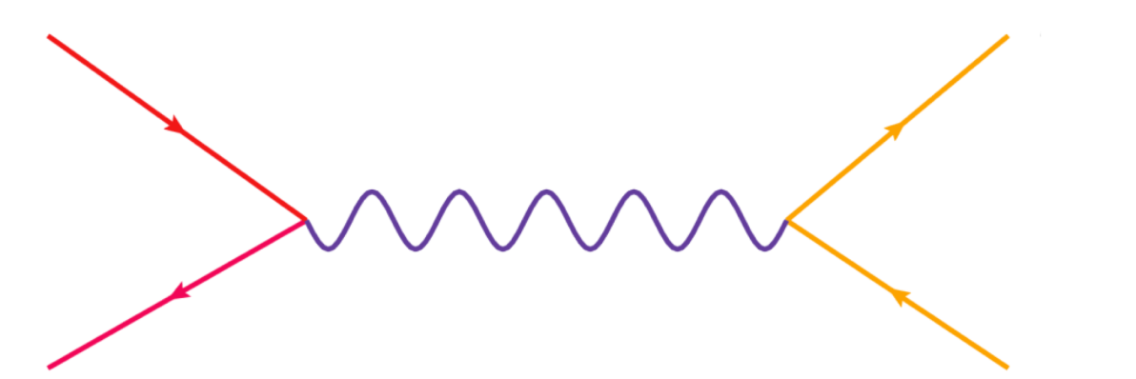
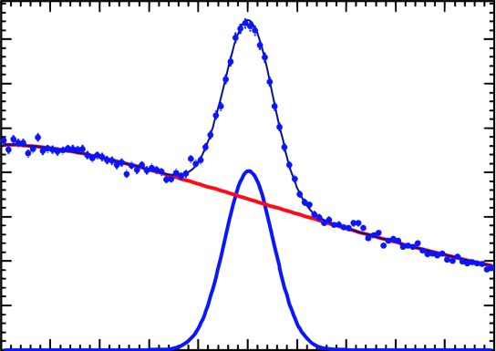
Signal and Background
Signal:
Background: (Drell-Yan)
+
=

Slide 38
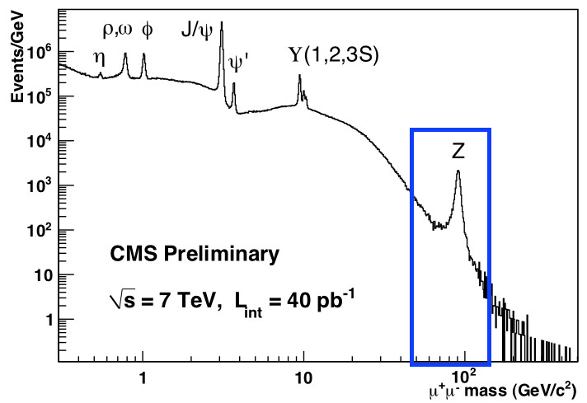
Dimuon Mass Spectrum

Slide 39
Particle Physics Simulation

Slide 40
Simulation in Physics Data Analysis
Source of the precise information on particle decays
Predecessor of data
Reconstructed
Decays
“Information” per object
Decay Simulation
Particle Tracks and Vertices
Reconstructed
Verteces
Reconstructed Tracks
Energy Deposition
Hits & Digits
Reconstructed
Energy Clusters
Raw Data
Processing stage
Based on F. Carminati, K. Cranmer, V. Innocente

Slide 41
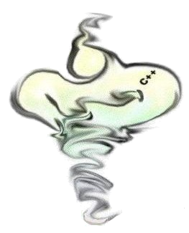
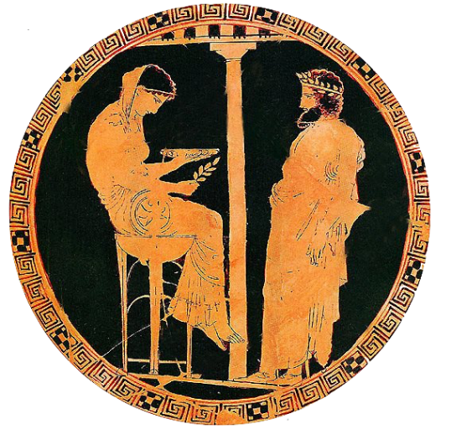

Simulation Packages
http://genie.hepforge.org/
http://home.thep.lu.se/Pythia/
https://geant4.web.cern.ch/geant4/
Much more at https://arxiv.org/pdf/1101.2599.pdf

Slide 42
Machine Learning Challenge Examples
Precise and fast particle tracking:
  single tracks, shower, jets.
Particle identification;
Fast and accurate online data processing and filtering;
Anomaly detection:
  data quality monitoring;
  infrastructure monitoring.
Detector design optimization (bayesian optimization);
Data Analysis (signal from background separation);
Simulation:
  speed-up simulation using generative models;
  simulator parameters optimization (tuning).

Slide 43
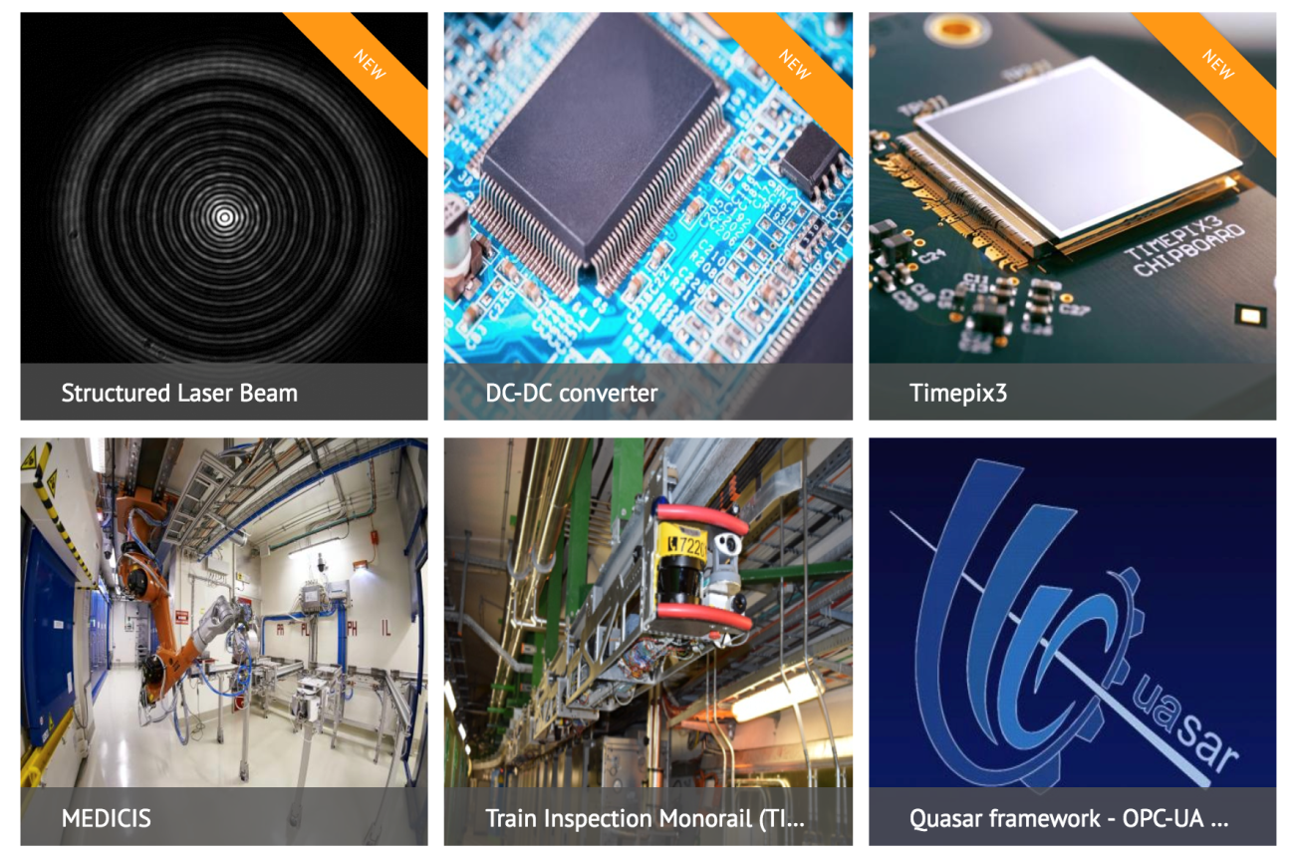
Science ➝ Industry ➝ Humanity
WWW, Internet
Muon tomography
Aerospace
Cryogenics,
ultra vacuum
Medicine:
  Ion radiotherapy
  Hadron therapy
Simulation toolkits (GEANT4, FLUKA)
https://kt.cern/technologies

Slide 44
Conclusion
LHC is a huge sub-atomic microscope with lots of twists
Search for the most basic components we are made of
Solid theoretical foundation
  still not complete (yet)
Plenty of Machine Learning challenges
  Data analysis
  Data stream processing
  Simulation tuning and speed-up
  Experiment design and optimization

Slide 45
Andrey Ustyuzhanin
austyuzhanin@hse.ru
anaderiRu @Telegram

Slide 46
Backup

Slide 47
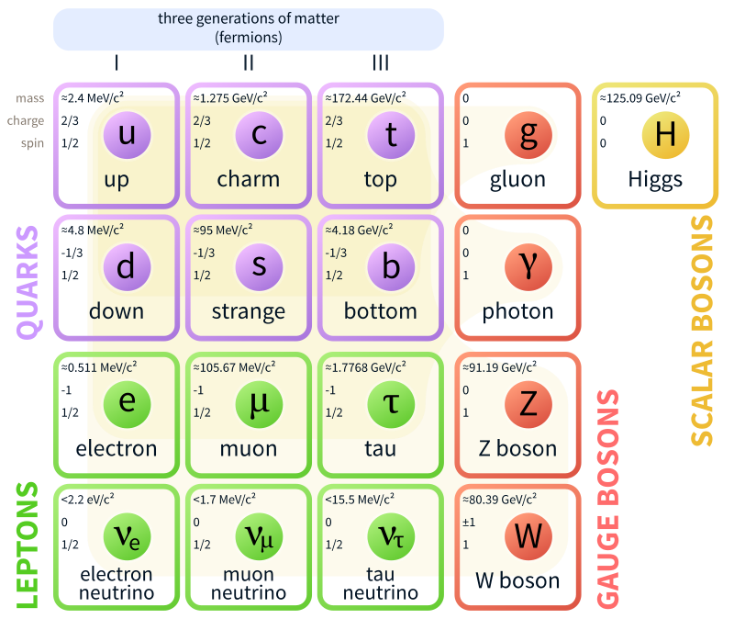
Standard Model (SM) of Elementary Particles
https://simple.wikipedia.org/wiki/Standard_Model

Slide 48
Standard Model (SM) Shortcomings
Gravity not included! Why gravity is so much weaker than everything else?
Why masses of particles differ so massively?
SM misses great deal of the Universe: No Dark Matter candidate. Can’t explain Dark Energy.
SM requires 19 unrelated and arbitrary parameters (e.g. lepton (electron, muon) masses)...Why these values?
Also the asymmetry between matter and anti-matter is too negligible according to the SM to explain why we exist!

