Slide 1
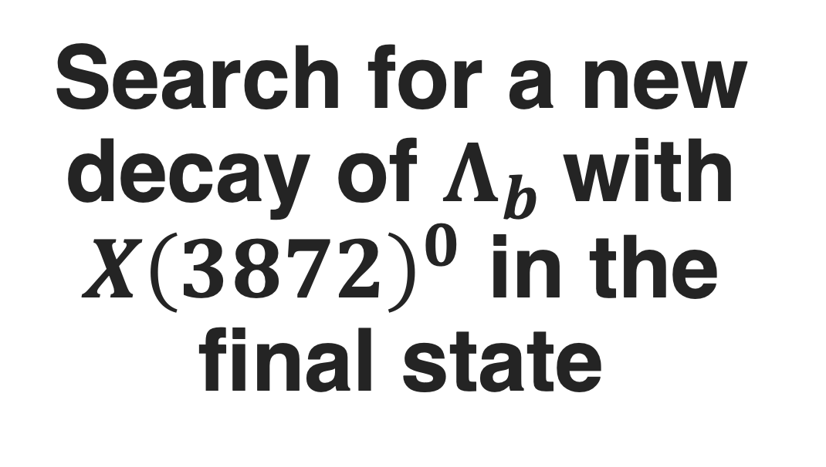
Search for a new decay of $Λ_{b}$with $X{\left(3872\right)}^{0}$ in the final state
Aleksandr Tulupov ^{1,2}, Sergey Polikarpov^{1,2}
¹LPI RAS, ²NRNU MEPhI

Slide 2
Outline
Motivation
Introduction & pre-selection
ML: algorithm, strategy, performance
Fitting: model, results
Sensitivity to the observation
Notes:
0-2 min
2-3 min
3-6 min
6-9 min
9-10 min

Slide 3
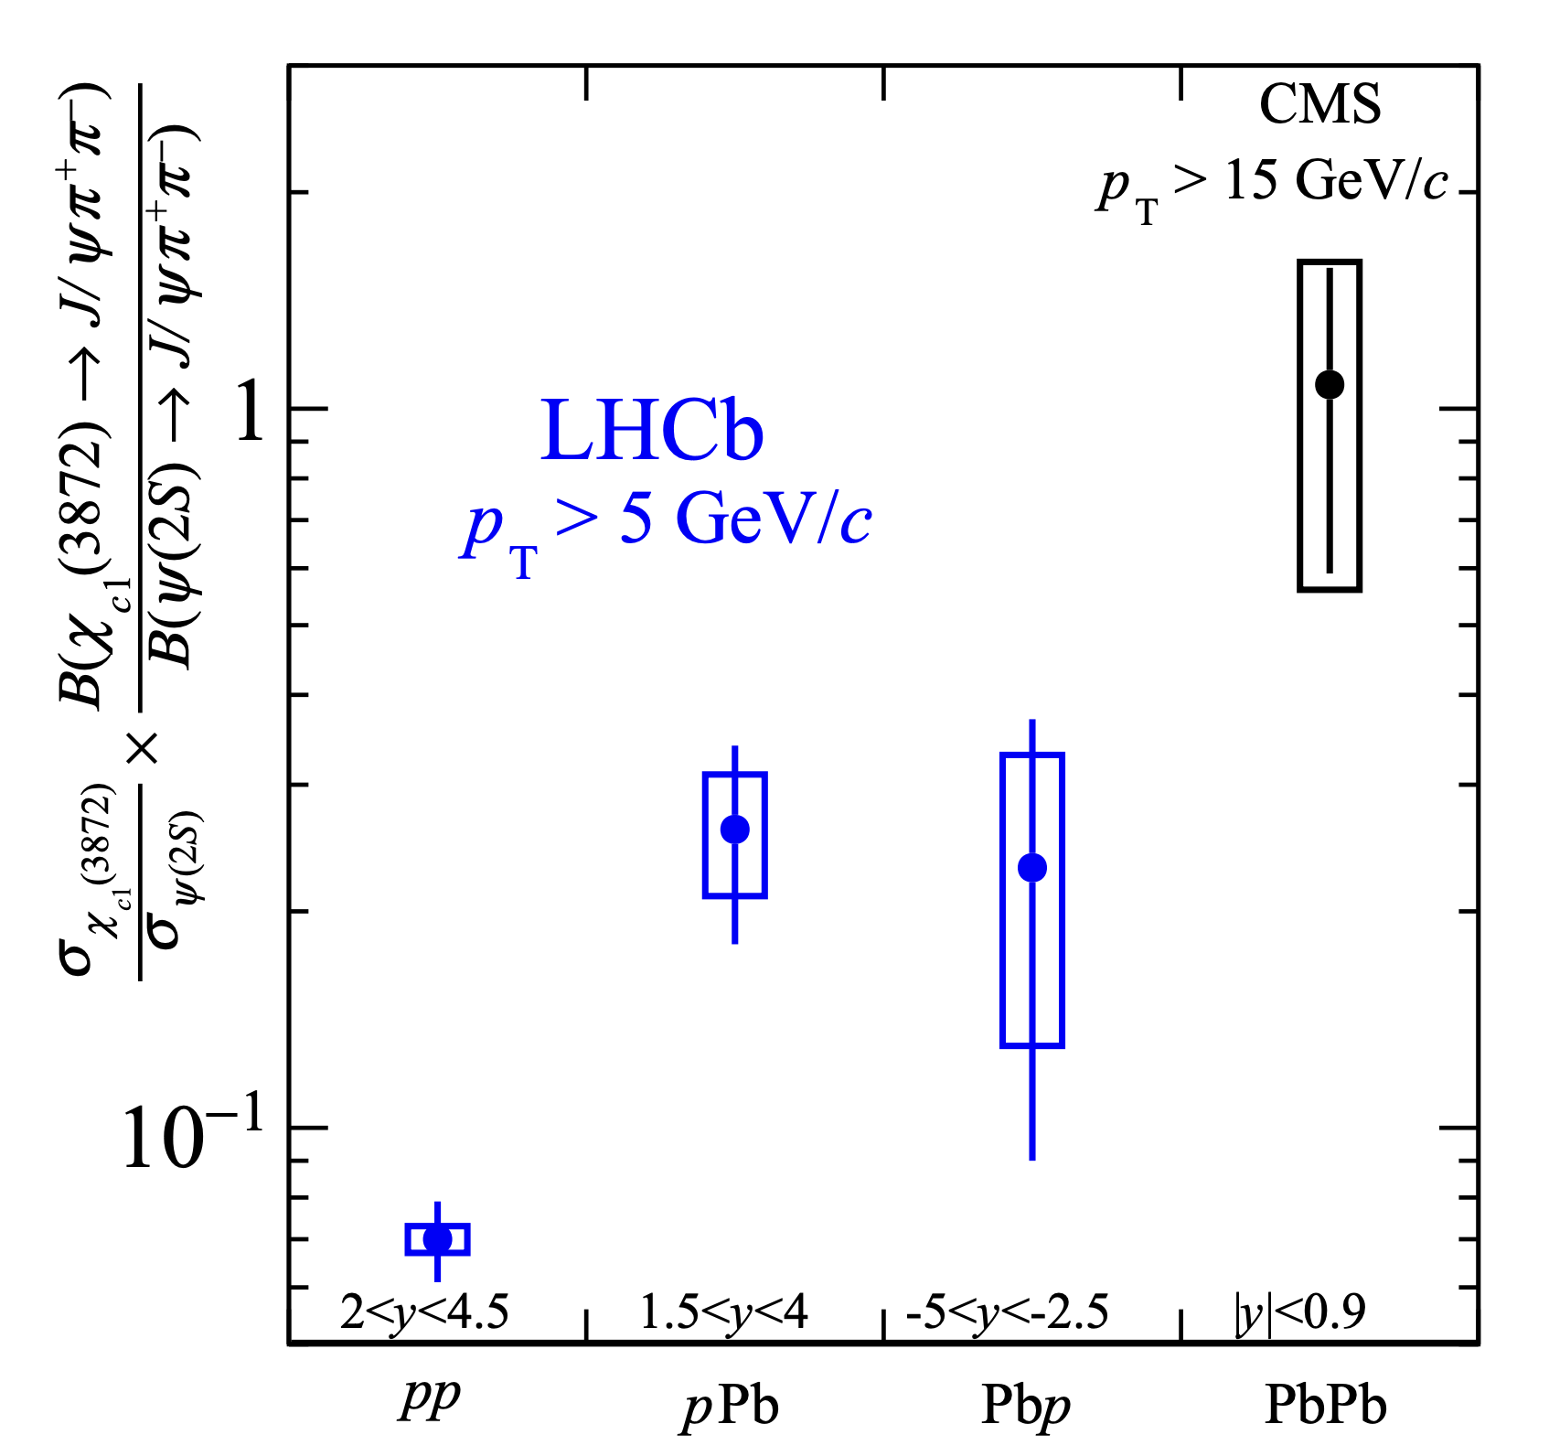
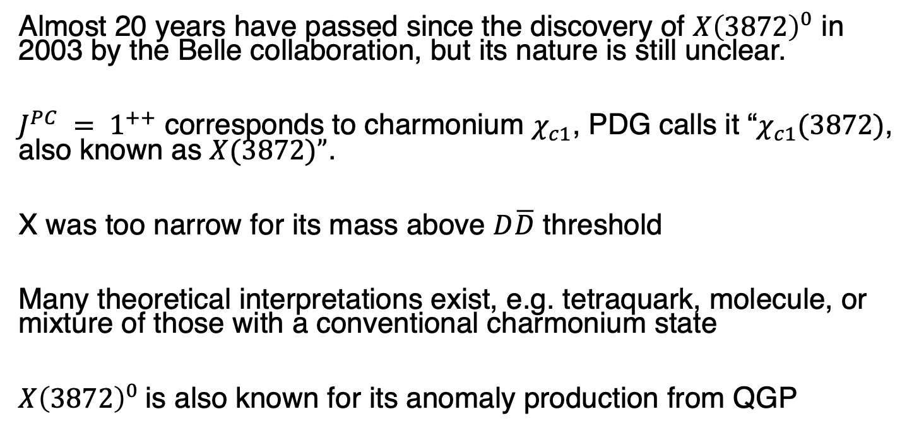
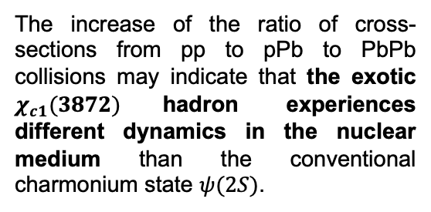
Motivation
Almost 20 years have passed since the discovery of $X{\left(3872\right)}^{0}$ in 2003 by the Belle collaboration, but its nature is still unclear.
$J^{PC} = 1^{++}$ corresponds to charmonium $χ_{c1}$, PDG calls it “$χ_{c1}(3872)$, also known as $X(3872)”$.
X was too narrow for its mass above $D\overline{D}$ threshold
Many theoretical interpretations exist, e.g. tetraquark, molecule, or mixture of those with a conventional charmonium state
$X{\left(3872\right)}^{0}$is also known for its anomaly production from QGP
The increase of the ratio of cross-sections from pp to pPb to PbPb collisions may indicate that the exotic $χ_{c1}(3872)$hadron experiences different dynamics in the nuclear medium than the conventional charmonium state $ψ(2S)$.
Notes:
Экзотика, чем интересна
Показать картинку про X из Сережиной статьи

Slide 4
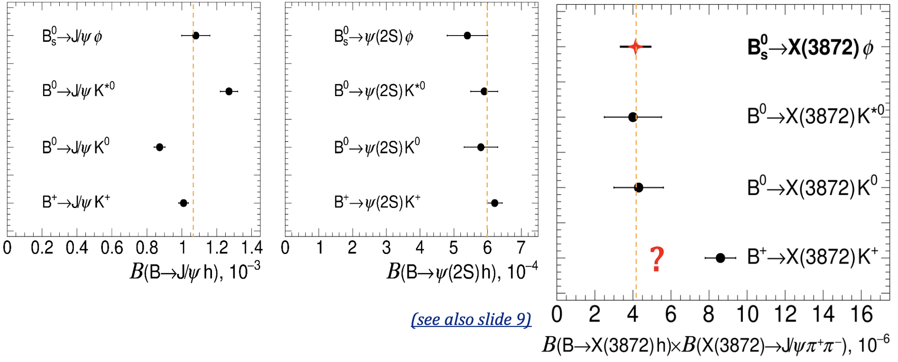

Motivation
In 2020, CMS showed a discrepancy in $B→Xh$ productions.
The discrepancy was explained in diquark-diquark model
S. Polikarpov, 2020
Measurement of its production in $Λ_{b}$ decays helps understanding the properties of $X{\left(3872\right)}^{0}$, in particular dynamics of its formation in B hadron decays

Slide 5
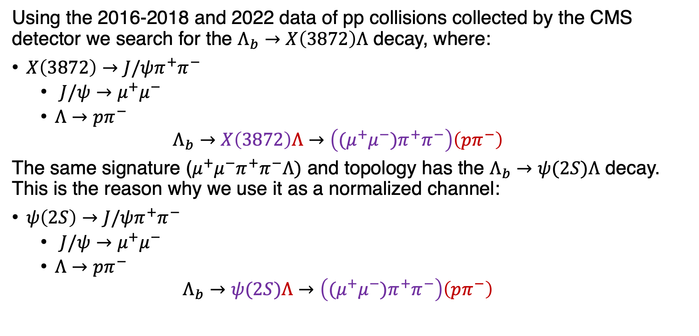
Introduction
Using the 2016-2018 and 2022 data of pp collisions collected by the CMS detector we search for the $Λ_{b}→X\left(3872\right)Λ$ decay, where:
$X\left(3872\right)→J/ψπ^{+}π^{−}$
  $J/ψ→μ^{+}μ^{−}$
  $Λ→pπ^{−}$
  $$Λ_{b}→X\left(3872\right)Λ→\left({(μ}^{+}μ^{−})π^{+}π^{−}\right)\left(pπ^{−}\right)$$
The same signature ($μ^{+}μ^{−}π^{+}π^{−}Λ)$ and topology has the $Λ_{b}→ψ(2S)Λ$ decay. This is the reason why we use it as a normalized channel:
$ψ\left(2S\right)→J/ψπ^{+}π^{−}$
  $J/ψ→μ^{+}μ^{−}$
  $Λ→pπ^{−}$
  $$Λ_{b}→ψ(2S)Λ→\left({(μ}^{+}μ^{−})π^{+}π^{−}\right)\left(pπ^{−}\right)$$

Slide 6
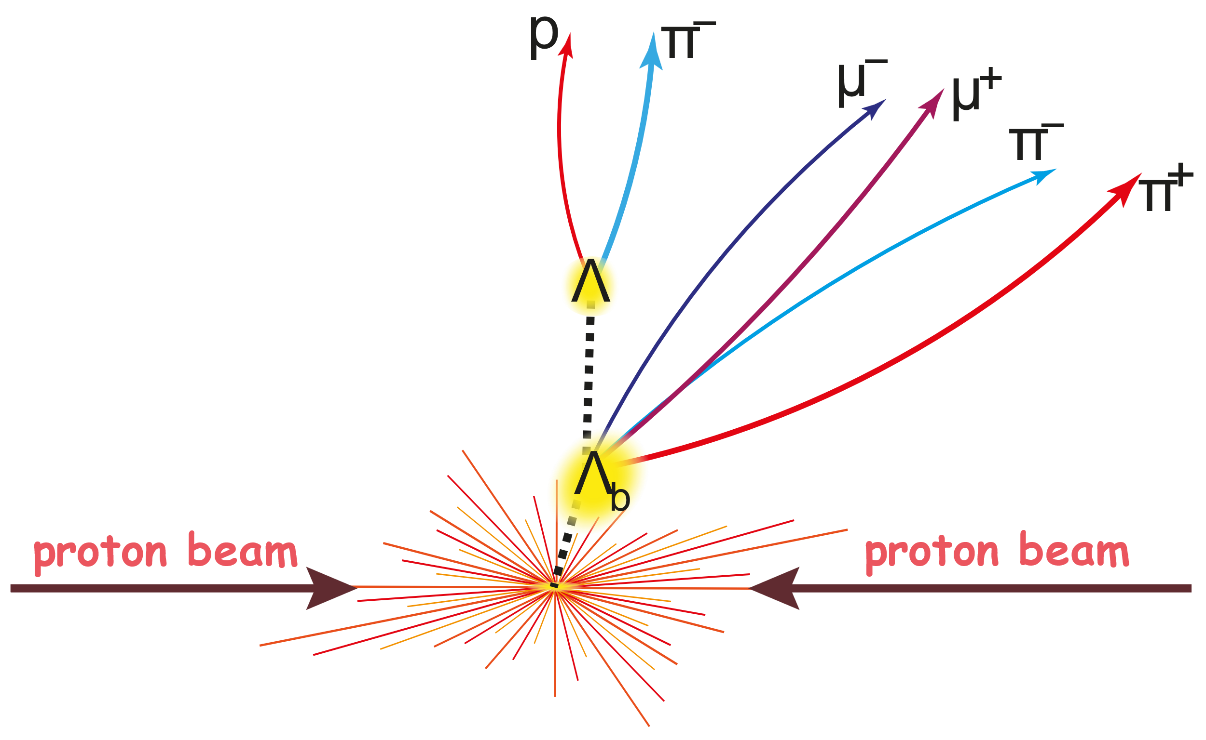

Pre-Selection
$$p_{T}\left(μ\right)>3 GeV p_{T}\left(π\right)>0.4 GeV{ p}_{T}\left(Λ_{b}\right)>1GeV$$
$$\left|η\left(μ\right)\right|<2.4 \left|η\left(π\right)\right|<3$$
$$5.5 GeV<m\left(Λ_{b}\right)<5.8 GeV$$
$$3.4 GeV<m\left(J/ψπ^{+}π^{−}\right)<4.0 GeV$$
Every vertex fit probability exceeds 1%
Distance significance between $Λ$ and $Λ_{b}$ exceeds 10 standard deviations
Distance significance between $Λ_{b}$ and PV exceeds 1 standard deviations

Slide 7
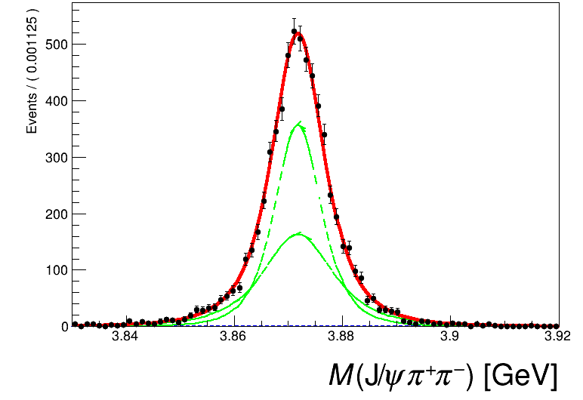
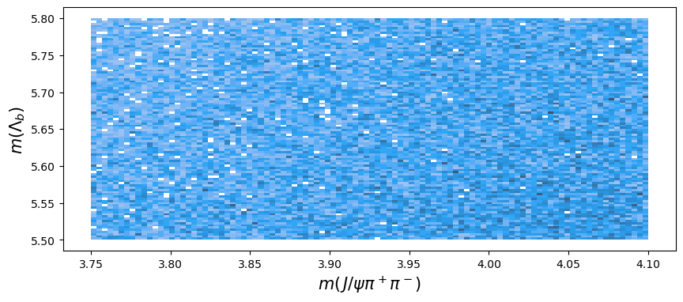
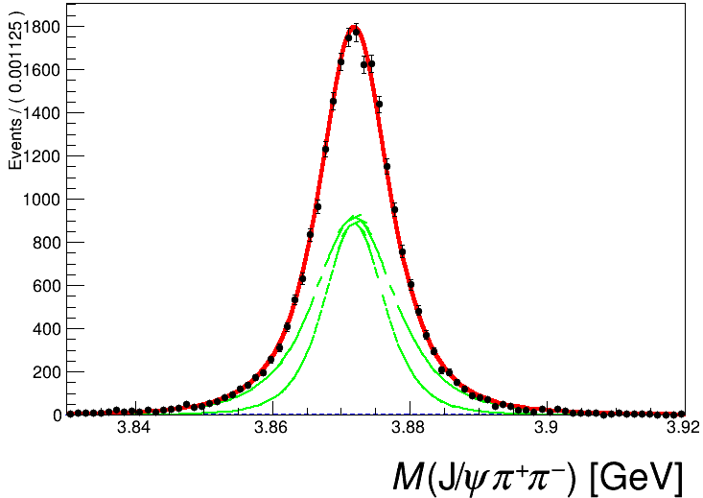
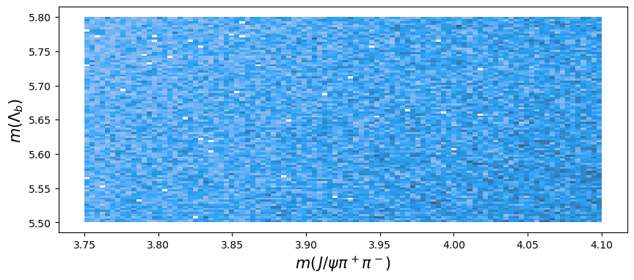
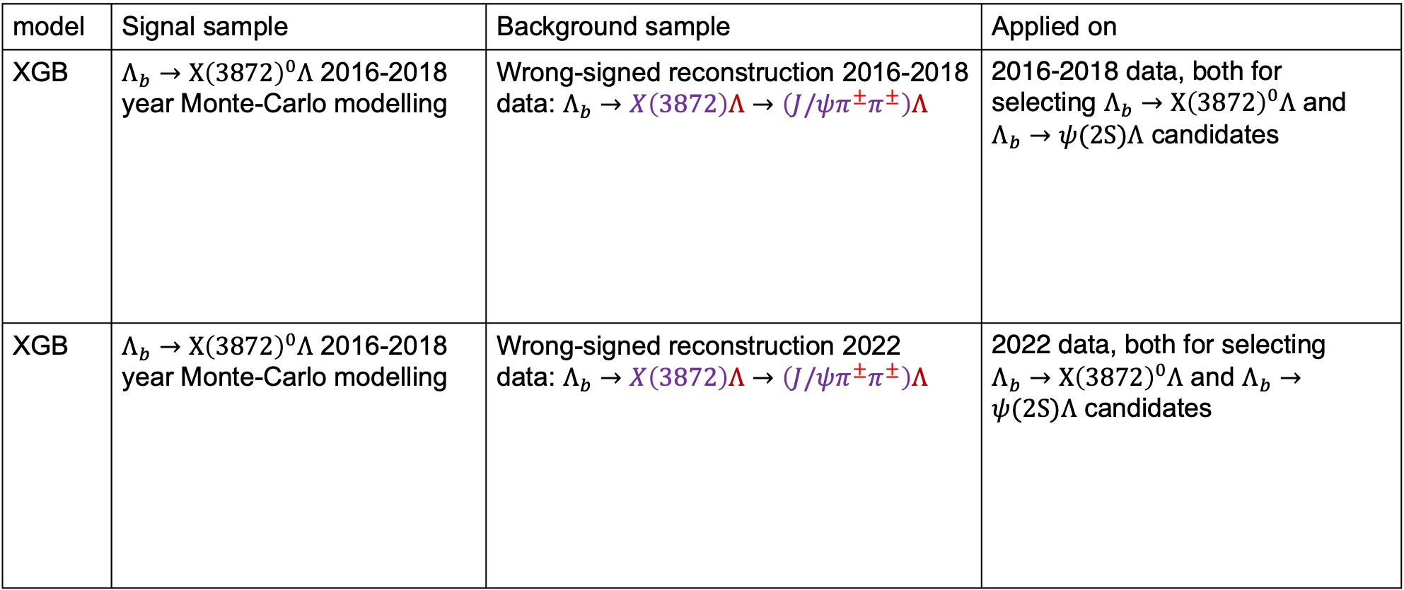
ML: Strategy
We use binary classifier based on XGB algorithm for background suppression
model | Signal sample | Background sample | Applied on
XGB | $Λ_{b}→X{\left(3872\right)}^{0}Λ$ 2016-2018 year Monte-Carlo modelling | Wrong-signed reconstruction 2016-2018 data: $Λ_{b}→X\left(3872\right)Λ→\left(J/ψπ^{±}π^{±}\right)Λ$ | 2016-2018 data, both for selecting $Λ_{b}→X{\left(3872\right)}^{0}Λ$ and $Λ_{b}→ψ(2S)Λ$ candidates
XGB | $Λ_{b}→X{\left(3872\right)}^{0}Λ$ 2016-2018 year Monte-Carlo modelling | Wrong-signed reconstruction 2022 data: $Λ_{b}→X\left(3872\right)Λ→\left(J/ψπ^{±}π^{±}\right)Λ$ | 2022 data, both for selecting $Λ_{b}→X{\left(3872\right)}^{0}Λ$ and $Λ_{b}→ψ(2S)Λ$ candidates
Private work (CMS simulation)
Private work (CMS data)
Private work (CMS simulation)
Private work (CMS data)
Notes:
We train different XGBs for Run-II and Run-III, because of different triggers

Slide 8
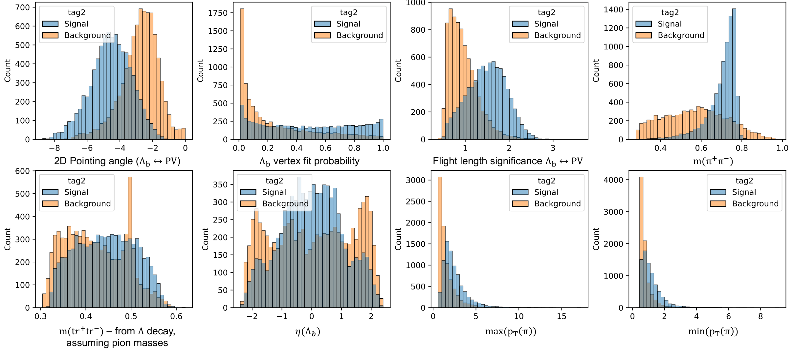
ML: Features
Private work (CMS data and simulation)

Slide 9
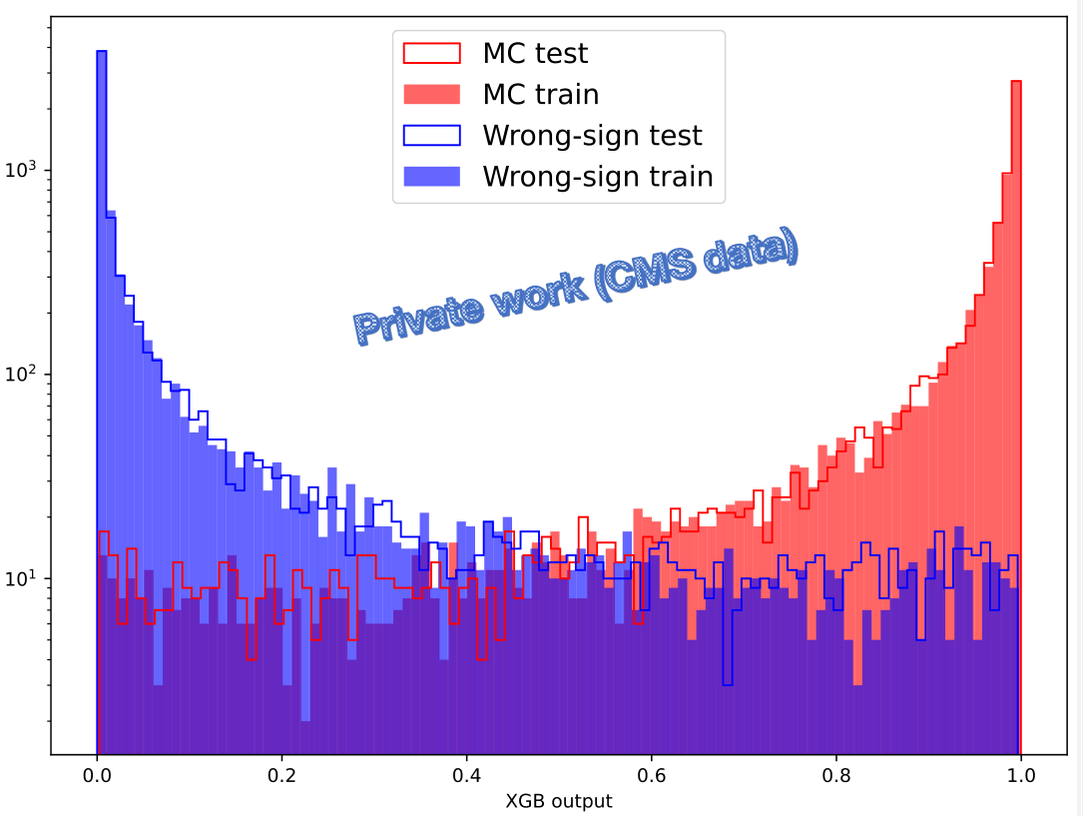

ML: Training results on Run II
The most powerful features are:
$m(π^{+}π^{−})$
$m({tr}^{+}{tr}^{−})$
2D Pointing angle ($Λ_{b}↔PV$)
Private work (CMS data)

Slide 10
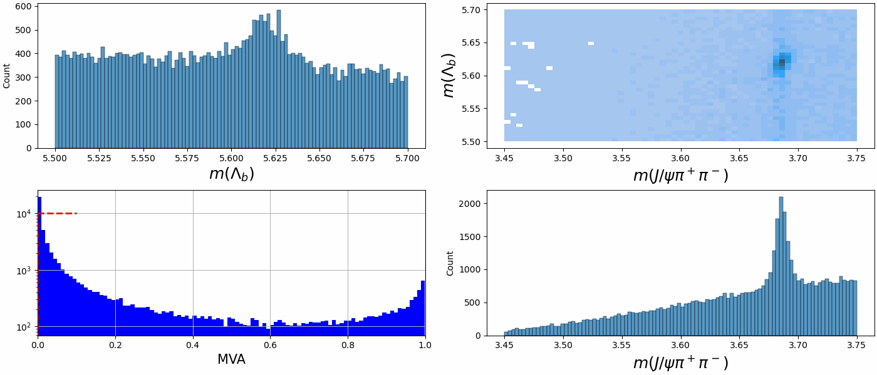
ML: Performance
Private work (CMS data)

Slide 11
ML: MVA cut optimization
MVA cut was optimized for Run II and Run III separately, by maximizing the expected significance of $Λ_{b}→X{\left(3872\right)}^{0}Λ$ decay.
Run II
Run III
Pseudo significance
Pseudo significance
Private work (CMS data)
Private work (CMS data)
MVA > x
MVA > x

Slide 12
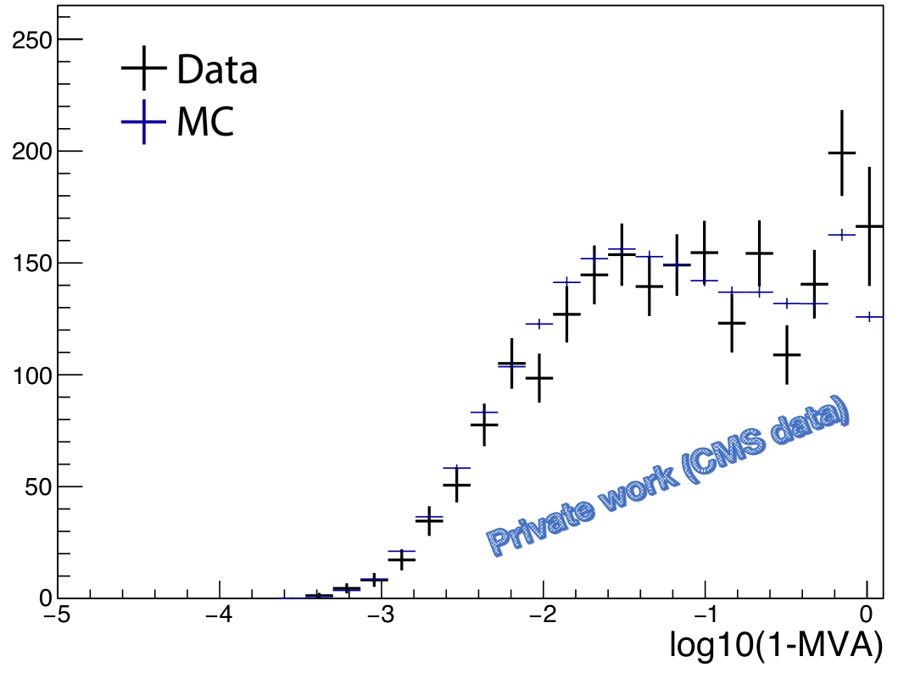
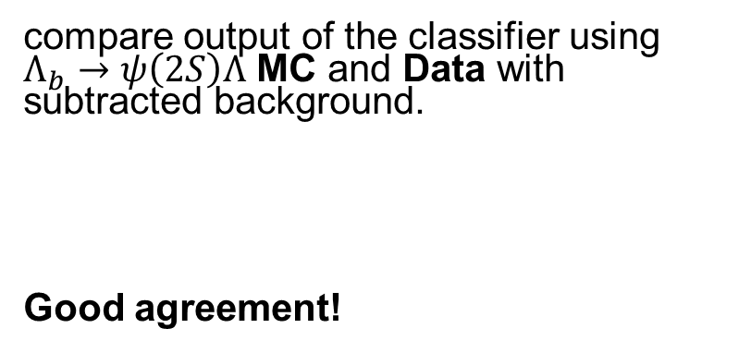
ML: Validation
compare output of the classifier using $Λ_{b}→ψ\left(2S\right)Λ$ MC and Data with subtracted background.
Good agreement!
Notes:
Both datasets correspond to pure signal, hence distributions are expected to be identical.

Slide 13
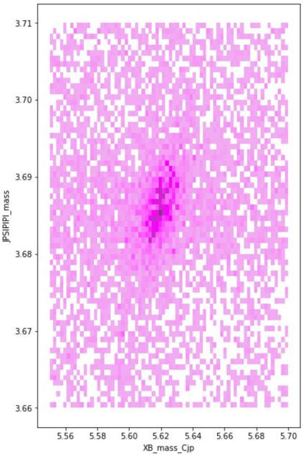
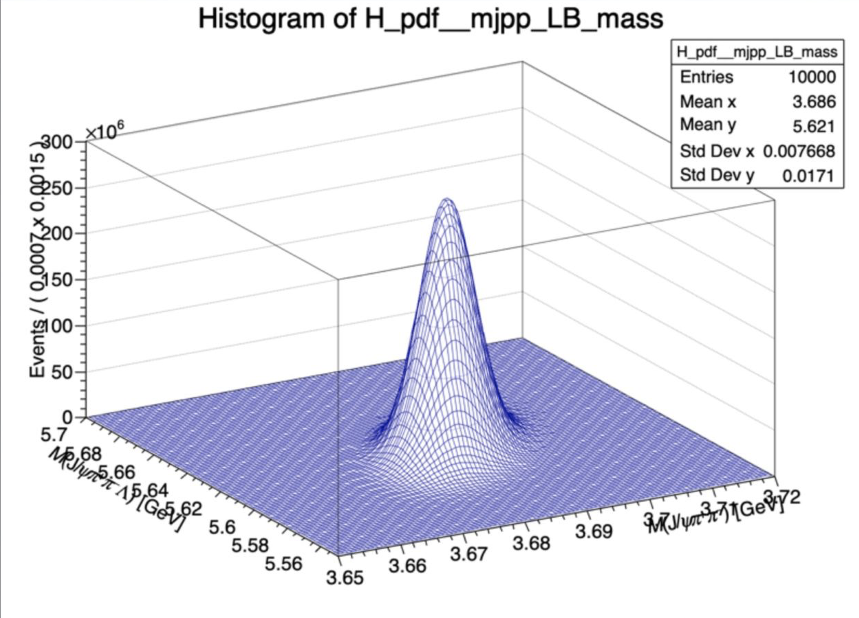


Fitting: Signal model
There is a strong correlation between signal variables.
Signal shape is described by the double 2D Student’s t-distribution with correlations and common mean.
Private work
(CMS simulation)
Notes:
_{КОРРЕЛЯЦИЯ слоэжно}
У нас сложный сигнал с корреляцией по переменным

Slide 14
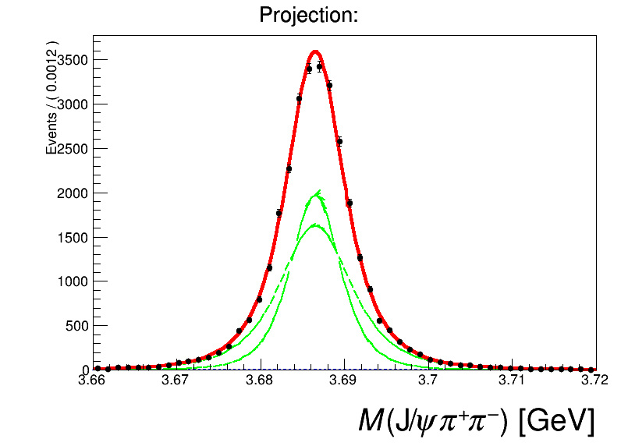
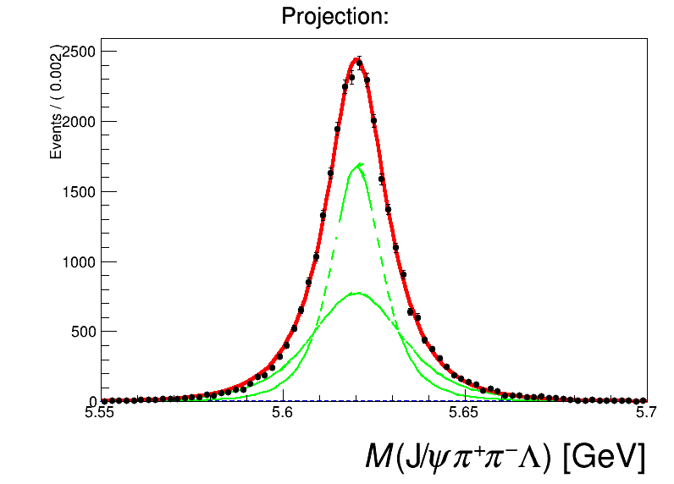
Fitting: Signal shape extraction
Only Run III data presented, Run II figures are similar
Private work
(CMS simulation)
Private work
(CMS simulation)

Slide 15
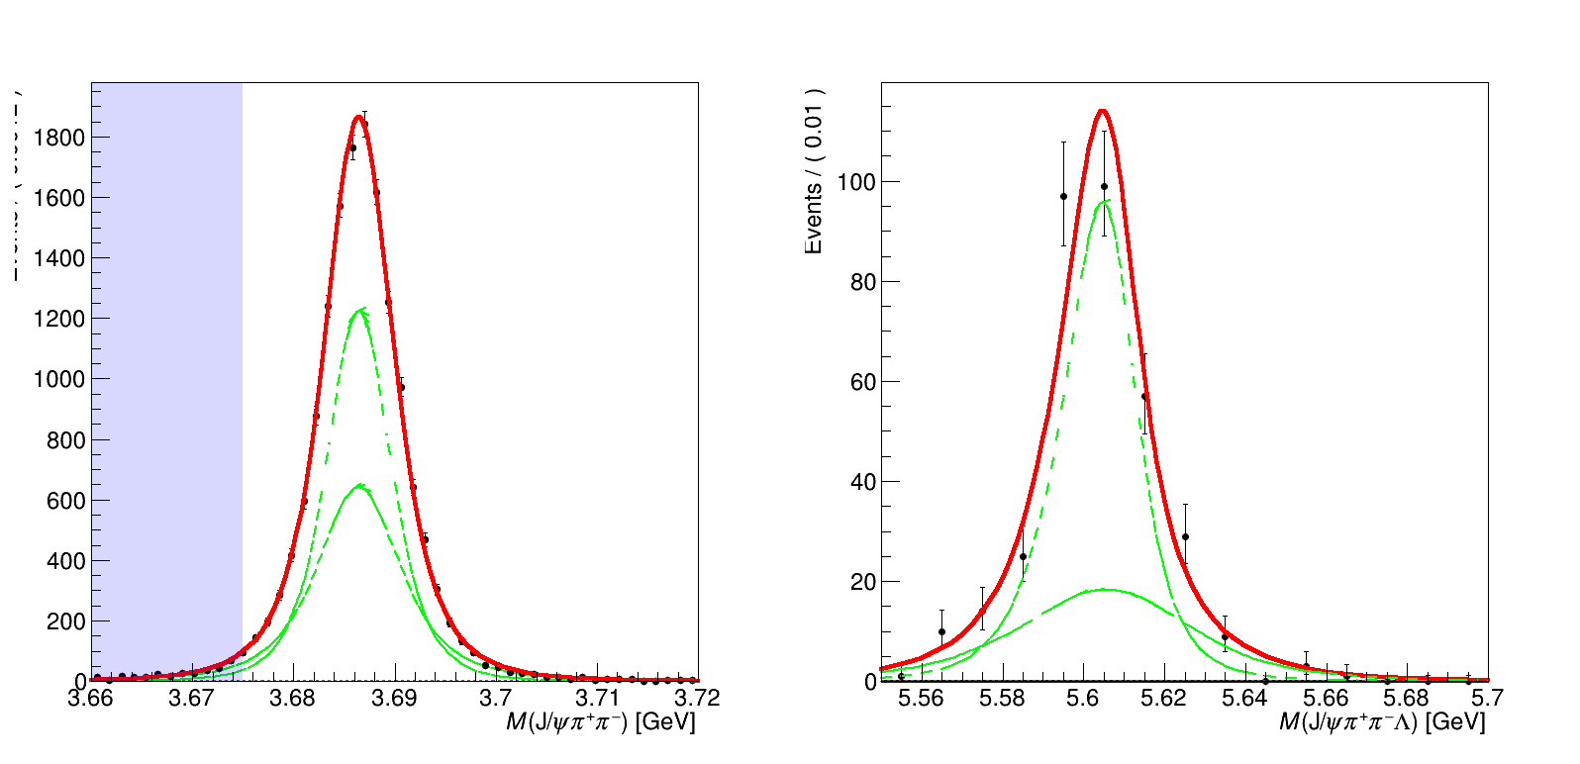
Fitting: Signal shape extraction
Private work
(CMS simulation)
Private work
(CMS simulation)

Slide 16
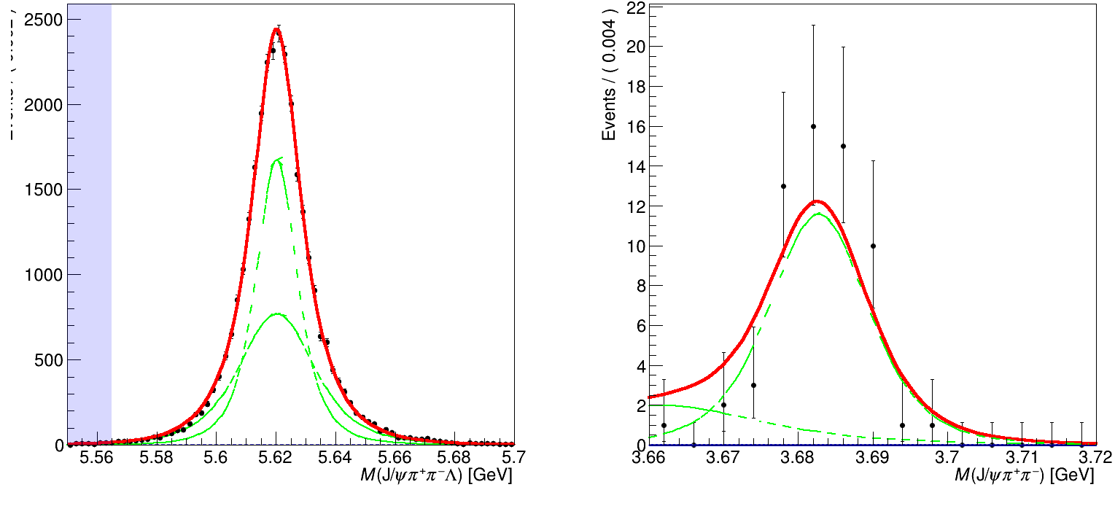
Fitting: Signal shape extraction
Private work
(CMS simulation)
Private work
(CMS simulation)

Slide 17
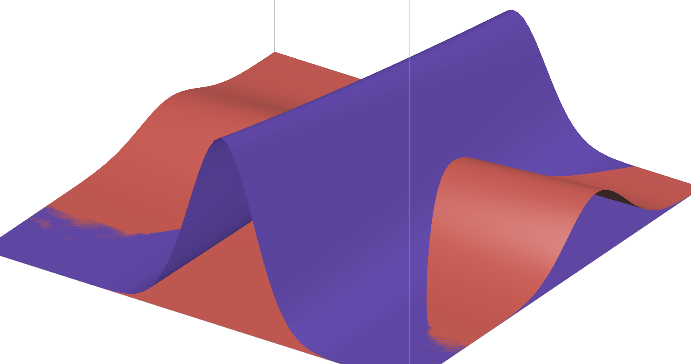

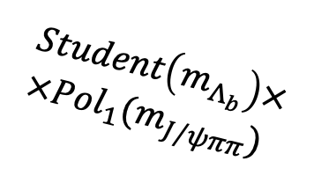
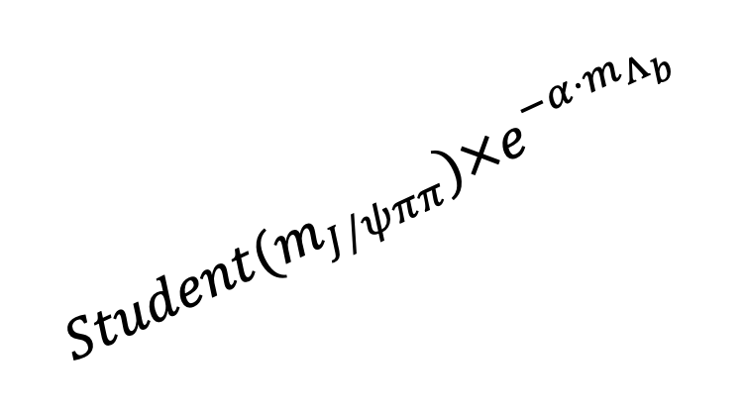

Fitting: non-resonant $Λ_{b}$ and $ψ(2S)$
Non-resonant background: $e^{−α⋅m_{Λ_{b}}}×Pol_{1}(m_{J/ψππ})$
$$Student(m_{J/ψππ})×e^{−α⋅m_{Λ_{b}}}$$
$$Student\left(m_{Λ_{b}}\right)× \\ ×Pol_{1}(m_{J/ψππ})$$
Notes:
Вместо текста показать эти компоненты
Сгенерить и показать наглядно каждуб из компонент

Slide 18
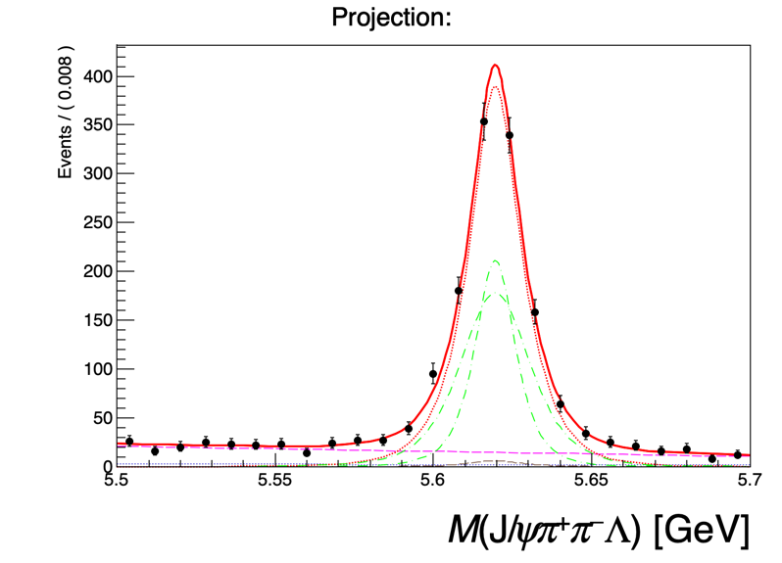
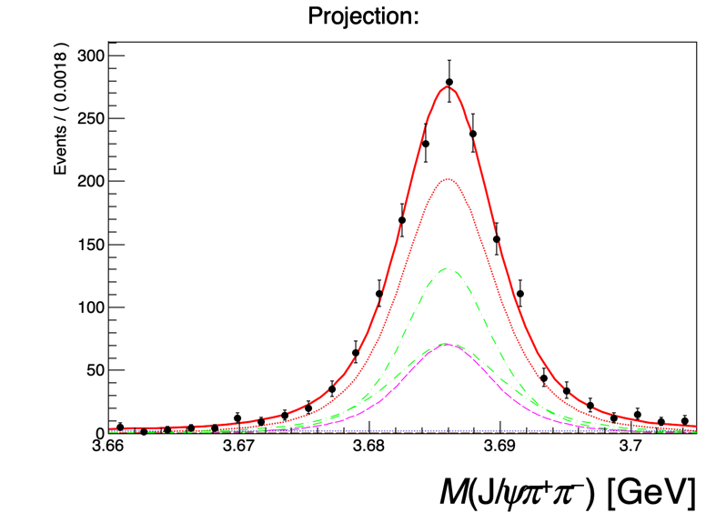



2D fit of $Λ_{b}→ψ(2S)Λ$ signal in data
Private work
(CMS data)
Private work
(CMS data)
- Non-resonant $ψ\left(2S\right)$
387 +- 27 events
- Resulting fit
- Signal components
Only Run II data presented, Run III figures are similar
- Non-resonant $Λ_{b}$
18 +- 12 events
- Signal total
1154 +- 40 events
- Background
50 +- 16 events

Slide 19
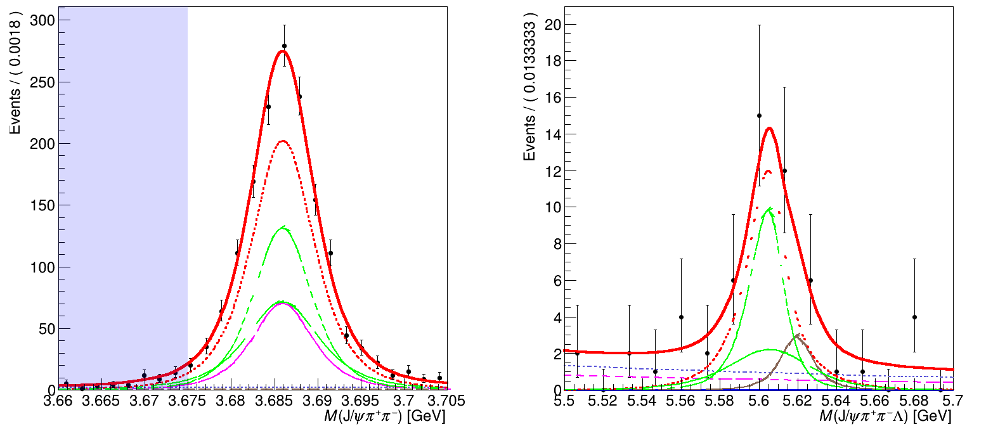


2D fit of $Λ_{b}→ψ(2S)Λ$ signal in data
Private work
(CMS data)
Private work
(CMS data)
- Non-resonant $ψ\left(2S\right)$
- Signal components
- Non-resonant $Λ_{b}$
- Comb. Background
- Signal total
- Resulting fit

Slide 20
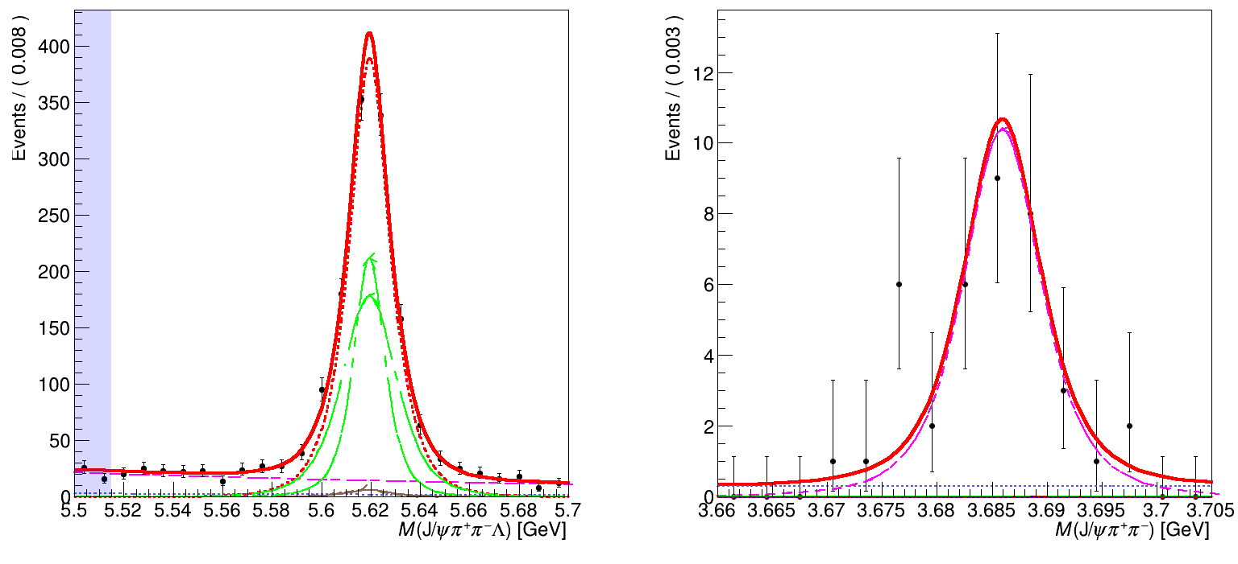
2D fit of $Λ_{b}→ψ(2S)Λ$ signal in data
Private work
(CMS data)
Private work
(CMS data)
- Non-resonant $ψ\left(2S\right)$
- Signal components
- Non-resonant $Λ_{b}$
- Comb. Background
- Signal total
- Resulting fit

Slide 21
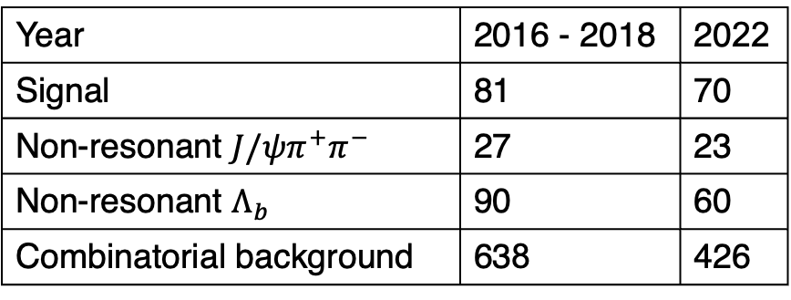

Sensitivity to X signal
To estimate sensitivity to the $Λ_{b}→X{\left(3872\right)}^{0}Λ$ decay, we generate toy MC sample using the expected distributions and yields, based on the LHCb ratio measurement (assuming same ratio for Λ), efficiencies (see backup), and sideband studies in data.
https://link.springer.com/article/10.1007/JHEP09(2019)028
Year | 2016 - 2018 | 2022
Signal | 81 | 70
Non-resonant $J/ψπ^{+}π^{−}$ | 27 | 23
Non-resonant $Λ_{b}$ | 90 | 60
Combinatorial background | 638 | 426

Slide 22
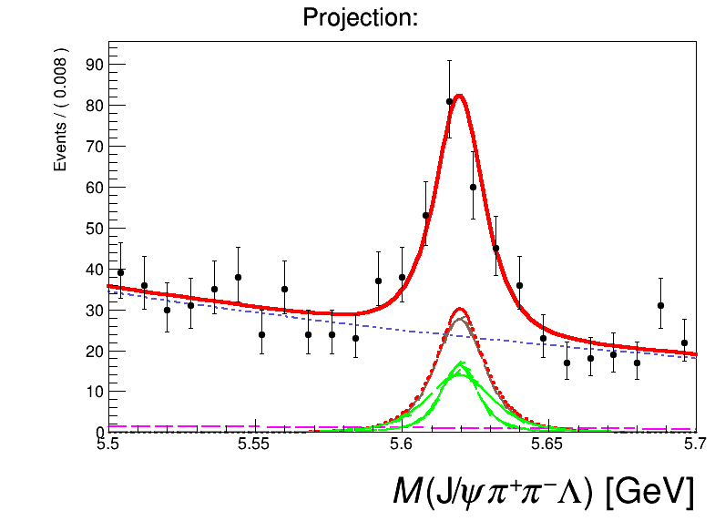
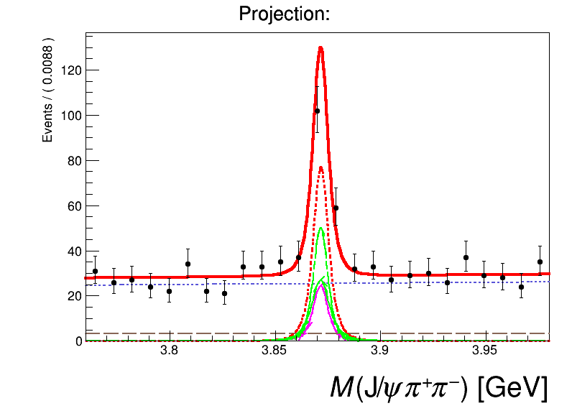
Fit toy MC
Only Run II is shown, Run III figures are similar
- Non-resonant $ψ\left(2S\right)$
- Signal components
- Non-resonant $Λ_{b}$
- Comb. Background
- Signal total
- Resulting fit

Slide 23
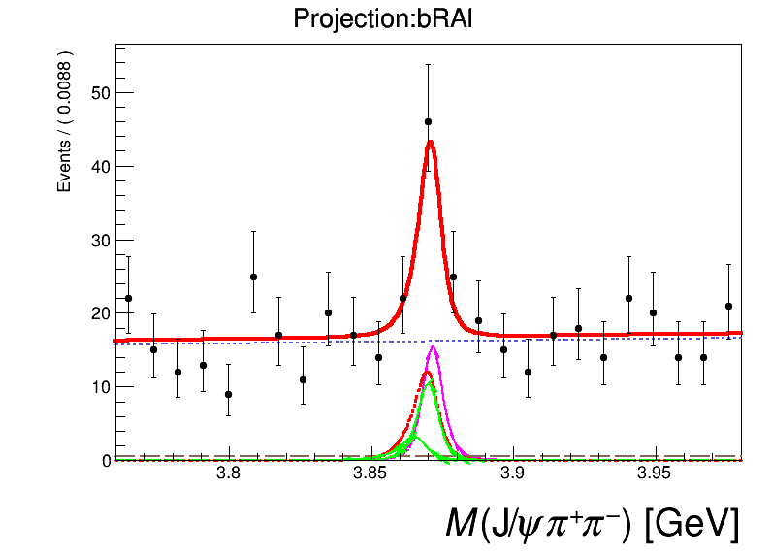
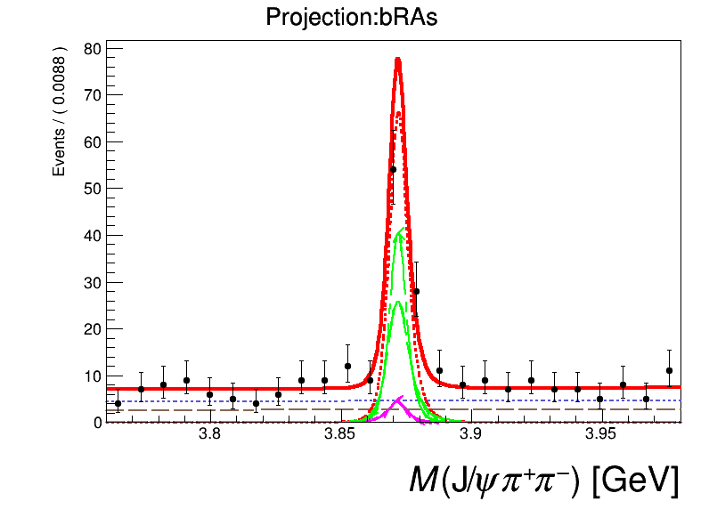
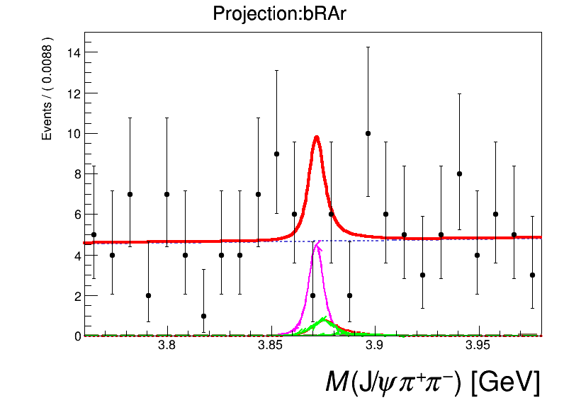
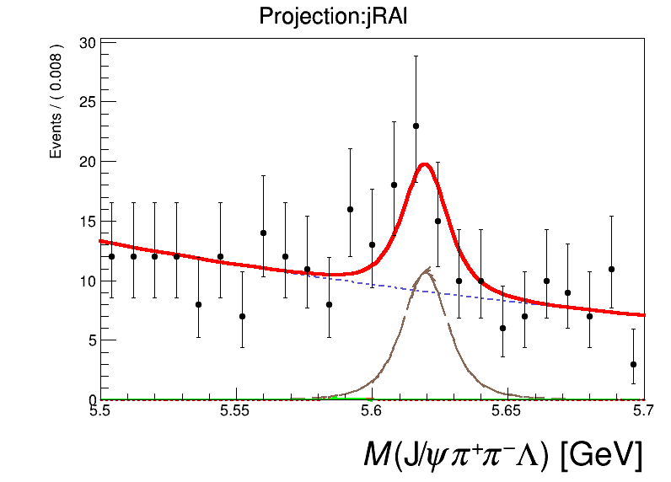
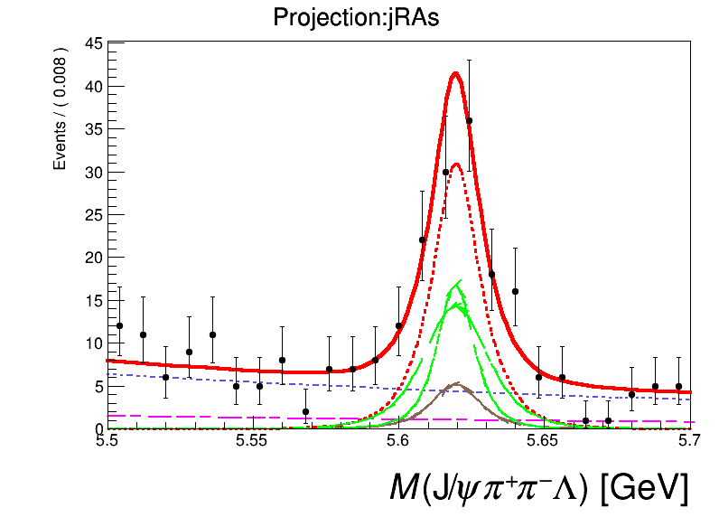
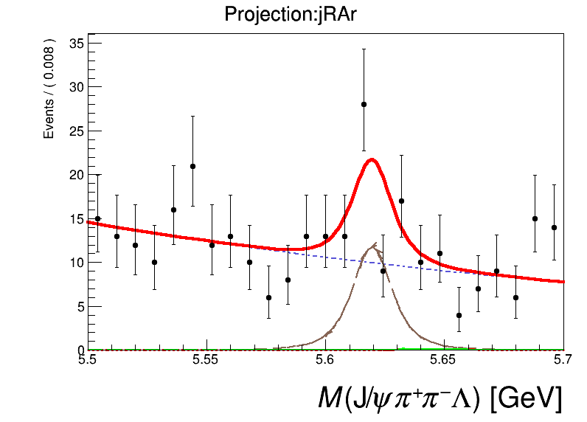






Fit toy MC
$$5.50<m\left(JψππΛ\right)<5.61$$
$$5.61<m\left(JψππΛ\right)<5.65$$
$$5.65<m\left(JψππΛ\right)<5.70$$
$$3.76<m\left(Jψππ\right)<3.85$$
$$3.85<m\left(Jψππ\right)<3.89$$
$$3.89<m\left(Jψππ\right)<3.98$$
- Non-resonant $ψ\left(2S\right)$
- Signal components
- Non-resonant $Λ_{b}$
- Comb. Background
- Signal total
- Resulting fit

Slide 24
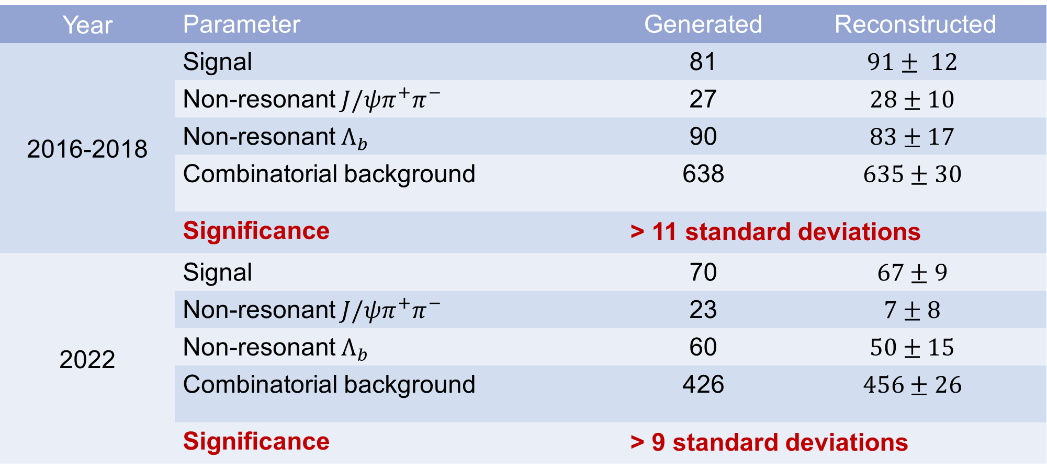
Resulting sensitivity
Year | Parameter | Generated | Reconstructed
2016-2018 | Signal | 81 | $$91± 12$$
 | Non-resonant $J/ψπ^{+}π^{−}$ | 27 | $$28±10$$
 | Non-resonant $Λ_{b}$ | 90 | $$83±17$$
 | Combinatorial background | 638 | $$635±30$$
 | Significance | > 11 standard deviations
2022 | Signal | 70 | $$67±9$$
 | Non-resonant $J/ψπ^{+}π^{−}$ | 23 | $$7±8$$
 | Non-resonant $Λ_{b}$ | 60 | $$50±15$$
 | Combinatorial background | 426 | $$456±26$$
 | Significance | > 9 standard deviations

Slide 25
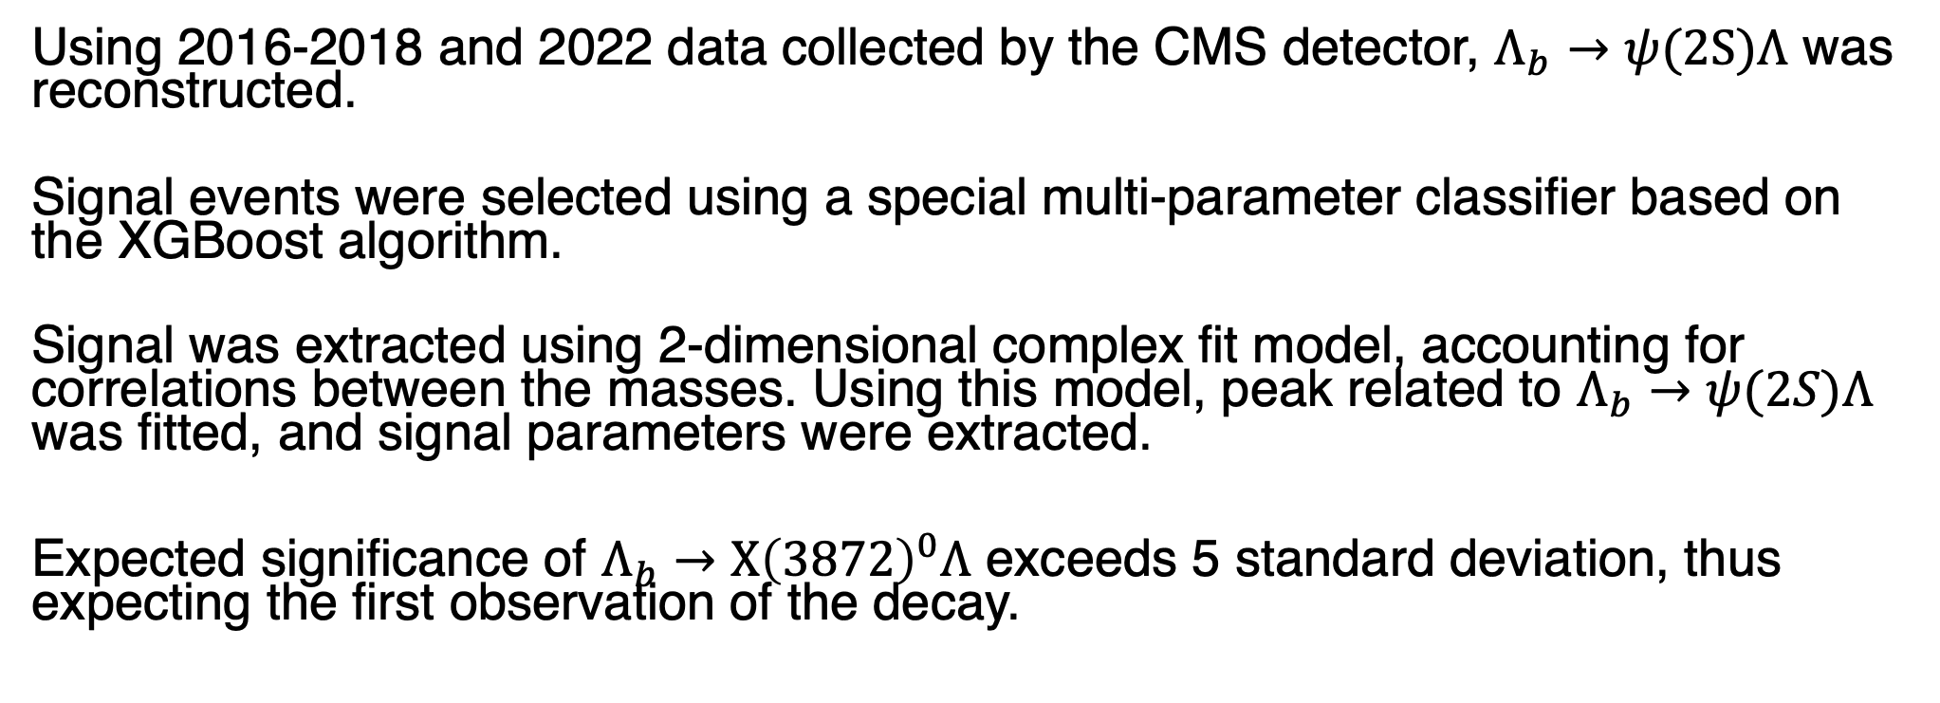
Results
Using 2016-2018 and 2022 data collected by the CMS detector, $Λ_{b}→ψ(2S)Λ$ was reconstructed.
Signal events were selected using a special multi-parameter classifier based on the XGBoost algorithm.
Signal was extracted using 2-dimensional complex fit model, accounting for correlations between the masses. Using this model, peak related to $Λ_{b}→ψ(2S)Λ$ was fitted, and signal parameters were extracted.
Expected significance of $Λ_{b}→X{\left(3872\right)}^{0}Λ$ exceeds 5 standard deviation, thus expecting the first observation of the decay.
Thank you!

Slide 26
Backup

Slide 27
The CMS detector

Slide 28
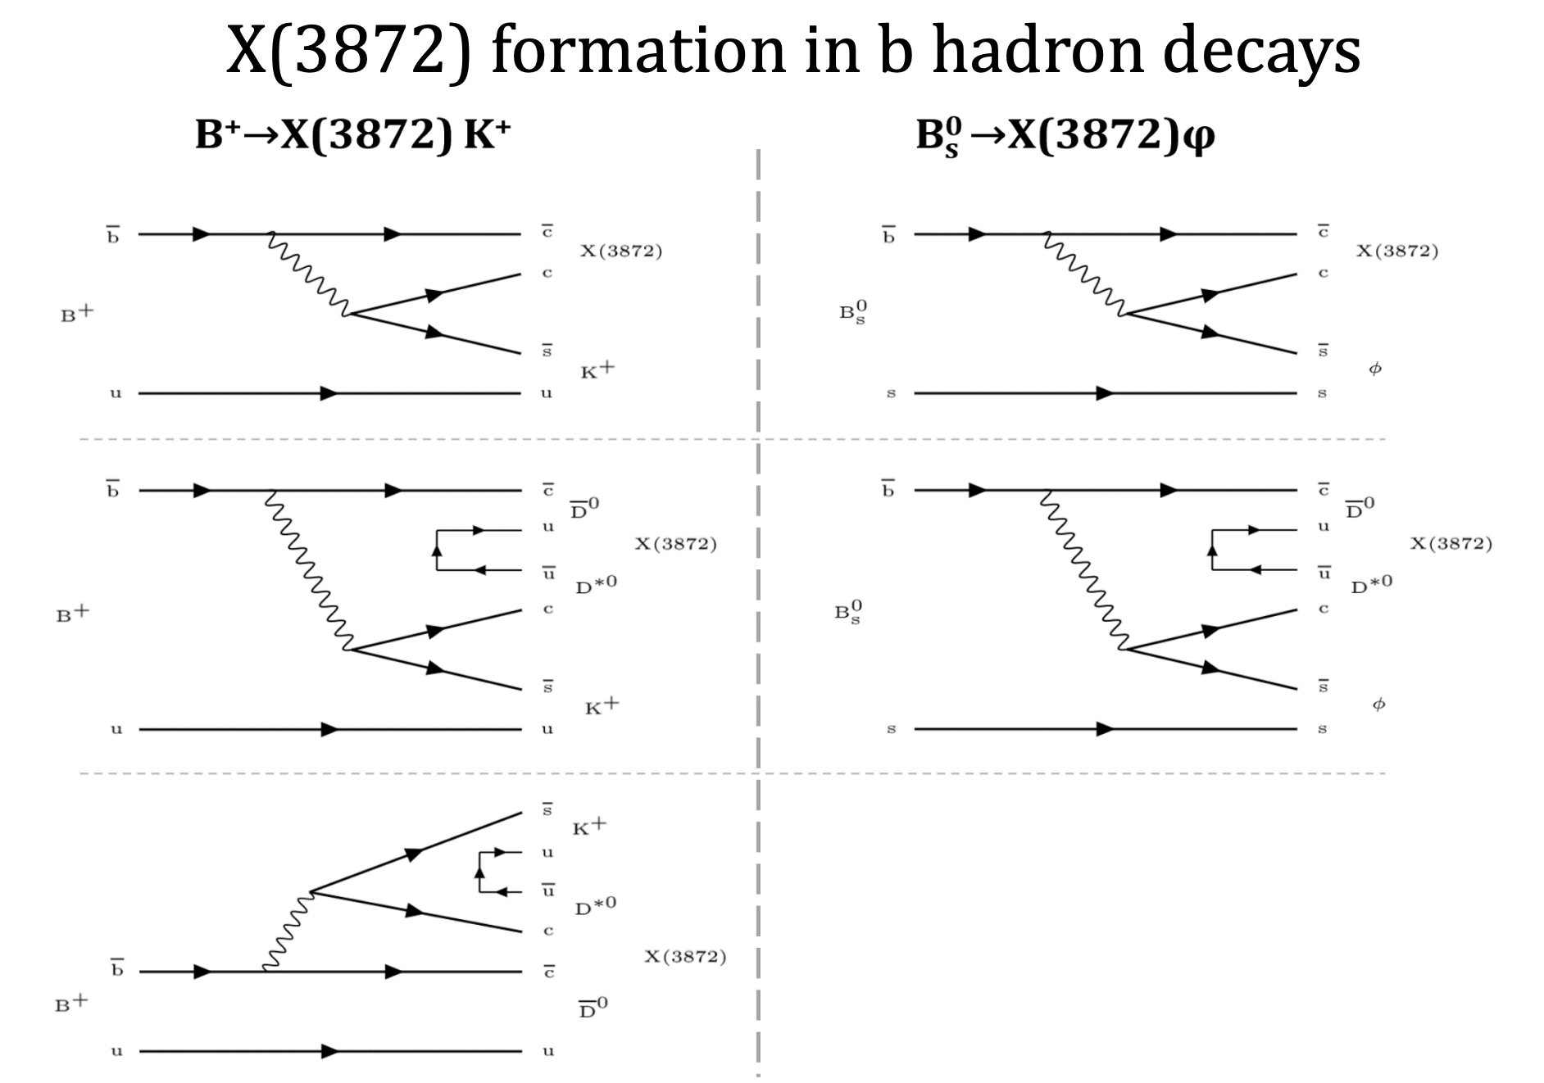

Explanation of $B→Xh$ phenomenon

Slide 29

ML: Features
Following variables were selected to be features of the classifier:
2D Pointing angle ($Λ_{b}↔PV$)
$Λ_{b}$ vertex fit probability
Flight length significance $Λ_{b}↔PV$
$m(π^{+}π^{−})$
$m({tr}^{+}{tr}^{−})$ – from $Λ$ decay, assuming pion masses
$η(Λ_{b})$
${max⁡(p}_{T}\left(π\right))$
${min⁡(p}_{T}\left(π\right))$
PV
Notes:
Слайд с мотивацией выбора переменных
Список переменных – кинематика, показать гистограммы! Расположить по мощности (для одного из годов)

Slide 30

ML algorithm: Signal
We use MC sample of $Λ_{b}→X\left(3872\right)Λ$ as a signal sample for the classifier.
Private work (CMS simulation)

Slide 31
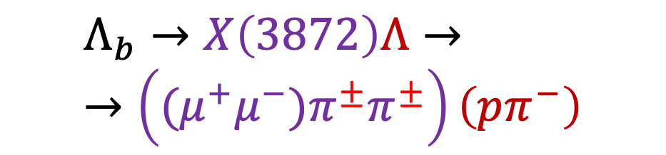
ML algorithm: Background
2 samples are used for training: pure signal (MC) and background (Wrong-signed data)
$$Λ_{b}→X\left(3872\right)Λ→→\left({(μ}^{+}μ^{−})π^{±}π^{±}\right)\left(pπ^{−}\right)$$
We use “wrong-signed” dataset as a background sample for training.
We use same reconstruction algorithm, applied on data, but both pions have same sign: positive or negative.

Slide 32
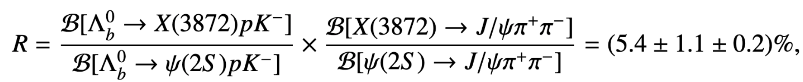

LHCb result for BFR
The first observation of the X(3872) in the $Λ_{b}^{0}$decay $Λ_{b}^{0}→X\left(3872\right)pK^{−}$, where $X\left(3872\right)→J/ψπ^{+}π^{−}$ was reported in 2019 by the LHCb collaboration. Following BFR could be obtained:

Slide 33



ML algorithm: Why do we need to use ML?
Most of variables have non-rectangular distribution in feature-space. Hence, cut-based approach is too rough.
X(3872) is too far from the threshold
We expect relatively low branching of $Λ_{b}→X\left(3872\right)Λ$
We need a powerful tool for background suppression.
Private work
(CMS data)
Private work
(CMS data)
Private work
(CMS data)
Private work
(CMS data)
Far from the threshold
Slide #32

Slide 34


ML algorithm: Background
No peaks are observed
No peak is seen
Private work
(CMS data)
Private work
(CMS data)
Private work
(CMS data)
Pions from $Λ_{b}$ vertex
Tracks from $Λ$ vertex (assuming pion masses)
Private work
(CMS data)
Private work
(CMS data)
K_{S} peak

Slide 35
Training: Run III
Private work (CMS data and simulation)
Slide #34

Slide 36
Feature importancies for Run-II data
Private work
(CMS data)

Slide 37

Fitting: Signal model in details
Signal shape is described by the double 2D Student’s t-distribution with correlations and common mean.
Parameters:
n₁, n₂: fixed to the MC
width₁, width₂: obtained from Psi MC and scaled by the factor f, coming from the Psi data:
$$width_{1,2}=width_{1,2}^{MC}⋅\frac{shape_{Psi}}{shape_{Psi}^{MC}}$$
mean: common mean for all signal-like components
corr₁, corr₂: fixed to ones obtained from Psi MC
Private work
(CMS data)

Slide 38

ML Algorithm: hyperparameters
We use XGBoost with “logloss” loss function as a classification algorithm with parameters given below. Hyperparameters were chosen following general recommendations written on the XGBoost website.
N_{train}/N_{test} = 4/1
N_{sig}= N_{bkg} both in train and test samples
Hyperparameter | Value
colsample_bytree | 0.5
max_depth | 3
min_child_weight | 15
reg_lambda | 5.0
subsample | 0.5
eval_metric | logloss
objective | binary:logistic
https://xgboost.readthedocs.io/en/stable/index.html

Slide 39
ML strategy: PiPi scaling of Psi-data
Baseline version of the classifier is trained on the X sample, so we scale dipion mass of the Psi Dataset to the range of dipion mass in X dataset to make predictions possible for Psi data samples.
Private work
(CMS simulation)

Slide 40

Efficiencies
So far, we have only taken into account efficiencies of reconstruction and selection.
Decay | Year | $$N_{MC}$$ | $$N_{reco}^{∗}$$ | $$ε_{reco}× {10}^{−3}$$
$$Λ_{b}→ψ(2S)Λ$$ | 2016-2018 | 17,613,638 | 21,977 | 1.248
 | 2022 | 10,298,969 | 37,250 | 3.617
$$Λ_{b}→X{\left(3872\right)}^{0}Λ$$ | 2016-2018 | 18,589,866 | 29,997 | 1.614
 | 2022 | 10,439,752 | 51,394 | 4.925
Private work
(CMS simulation)

Slide 41


Fitting Psi dataset: Run III
Private work
(CMS simulation)
Private work
(CMS simulation)
- Non-resonant psi
- Signal components
- Signal total
- Resulting fit
- Non-resonant LB
- Background

Slide 42
















Fitting Psi dataset: Run III
$$5.550<m\left(JψππΛ\right)<5.600$$
$$5.600<m\left(JψππΛ\right)<5.620$$
$$5.620<m\left(JψππΛ\right)<5.645$$
$$5.645<m\left(JψππΛ\right)<5.700$$
Private work
(CMS data)
Private work
(CMS data)
Private work
(CMS data)
Private work
(CMS data)
$$3.660<m\left(Jψππ\right)<3.680$$
$$3.680<m\left(Jψππ\right)<3.686$$
$$3.686<m\left(Jψππ\right)<3.695$$
$$3.695<m\left(Jψππ\right)<3.720$$
Private work
(CMS data)
Private work
(CMS data)
Private work
(CMS data)
Private work
(CMS data)
- Non-resonant psi
- Signal components
- Signal total
- Resulting fit
- Non-resonant LB
- Background

Slide 43








2D fit of $Λ_{b}→ψ(2S)Λ$ signal in data
$$5.550<m\left(JψππΛ\right)<5.600$$
$$5.600<m\left(JψππΛ\right)<5.620$$
$$5.620<m\left(JψππΛ\right)<5.645$$
$$5.645<m\left(JψππΛ\right)<5.700$$
Private work
(CMS data)
Private work
(CMS data)
Private work
(CMS data)
Private work
(CMS data)
$$3.660<m\left(Jψππ\right)<3.680$$
$$3.680<m\left(Jψππ\right)<3.686$$
$$3.686<m\left(Jψππ\right)<3.695$$
$$3.695<m\left(Jψππ\right)<3.720$$
Private work
(CMS data)
Private work
(CMS data)
Private work
(CMS data)
Private work
(CMS data)
- Non-resonant psi
- Signal components
- Signal total
- Resulting fit
- Non-resonant LB
- Background

Slide 44








Fitting: Signal shape extraction
$$3.680<m\left(Jψππ\right)<3.686$$
$$3.686<m\left(Jψππ\right)<3.695$$
Only Run III data presented, Run II figures look similar
Private work
(CMS simulation)
Private work
(CMS simulation)
$$3.660<m\left(Jψππ\right)<3.680$$
$$3.695<m\left(Jψππ\right)<3.720$$
Private work
(CMS simulation)
Private work
(CMS simulation)
Private work
(CMS simulation)
Slide #43

Slide 45








Fitting: Signal shape extraction
$$5.600<m\left(JψππΛ\right)<5.620$$
$$5.620<m\left(JψππΛ\right)<5.645$$
Only Run III data presented, Run II figures look similar
Private work
(CMS simulation)
Private work
(CMS simulation)
$$5.550<m\left(JψππΛ\right)<5.600$$
$$5.645<m\left(JψππΛ\right)<5.700$$
Private work
(CMS simulation)
Private work
(CMS simulation)
Private work
(CMS simulation)
Slide #44

